Slide 1
Sept. 21, 2018 Advisory
Collect ½ sheet paper at door / blue basket
Sharpen Pencil
Sit in assigned seat
Watch video clip
Be ready to discuss one thing that stood out to you from the video. One positive thing you learned from this video

Slide 3
Sept. 21, 2018
Collect 1 card sort (flash card race) per table from Green Basket
Sharpen pencil
Sit in assigned seat
Play Flash Card Race with table partner
(keep the volume to a whisper)

Slide 4
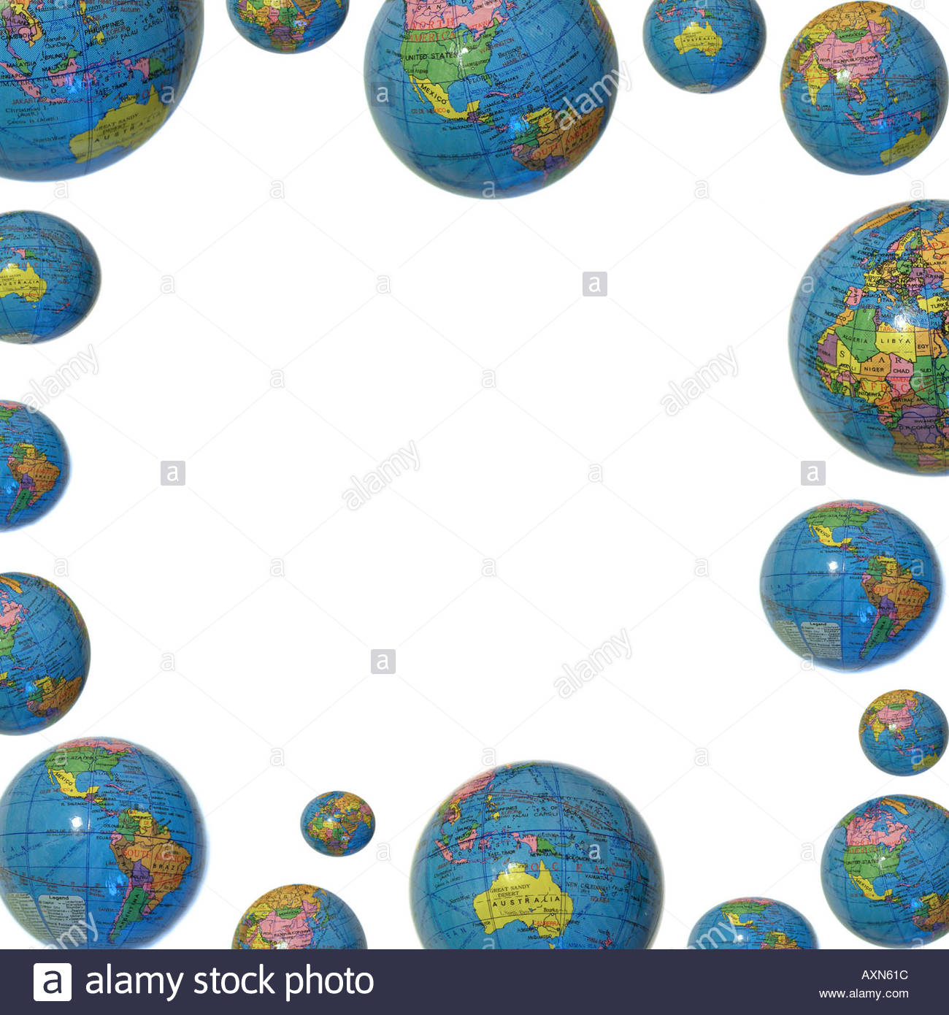
TEK 6.5 B
(B) recognize that a limited number of the many known elements comprise the largest portion of solid Earth, living matter, oceans, and the atmosphere

Slide 5
LO:
Students will compare/contrast the different types of elements found the Earth’s 4 spheres by completing a foldable / diagram.

Slide 6
DOL:
Students will complete 5/5 questions to compare/contrast the different types of elements found within the Earth’s spheres with 80% accuracy.

Slide 7
Procedure
1. Teacher will hand out model/ explain how complete the pie charts.
2. Students will work in small groups to complete the % of elements found in each Sphere.
3. Regulars: will follow along with teacher led presentation to complete spheres
Honors: Will use web links provided, textbooks and video links to complete foldable in a small group.

Slide 8
Video Clip Links
Crash Course Earth Spheres Part 1
https://www.youtube.com/watch?v=VMxjzWHbyFM
Crash Course Earth Spheres Part 2
https://www.youtube.com/watch?v=UXh_7wbnS3A
Moo Moo Earth Spheres
https://www.youtube.com/watch?v=m4TnPv_b6WU

Slide 9
Web Links…
Earth Spheres Poster Virtual Link
https://www.youtube.com/watch?v=W4ixGKA076o
Earth Spheres Virtual Lab
http://www.classzone.com/books/earth_science/terc/content/visualizations/es0102/es0102page01.cfm
http://www.classzone.com/books/earth_science/terc/content/investigations/es0103/es0103page01.cfm
Numerous Power points on Earth Spheres
https://science.pppst.com/spheres.html

Slide 10
Additional Research Links:
https://www.classzone.com/books/earth_science/terc/content/investigations/es0103/es0103page08.cfm?chapter_no=investigation
http://www.cotf.edu/ete/ess/ESSspheres.html
http://www.kidsgeo.com/geography-for-kids/0024-b-earth-spheres-atmoshpere-lithosphere-hydrosphere.php
http://www.geogrify.net/GEO1/Lectures/IntroPlanetEarth/FourSpheres.html

Slide 14
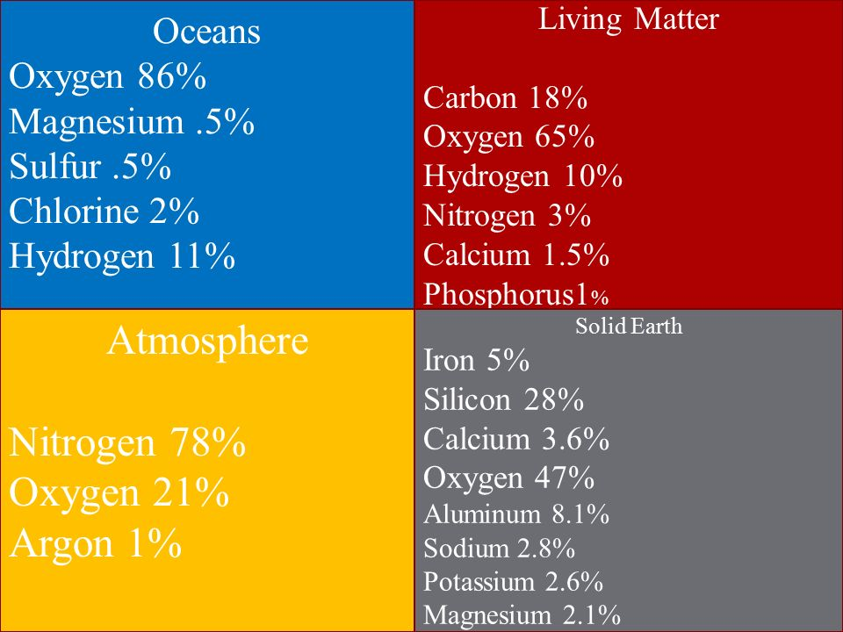

Slide 15
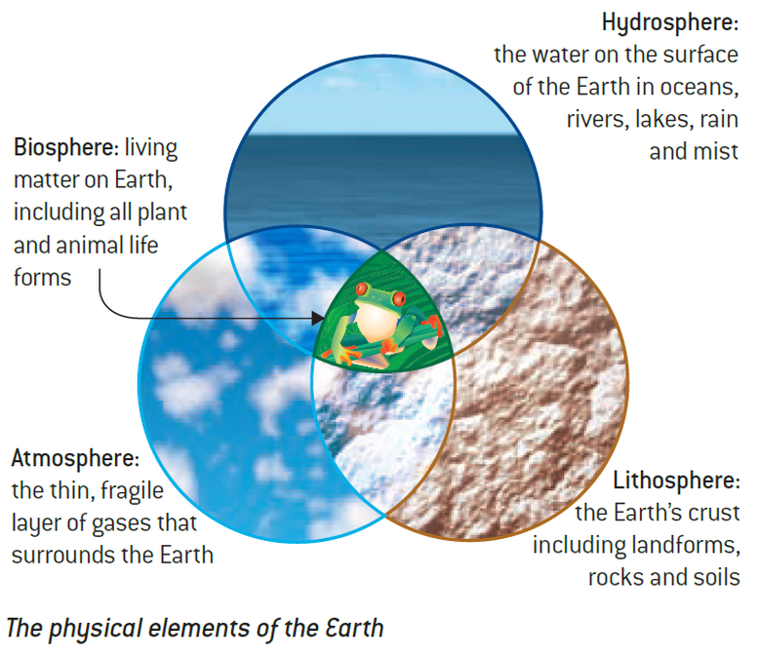

Slide 16
Elements in Earth’s Spheres Color Key
O: Oxygen = Blue Other Elements = Purple
N: Nitrogen = Green Si: Silicon = Orange
H: Hydrogen = Red Fe: Iron = Brown
C: Carbon = Black Ca: Calcium = Yellow
Al: Aluminum = Pink

Slide 17
1%
3%
4%
10%
21%
18%
65%
78%
% of elements
Earth’s
Spheres
3%
spheres
3.6%
8.4%
11%
5%
8%
47%
86%
28%
% of elements
% of elements

Slide 18
Items found in the...
Elements %
Items found in the...
Elements %
spheres
Elements %
Elements %
Items found in the...
Items found in the...

Slide 19
Earth’s Biosphere Hints
Oxygen, nitrogen, hydrogen, and carbon are the most abundant elements in Earth’s biosphere
This element is the most abundant in the biosphere and people and animals must inhale it to survive
The element that makes up the second largest portion of the biosphere has the chemical symbol C
The element that makes up 10% of the biosphere is hydrogen
The element that makes up 3% of the biosphere has the chemical symbol N
3%
4%
10%
18%
65%
Element | %

Slide 20
Lithosphere Elements Hint...
E;e
Element
0%
Oxygen, aluminum, calcium, iron, and silicon are the most abundant Earth’s lithosphere
The most abundant element in the lithosphere is also most abundant in the biosphere
The element that makes up the second largest portion of the lithosphere has the chemical symbol Si
The element that makes up 8% of the lithosphere is aluminum
Iron makes up 5% of the lithosphere
The element with the chemical symbol Ca makes up 3.6% of the lithosphere
3.6%
8.4%
5%
8%
47%
28%
% of elements

Slide 21
Atmosphere Element Hints...
1%
21%
Oxygen and Nitrogen are the most abundant elements in Earth’s atmosphere
The element with the chemical symbol N is the most abundant element in Earth’s atmosphere
The most abundant element in the biosphere, and the hydrosphere, is the second most abundant element in atmosphere
78%
Element | %

Slide 22
Hydrosphere Element Hints...
Element | %
Oxygen and hydrogen are the most abundant elements in the Earth’s hydrosphere
The most abundant element in the lithosphere and biosphere is also the most abundant element in Earth’s hydrosphere.
The second most abundant element in Earth’s hydrosphere has the chemical symbol H
3%
11%
86%
% of elements

Slide 23
DOL Exit Slip
Explain 3 ways the biosphere and lithosphere interact. Explain what type of elements they have in common.
(Complete sentences!)

