Slide 1
Sept. 19, 2018 Advisory

Slide 2
Sept. 19, 2018
Collect PDN from Green Basket or Coach Pease at the door
Sharpen pencil
Sit in assigned seat
Complete PDN on own

Slide 3
PDN: Earth’s 4 Spheres
Name : _________________________________________________ Pease Per: _____ Date: _____ / ______ / ________
Directions: Collect Textbook / open to page 87 / use pgs. 87-89 to complete questions / statements below.
1-4. What are the four most common elements in the universe?
1. __________________________________ 2. ___________________________________
3. __________________________________ 4. ___________________________________
5. What is the most common element found in the Earth’s crust (lithosphere)? ______________________________________________________
6-7. What two elements make up most of the Earth’s crust? 6.__________________ 7. _________________
8-9. What are the two most common elements found in the atmosphere?8.___________________________
9._____________________
10-11. What are the other types of spheres found in our Earth called? 10. _____________________ 11. _________________

Slide 4
PDN: Earth’s 4 Spheres
Name : _________________________________________________ Pease Per: _____ Date: _____ / ______ / ________
Directions: Collect Textbook / open to page 87 / use pgs. 87-89 to complete questions / statements below.
1-4. What are the four most common elements in the universe?
1. __________________________________ 2. ___________________________________
3. __________________________________ 4. ___________________________________
5. What is the most common element found in the Earth’s crust (lithosphere)? ______________________________________________________
6-7. What two elements make up most of the Earth’s crust? 6.__________________ 7. _________________
8-9. What are the two most common elements found in the atmosphere?8.___________________________
9._____________________
10-11. What are the other types of spheres found in our Earth called? 10. _____________________ 11. _________________

Slide 5
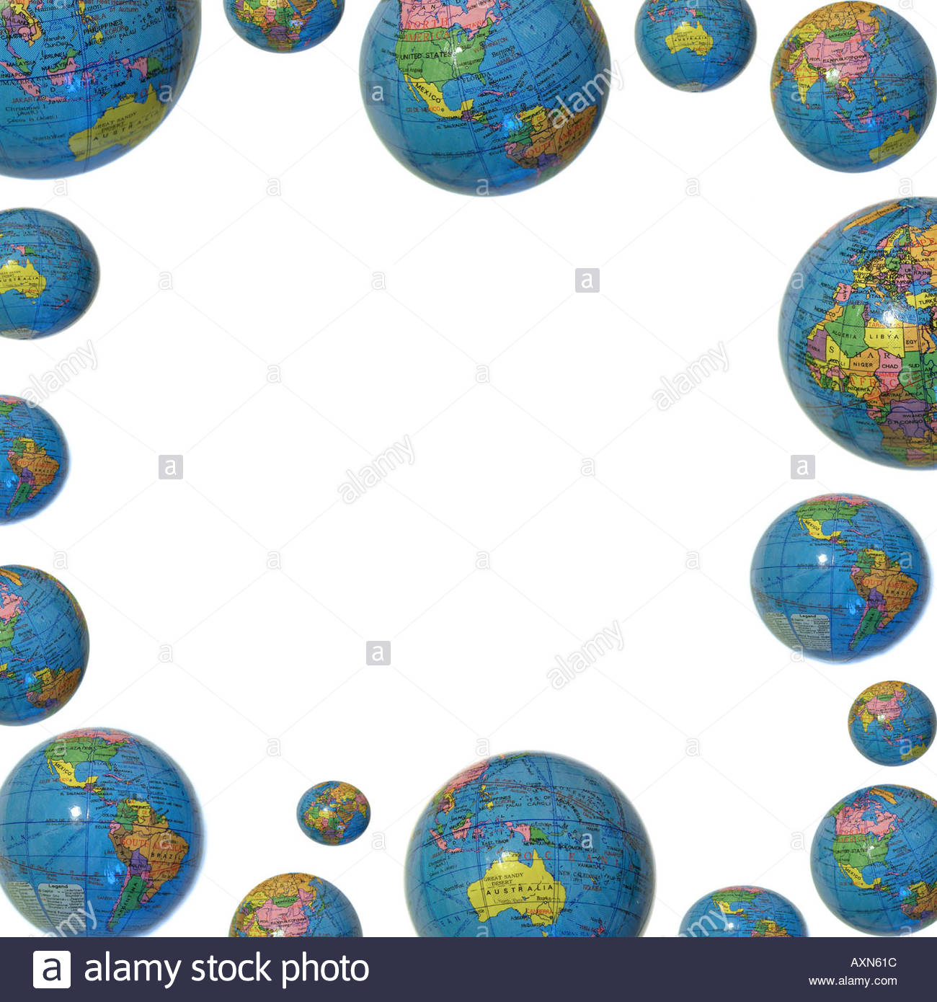
TEK 6.5 B
(B) recognize that a limited number of the many known elements comprise the largest portion of solid Earth, living matter, oceans, and the atmosphere

Slide 6
LO:
Students will compare/contrast the different types of elements found the Earth’s 4 spheres by completing a foldable.

Slide 7
DOL:
Students will complete 5/5 questions to compare/contrast the different types of elements found within the Earth’s spheres with 80% accuracy.

Slide 8
Procedure
1. Teacher will hand out model/ explain how to put the foldable together.
2. Students will follow along in completing the correct way to fold foldable. Students will write name/teacher/period/date at bottom of foldable on the back side.
3. Regulars: will follow along with teacher led presentation to complete foldable
Honors: Will use weblink provided, textbooks and video links to complete foldable with table partner.

Slide 9
Video Clip Links
Crash Course Earth Spheres Part 1
https://www.youtube.com/watch?v=VMxjzWHbyFM
Crash Course Earth Spheres Part 2
https://www.youtube.com/watch?v=UXh_7wbnS3A
Moo Moo Earth Spheres
https://www.youtube.com/watch?v=m4TnPv_b6WU

Slide 10
Web Links…
Earth Spheres Poster Virtual Link
https://www.youtube.com/watch?v=W4ixGKA076o
Earth Spheres Virtual Lab
http://www.classzone.com/books/earth_science/terc/content/visualizations/es0102/es0102page01.cfm
http://www.classzone.com/books/earth_science/terc/content/investigations/es0103/es0103page01.cfm
Numerous Power points on Earth Spheres
https://science.pppst.com/spheres.html

Slide 11
Additional Research Links:
https://www.classzone.com/books/earth_science/terc/content/investigations/es0103/es0103page08.cfm?chapter_no=investigation
http://www.cotf.edu/ete/ess/ESSspheres.html
http://www.kidsgeo.com/geography-for-kids/0024-b-earth-spheres-atmoshpere-lithosphere-hydrosphere.php
http://www.geogrify.net/GEO1/Lectures/IntroPlanetEarth/FourSpheres.html

Slide 12
Students will create a poster to compare/contrast the 4 different spheres’. Example of poster below
Litho-
Atmo-
%
%
spheres
Hydro-
Bio-
%
%

Slide 13
% of elements
Earth’s
Spheres
spheres
% of elements
% of elements

Slide 14
