Slide 1
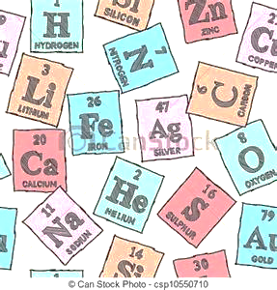
Please Do Now / Nov. 20, 2015
Sharpen Pencil
Collect Please Do Now from front table,
chrome
3. Take out journals, write in homework
-Study for 3rd 6 Weeks 3 Week Test
on next Tuesday
4. Do the PLEASE DO NOW for Friday

Slide 2
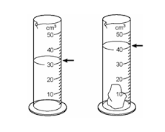
What is the volume of the rock? Explain how you found the volume of an irregular shaped object. (show your work)
Volume of water before you put rock in it is ____________
Volume of water after you put rock in it is ______________
To find the volume of the rock you will…
Volume with rock _______
- Volume without the rock ________
Volume of rock ________
What is it called when you the volume of an irregular shaped object using the method show in the picture?
The _________________________ method.

Slide 3
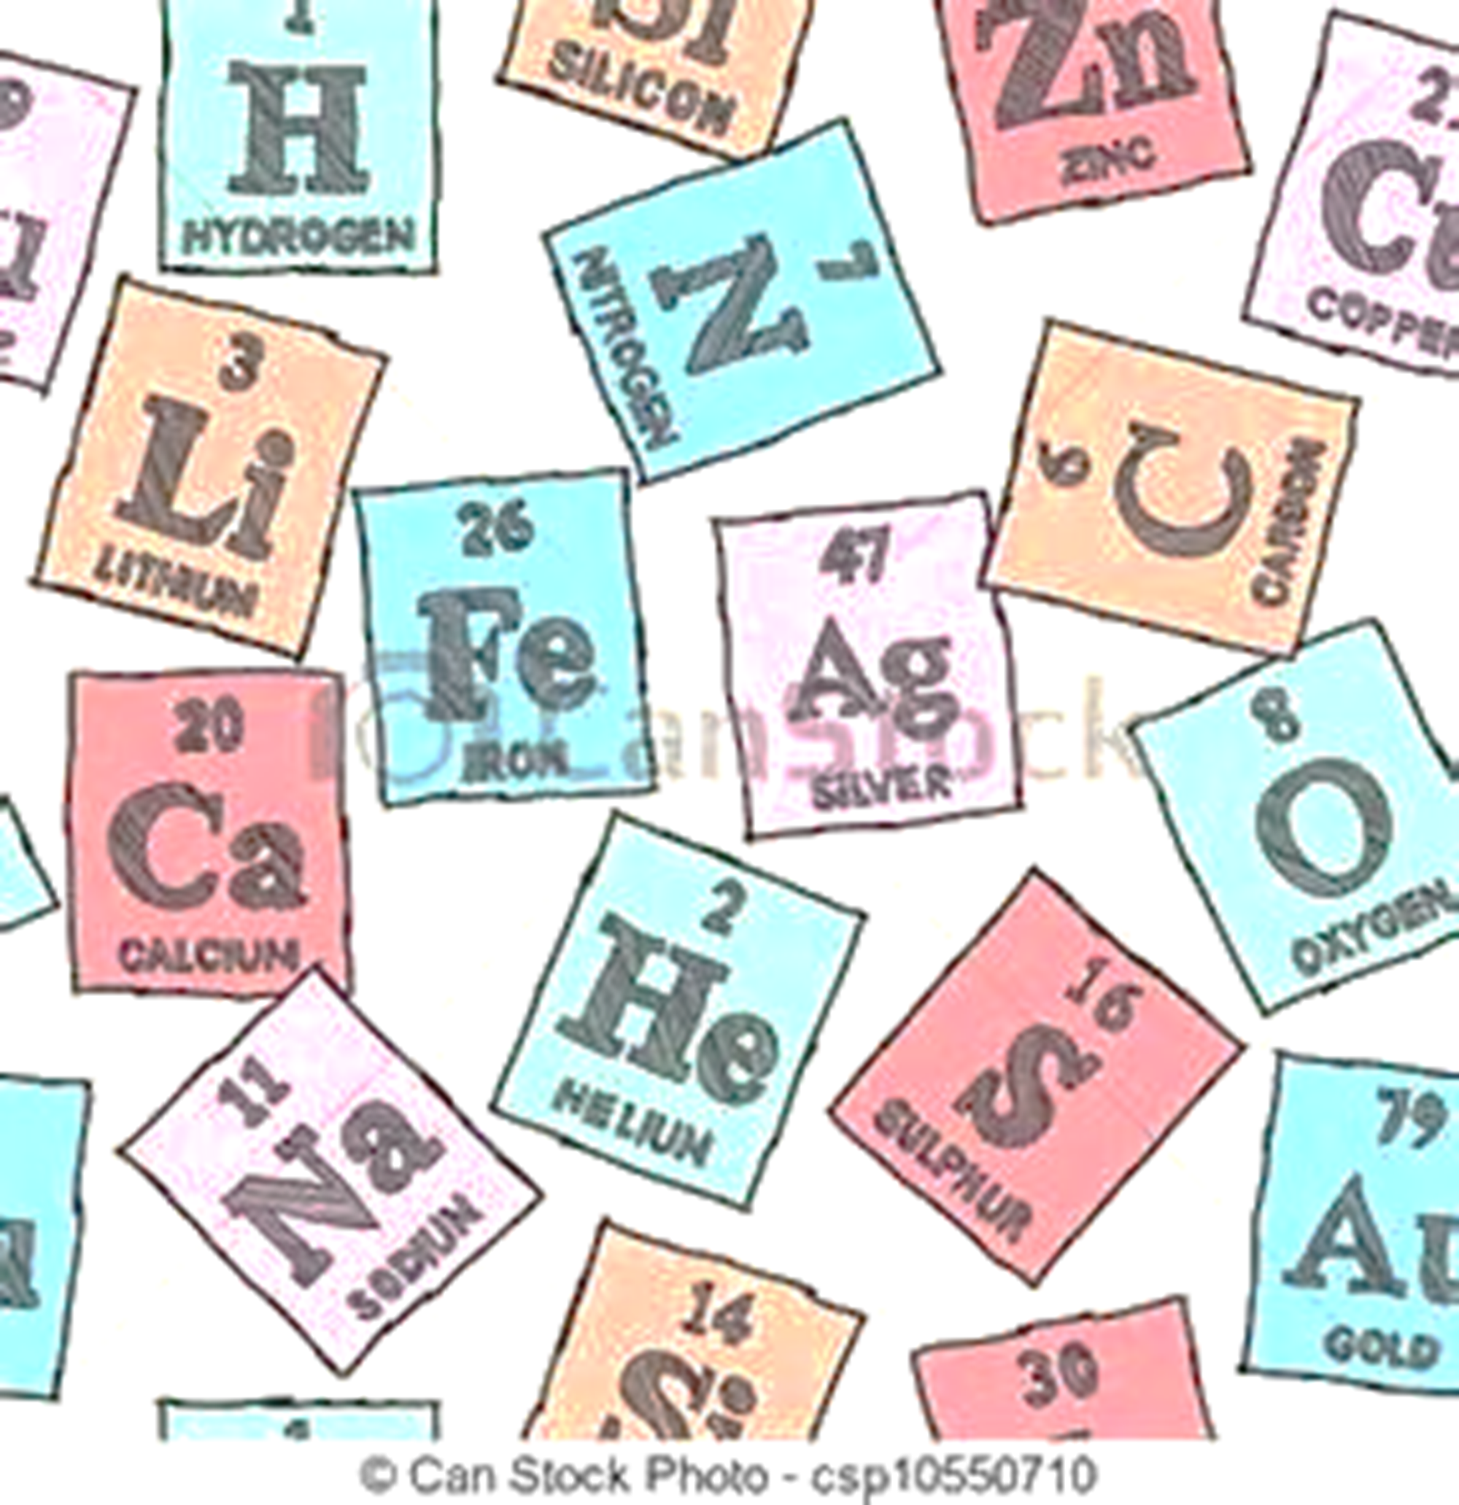
What is the difference between an element and a compound? Explain.
1. Answer the above question on the next empty page in your journal.
2. When Teacher says go, share ideas with others at your table.
3. Re-Group and share small group ideas with class.

Slide 4
Use the information you know and the new information you learned about elements and compounds to complete station items. (stations are in white baskets on counter by doors)
1. Please Do Now
2. Inter-active activities via website
3. Make an Element vs’ Compound comic strip

Slide 5
Station 2: use link below http://www.curriculumbits.com/prodimages/details/chemistry/che0001.html
As you complete the activity, record correct answers on handout.
Put your name at the top of the handout.
Once complete put in your class periods turn in basket for a grade.

Slide 6
As you play the web sorting activity, place your answers in the correct columns below. Web link: http://www.curriculumbits.com/prodimages/details/chemistry/che0001.html
Name:
Class Period:
Elements | Compounds
Answer Questions below on the back of this sheet of paper. Answer in complete sentences.
What did you notice about all the items that you put in the elements column above? Explain
What did you notice about all the items that you put in the compounds column above? Explain
Explain what you noticed that both elements and compounds have in common.
Explain what you noticed that both elements and compounds do not have in common.

Slide 7
Basket 3: Element Vs’ Compound Comic Strip See outline on how to set it up below. Students will create a comic strip that shows how elements and compounds are different.
Element
Compound
Title of Strip
name:
Per.:
Student write in definition in own words.
Student write in definition in own words
Beginning
Middle
End

Slide 8
Element
Compound
_________
name:
Per.:
Student writes in definition in own words.
Student writes in definition in own words
Beginning
Middle
End

