Slide 1
October 3, 2017
Collect PDN / DOL and Clicker
Sharpen Pencil
Sit in assigned seat
Complete PDN / DOL

Slide 2
6th Grade
LO: We will investigate the similarities and differences between elements and compounds.
7th Grade
LO: We will identify the structures and functions of the muscular system.

Slide 3
7th Grade
DOL: I will complete 5 multiple choice questions over the muscular system via an exit slip.
6th Grade
DOL: I will compare and contrast what an element to and compound have in common in an exit slip.

Slide 4
7th Grade Agenda
DOL over Integumentary System
Introduced to Muscular System / video
Complete Muscular System Foldable
Dol
6th Grade
PDN
Review Element / Compound
Lego Model Build Practice
DOL

Slide 5
7th Grade TEK
7.12(B) identify the main functions of the systems of the human organism, including the circulatory, respiratory, skeletal, muscular, digestive, excretory, reproductive, integumentary, nervous, and endocrine systems
6th Grade TEK
6.5(C) differentiate between elements and compounds on the most basic level

Slide 6
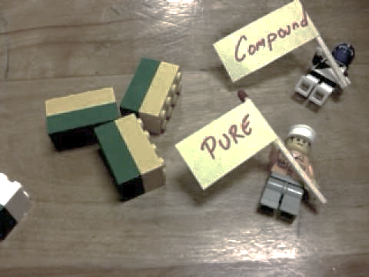
6th Grade Lego Model Lab
*1 color of legos represents 1 element
*1 lego of each color represents 1 atom
of the element
Look at the chemical formula
Decide how many elements are in it
Pick out legos for element (see top description)
Build the chemical formula
Use the model to complete the chart for each formula

Slide 7
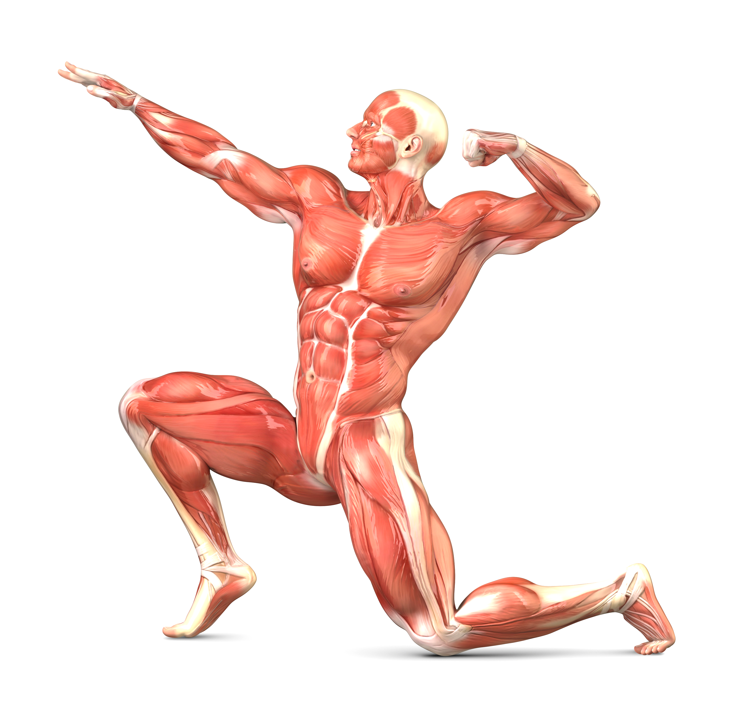
7th Grade
1. Review / Grade Dol on Integumentary System
2. Discuss what Muscles do for your body as a pair share, record in journal
3. Discuss as a class
4. Pass out Muscular System Foldable
5. Log in to www.kidshealth.org
6. Click on “for kids”
7. Type Muscular System into Search
8. Use information from articles to complete foldable

