Slide 1
March 27, 2018
Collect PDN / DOL from basket / Blue=6th Green=7th
7th Grade Collect TX Fusion Textbook
Sharpen Pencil
Sit in assigned seat
Complete PDN/DOL on own

Slide 2
Agenda
7th Grade
PDN
Finish Power Point
Card Sort
DOL
6th Grade
PDN
Video Clip
KidsHealth.org
DOL

Slide 3
LO’s
7th Grade
We will compare/contrast weathering, erosion, deposition through vocabulary activity.
6th Grade
We will identify the structures and functions of the skeletal system and the muscular system.

Slide 4
DOL’S
7th Grade
I will complete 5/5 written assessment questions over weathering.
6th Grade
I will complete 5/5 questions over the skeletal system.

Slide 5
TEK’S
7th Grade
7.8 (B) analyze the effects of weathering, erosion, and deposition on the environment in ecoregions of Texas
6th Grade
7.12 (B) identify the main functions of the systems of the human organism, including the circulatory, respiratory, skeletal, muscular, digestive, excretory, reproductive, integumentary, nervous, and endocrine systems

Slide 6
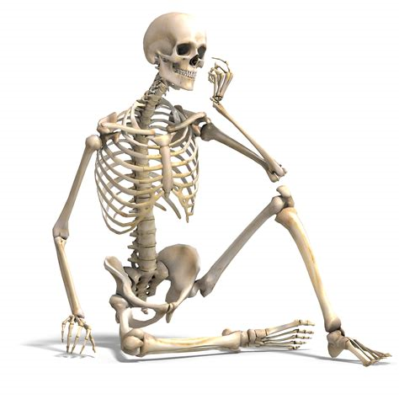
6th Grade Skeletal System
Teacher will hand out next page for human body book
Students will complete page as they watch the film over the skeletal system
https://www.youtube.com/watch?v=i42FSNA9bAY
Students will use kidshealth.org to finish book page information
Students will complete DOL

Slide 7
6th Grade Muscular System
Teacher will hand out next page for human body book
Students will complete page as they watch the film over the muscular system
http://kidshealth.org/en/kids/msmovie.html?WT.ac=en-k-htbw-main-page-g
Students will use kidshealth.org to finish
book page information
Students will complete DOL

Slide 8
7th Grade: Weathering / Erosion / Deposition
Essential Question:
You are walking from the car to the lake to go swimming. You decide to leave your shoes in the car so they won’t get full of sand. As you walk at first there are a lot of rocks that you step on along the way that hurt your feet. Once you get to the sand you find it is a lot less painful to walk. Even though both the rocks and the sand come from the same original mountain rock type of material why is there such a difference between the two? What do you think causes this to happen?

Slide 9
7th Grade Weathering / Erosion / Deposition Video
https://www.youtube.com/watch?v=R-Iak3Wvh9c
http://studyjams.scholastic.com/studyjams/jams/science/rocks-minerals-landforms/weathering-and-erosion.htm
Power Point Notes
http://www.coachpease.com/5th-6-weeks.php

