Slide 1
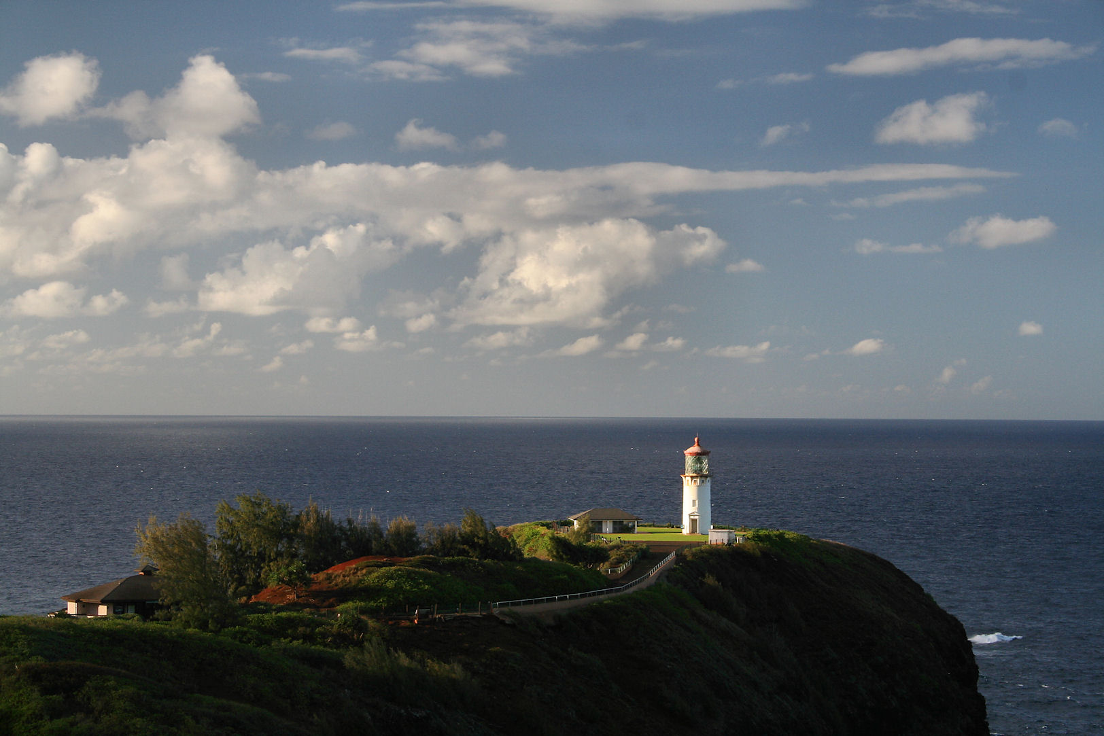
Levels of Organization Ecology Flow
Chart
By: Katherine Pease
Notes:
Half-circle picture with accent arcs
(Basic)
To reproduce the shape effects on this slide, do the following:
On the Home tab, in the Slides group, click Layout, and then click Blank.
On the Home tab, in the Drawing group, click Shapes, and then under Basic Shapes, click Arc (third row, 12th option from the left). On the slide, drag to draw an arc.
Select the arc. Under Drawing Tools, on the Format tab, in the Size group, do the following:
In the Shape Height box, enter 7.5”.
In the Shape Width box, enter 7.5”.
Drag the right yellow diamond adjustment handle to the bottom of the slide to create a half-circle.
Under Drawing Tools, on the Format tab, in the bottom right corner of the Shape Styles group, click the Format Shape dialog box launcher. In the Format Shape dialog box, click Fill in the left pane. In the Fill pane, select Picture or texture fill, and then under Insert from, click File.
In the Insert Picture dialog box, select a picture, and then click Insert.
Also in the Format Shape dialog box, in the Fill pane, under Insert from, select Tile picture as texture.
Also in the Format Shape dialog box, click Line Color in the left pane, and then select No line in the Line Color pane.
Also in the Format Shape dialog box, click Shadow in the left pane, and then do the following in the Shadow pane:
Click the button next to Presets, and then under Inner click Inside Diagonal Top Right (first row, third option from the left).
In the Transparency box, enter 70%.
In the Blur box, enter 20 pt.
In the Distance box, enter 20 pt.
Drag the half-circle to the left until the two middle yellow adjustment diamonds are lined up with the left edge of the slide. On the Home tab, in the Drawing group, click Arrange, point to Align, and then do the following:
Click Align to Slide.
Click Align Middle.
Select the arc. On the Home tab, in the Clipboard group, click the arrow under Copy, and then click Duplicate.
Select the second arc. Under Drawing Tools, on the Format tab, in the Size group, do the following:
In the Shape Height box, enter 6.79”.
In the Shape Width box, enter 10.03”.
On the Home tab, in the bottom right corner of the Drawing group, click the Format Shape dialog box launcher. In the Format Picture dialog box, click Fill in the left pane, and then in the Fill pane, select No fill.
Also in the Format Shape dialog box, click Line Color in the left pane. In the Line Color pane, select Solid line and then do the following:
Click the button next to Color, and then under Theme Colors click White, Background 1 (first row, first option from the left).
In the Transparency box, enter 50%.
Also in the Format Shape dialog box, click Line Style in the left pane. In the Line Style pane, in the Width box, enter 1.5 pt.
Drag the second arc left on the slide until the two middle yellow adjustment diamonds are lined up with the left edge of the slide. On the Home tab, in the Drawing group, click Arrange, point to Align, and then do the following:
Click Align to Slide.
Click Align Middle.
Select the second arc. On the Home tab, in the Clipboard group, click the arrow under Copy, and then click Duplicate.
Select the third arc. Under Drawing Tools, on the Format tab, in the Size group, do the following:
In the Shape Height box, enter 6.86”.
In the Shape Width box, enter 9.98”.
On the Home tab, in the bottom right corner of the Drawing group, click the Format Shape dialog box launcher. In the Format Shape dialog box, click Line Color in the left pane, select Gradient line in the Line Color pane, and then do the following:
In the Type list, select Linear.
Click the button next to Direction, and then click Linear Down (first row, second option from the left).
Under Gradient stops, click Add gradient stop or Remove gradient stop until two stops appear in the slider.
Also under Gradient stops, customize the gradient stops that you added as follows:
Select the first stop in the slider, and then do the following:
In the Position box, enter 0%.
Click the button next to Color, and then under Theme Colors click Blue, Accent 1, Lighter 40% (fourth row, fifth option from the left).
In the Transparency box, enter 77%.
Select the second stop in the slider, and then do the following:
In the Position box, enter 100%.
Click the button next to Color, click More Colors, and then in the Colors dialog box, on the Custom tab, enter values for Red: 208, Green: 215, Blue: 222.
In the Format Shape dialog box, in the Line Style pane, in the Transparency box, enter 90%.
Also in the Format Shape dialog box, click Line Style in the left pane. In the Line Style pane, in the Width box, enter 4.25 pt.
On the Home tab, in the Drawing group, click Arrange, point to Align, and then do the following:
Click Align to Slide.
Click Align Left.
Drag the third arc left on the slide until the two middle yellow adjustment diamonds are lined up with the left edge of the slide. Drag the third arc vertically as needed to position it slightly above the second arc on the slide.
To reproduce the background on this slide, do the following:
Right-click the slide background area, and then click Format Background. In the Format Background dialog box, click Fill in the left pane, select Gradient fill in the Fill pane, and then do the following:
In the Type list, select Linear.
Click the button next to Direction, and then click Linear Up (second row, second option from the left).
In the Angle box, enter 270⁰.
Under Gradient stops, click Add gradient stop or Remove gradient stop until four stops appear in the slider
Also under Gradient stops, customize the gradient stops that you added as follows:
Select the first stop in the slider, and then do the following:
In the Position box, enter 0%.
Click the button next to Color, click More Colors, and then in the Colors dialog box, on the Custom tab, enter values for Red: 167, Green: 185, Blue: 197.
Select the second stop in the slider, and then do the following:
In the Position box, enter 30%.
Click the button next to Color, and then under Theme Colors click White, Background 1 (first row, first option from the left).
Select the third stop in the slider, and then do the following:
In the Position box, enter 70%.
Click the button next to Color, and then under Theme Colors click White, Background 1 (first row, first option from the left).
Select the fourth stop in the slider, and then do the following:
In the Position box, enter 100%.
Click the button next to Color, click More Colors, and then in the Colors dialog box, on the Custom tab, enter values for Red: 167, Green: 185, Blue: 197.

Slide 2
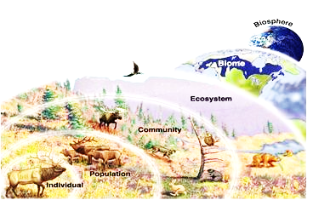
Materials:
Pen / Pencil that works
Colors
Scissors
Pre-Ran Circle Outline (1 per student)
Journal Notes over Ecology
Stapler

Slide 3
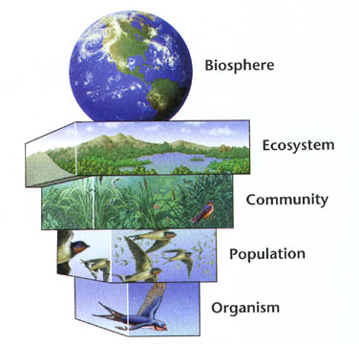
Procedure:
Student will pick 1 type of organism
(plant or animal) to make flow chart.
Student will collect levels of organization circle template, colors and pencil that works
Student will start with organism circle first by drawing picture to represent organism on front of the circle.
Student will label the Biotic / Abiotic factors in the picture

Slide 4
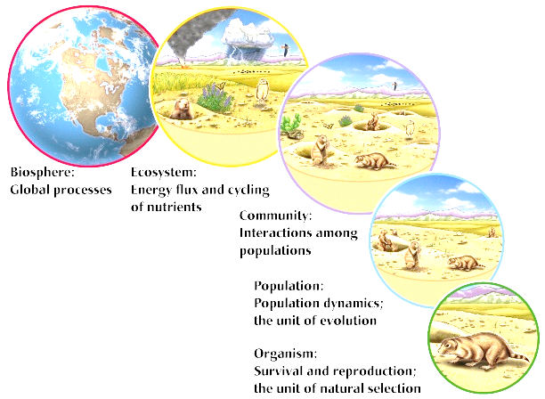
4. Student will continue to show flow through the levels of
organization by continuing to draw pictures on front of the
other circles.
5. Student will label the biotic / abiotic factors in each level
6. Student will color in illustrations
7. Student will cut out each level

Slide 5
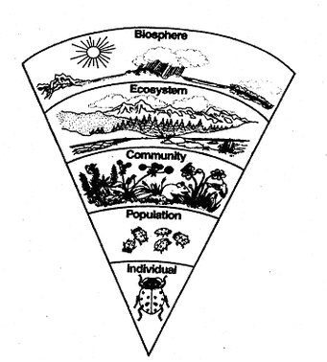
Students will write a description about each level on the back of the different level circles. Description will explain the level and explain how it flows into the next level.
Students will put the circles in the correct order to show the flow through the levels of organization.
10. Students will put a staple at the top
of the circles to keep them all
together
11. Student will put name and class
period on the back of the biosphere
circle

