Slide 1
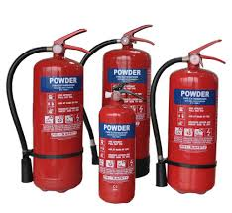
Fire Extinguisher
a portable device that discharges a jet of water, foam, gas, or other material to extinguish a fire

Slide 2
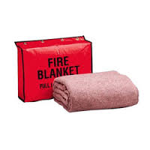
Fire Blanket
A sheet of flexible material, typically woven fiberglass, used to smother a fire in an emergency.

Slide 3
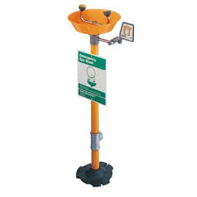
Face / Eyewash
a cleansing receptacle set apart for the purpose of emergencies in which the eyes must be quickly flushed with water. eyeglass, postmydriatic.

Slide 4
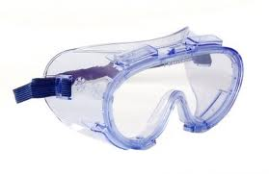
Safety Goggles
forms of protective eyewear that usually enclose or protect the area surrounding the eye

Slide 5
Aprons
A garment, usually fastened in the back, worn over all or part of the front of the body to protect clothing.

Slide 6
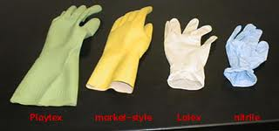
Gloves
A fitted covering for the hand with a separate sheath for each finger and the thumb.

Slide 7
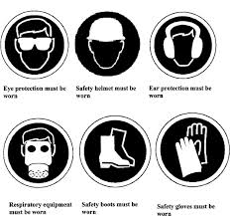
Emergency Safety Equipment
Equipment such as an eye/face wash, a fire blanket, and a fire extinguisher used to take care of an emergency situation.

Slide 8
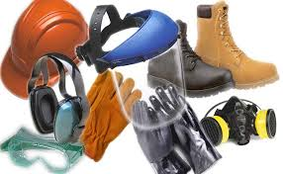
Protective Safety Equipment
Equipment, such as goggles and aprons, used for protection in an experiment.

Slide 9
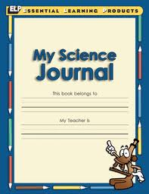
Science Journal
a periodical that serves as a source of scientific information and means of scientific communication.

Slide 10
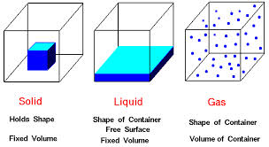
Matter
physical substance in general, as distinct from mind and spirit; (in physics) that which occupies space and possesses rest mass, especially as distinct from energy

Slide 11
Physical Property
Property of matter that can be observed without changing the composition or identity of the matter.

Slide 12
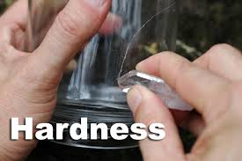
Hardness
Ability of a mineral to resist scratching

Slide 13
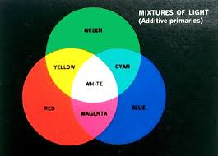
Color
the property possessed by an object of producing different sensations on the eye as a result of the way the object reflects or emits light.

Slide 14
Luster
How the surface of a mineral appears when it reflects light (shiny or dull)

Slide 15
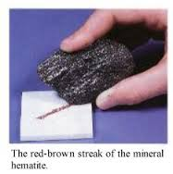
Streak
The color of a mineral seen when rubbed on a streak plate

Slide 16
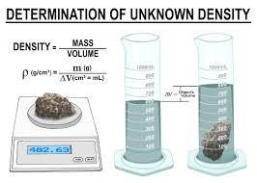
Density
The amount of matter that will fit into a given amount of space
Density = mass / volume

Slide 17
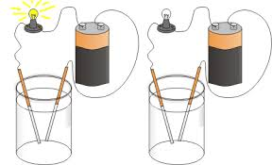
Conductivity
Ability to conduct electrical current

Slide 18
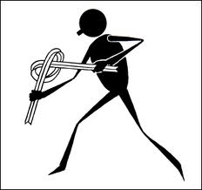
Ductility
Ability to be stretched into a wire without breaking.

Slide 19
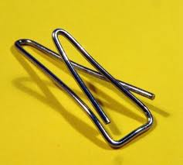
Malleability
Ability to be formed or shaped under pressure (metals hammered or rolled into thin sheets)

Slide 20
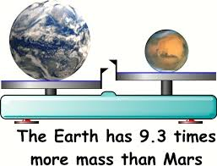
Mass
The amount of matter in something.

Slide 21
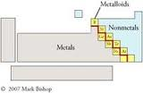
Metalloids
Substances that exhibit some properties of metals and nonmetals

Slide 22
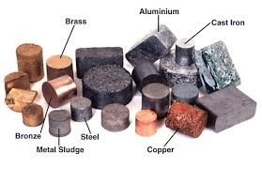
Metals
Substances that have the physical properties of luster, conductivity, and malleability; may appear in all three states of matter

Slide 23
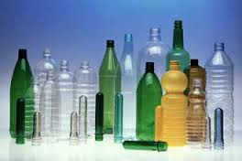
Nonmetals
Substances that have the physical properties of being dull, insulators, and brittle; may appear in all three states of matter

Slide 24
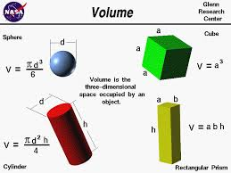
Volume
The amount of space that a substance or object occupies

Slide 25
Quantitative Data
information about quantities; that is, information that can be measured and written down with numbers

Slide 26
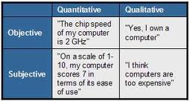
Qualitative Data
Data can be observed but not measured. Colors, textures, smells, tastes, appearance

Slide 27
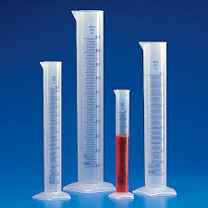
Graduated Cylinders
measuring cylinder or mixing cylinder is a piece of laboratory equipment used to measure the volume of a liquid

Slide 28
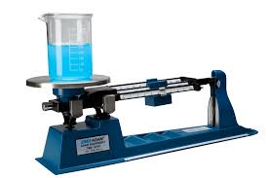
Triple Beam Balance
a typical mechanical balance. It has a beam which is supported by a fulcrum. On one side is a pan on which the object is placed. On the other side, the beam is split into three parallel beams , each supporting one weight.

Slide 29
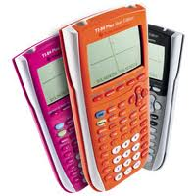
Calculators
something used for making mathematical calculations, in particular a small electronic device with a keyboard and a visual display.

Slide 30
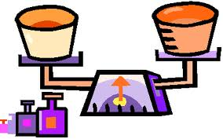
Volume
The amount of space that a substance or object occupies
Length * Width * Height = Volume

