Slide 1
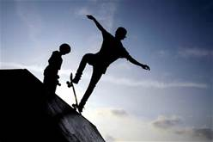
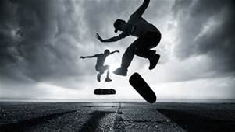
Dr. Skateboard’s Motion Video Clips
Students will use information gathered from Dr. Skateboard’s Videos to complete Motion / Speed / Distance / Time Vocabulary Foldable
Dr. Skateboard 1 Motion
https://www.youtube.com/watch?v=6RTeoKgh9V4
Dr. Skateboard 2 Motion, Speed, Velocity Velocityhttps://www.youtube.com/watch?v=dKDDrnx-Fgw
Dr. Skateboard 3 Motion, Acceleration
https://www.youtube.com/watch?v=uWkTV3ejTc4
Dr. Skateboard 4 Motion, Momentum
https://www.youtube.com/watch?v=tmRQ7Ba4Auc
Dr. Skateboard 5 Motion, energy
https://www.youtube.com/watch?v=tmRQ7Ba4Auc
DR. Skateboard 6 Motion Overview
https://www.youtube.com/watch?v=lRD9C1mfIG8

