Slide 1
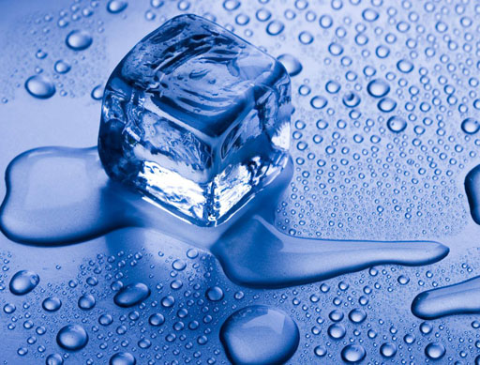
Flip Book Activity
By: Katherine Pease

Slide 2
Card Sort Warm Up
Take out all cards and put face up on the table (so you can see the picture/word)
Put the titles (Chemical Change / Physical Change) at one of table so it forms two columes
Sort out the pictures/words cards into one of the two columes
Teacher will check when your group thinks they have it correct.
The first group correctly done will win.
Chemical
Change
Physical
Change

Slide 3
Students will create a book to compare/contrast chemical vs’ physical changes.
Procedure:
Collect 1 large sheet plain paper
Follow Teacher on way to fold the paper
Staple on side of crease / teacher will model
Cut apart creases on other sides not stapled / teacher will model
Put Name / Class period on bottom right corner of cover
Put a Title on the Cover Page (Chemical Vs’ Physical Changes)

Slide 4
Procedure Continued
Students Watch StudyJams.org as a group to complete definitions in your own words
http://www.kentchemistry.com/links/Matter/PhysicalChemicalChanges.htm
Students will use various websites on www.coachpease.com under 2nd 6 Weeks and Links
Students will set up pages 1-10 as the slides that follow state
Students are to put all descriptions and explanations in their own words
All Pictures need to be colored
Neatness / turned in on time (By 3:30pm on Thursday, Oct.29th)
http://vital.cs.ohiou.edu/steamwebsite/downloads/ChangeLab.swf
http://www.myips.org/cms/lib8/IN01906626/Centricity/Domain/8123/PhysicalChemicalChangesLab.pdf
https://edutrainingcenter.withgoogle.com/training
http://www.bbc.co.uk/bitesize/standard/chemistry/elementsandreactions/chemical_reactions/revision/1/
http://www.learner.org/courses/essential/physicalsci/session4/closer1.html
http://www.kentchemistry.com/links/Matter/PhysicalChemicalChanges.htm

Slide 5
Book Title
Chemical Vs’ Physical Changes
Name
Class Period

Slide 6
Chemical Change
Definition in your own words
Illustration/Picture
Physical Change
Definition in your own words
Illustration/Picture
Pg.1
Pg.2

Slide 7
Picture of Change
1. Explain what is happening in the picture
2. Explain what type of change (chemical or physical)
3. Explain how you know it is a chemical or physical change
Picture of Change
1. Explain what is happening in the picture
2. Explain what type of change (chemical or physical)
3. Explain how you know it is a chemical or physical change
Pg.3
Pg.4

Slide 8
Picture of Change
1. Explain what is happening in the picture
2. Explain what type of change (chemical or physical)
3. Explain how you know it is a chemical or physical change
Picture of Change
1. Explain what is happening in the picture
2. Explain what type of change (chemical or physical)
3. Explain how you know it is a chemical or physical change
Pg.5
Pg.6

Slide 9
Physical Reaction Properties
1. List properties
2. Explain each property
3. Illustrate/Picture for each property (small example)
Pg.7
Pg.8

Slide 10
Chemical Reactants Menomic Device
Letter Menomic Word Reactant
C
G
L
T
P
Chemical Reaction
Properties
1. List properties
2. Explain each property
3. Illustrate/Picture for each property (small example)
Pg. 9
Pg.10

