Slide 1
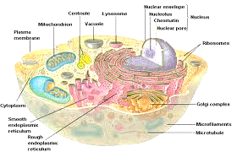
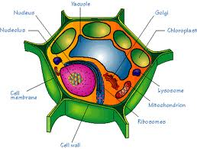
4th 6 Weeks 7th Grd. Vocabulary Cells
Cell
Cell theory
Golgi bodies
Nucleus
Chromosomes
Vacuole
Ribosomes
Endoplasmic reticulum
Nuclear membrane
10. Centrioles
11. Cytoplasm
12. Cell membrane
13. Cell wall
14. Mitochondria
15. Lysosome
16. Genes
17. Tissue
18. Organ
19. Organ system
20. Organism

