Slide 1
What am I??? Beetle Observation
Typed by: Katherine Pease / 2017

Slide 2
Procedure: 1. Working with a partner make an detailed observation about what physical features you can see when you observe the beetle pictures. 2. Write your observations done on the sheet of paper provided. 3. Make sure you put you and your partners name / class period on the paper also

Slide 3
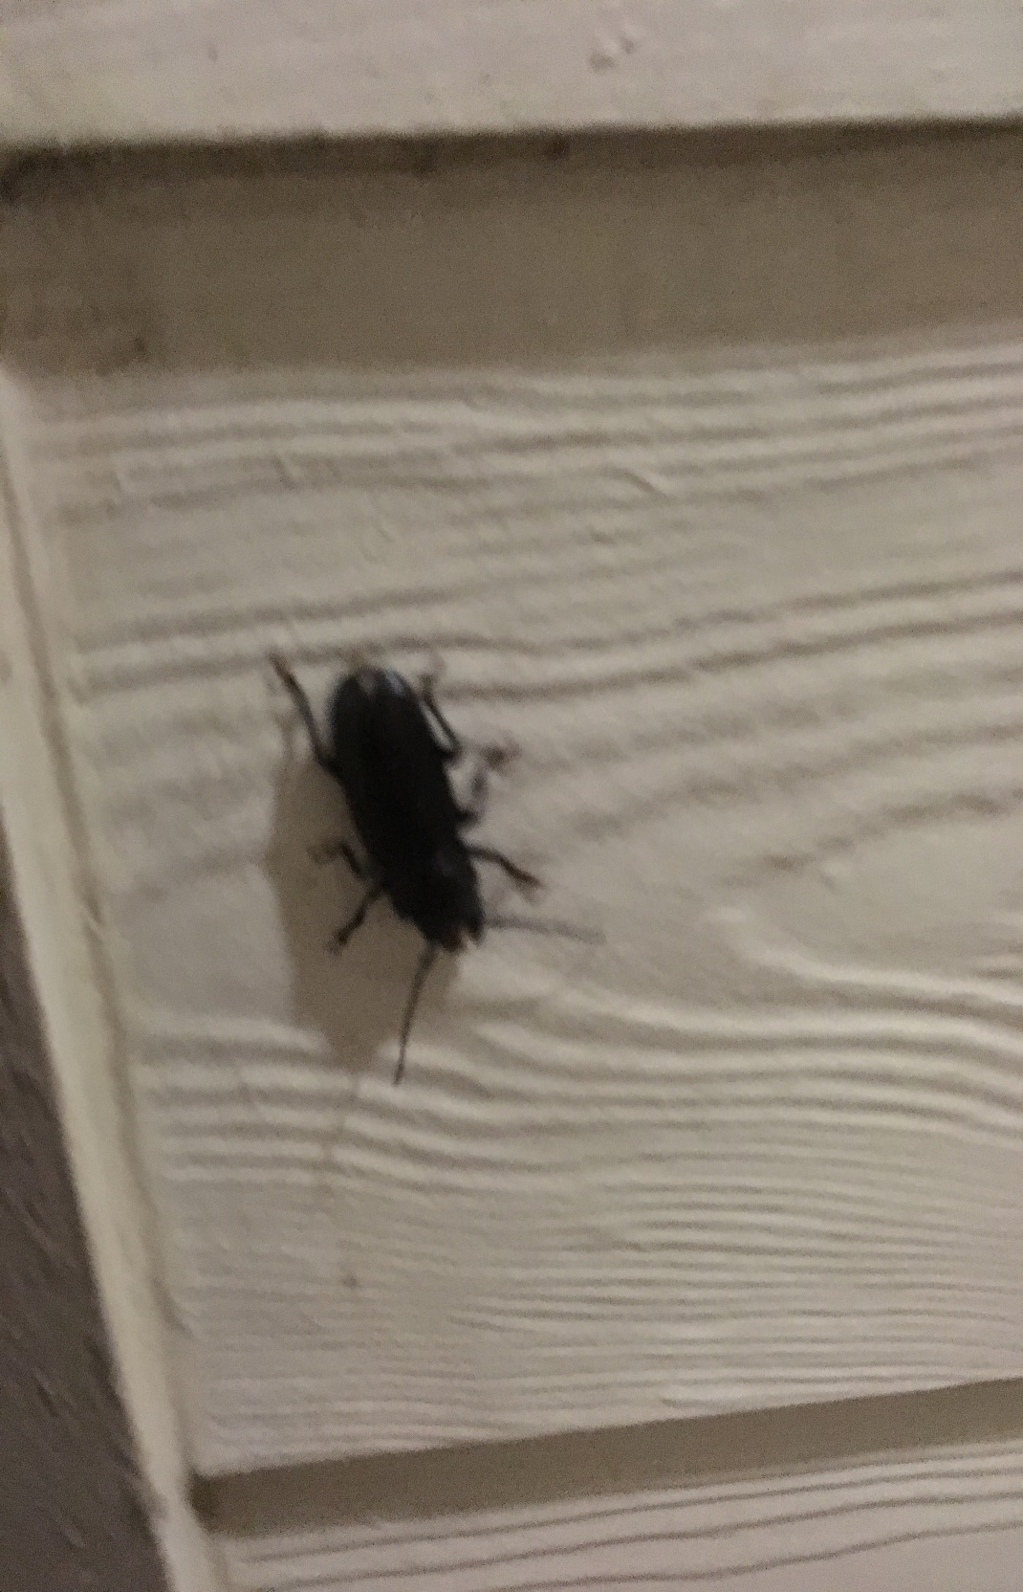

Slide 4
Online Research… Use the links below to do determine what type of beetle we have.. Remember to use your observation data about the beetles characteristics. Record your research onto the sheet of paper you put your observations.
https://www.google.com/search?q=beetles+in+texas&oq=beetles+&aqs=chrome.1.69i57j0l5.4662j0j7&sourceid=chrome&ie=UTF-8
http://www.insectidentification.org/insects-by-type-and-region.asp?thisState=Texas&thisType=Beetle
http://texasento.net/beetles.htm

