Slide 1
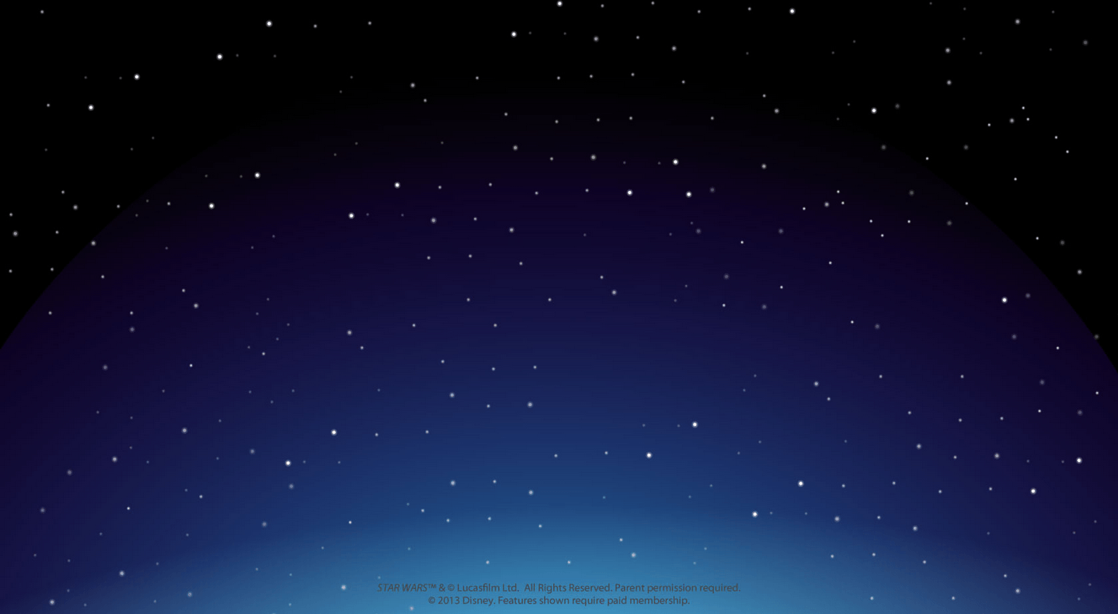
Survival in Space Pages 638-644 in TX Fusion
TEK 7.9 (B) identify the accommodations, considering the characteristics of our solar system, that enabled manned space exploration.

Slide 2
Please answer the question below on the back of your PDN
Nasa has just called and you were picked to be the first middle school student to go visit the ISS, international space station. What would you need to bring for the trip? Explain why you would pack each item you listed.

Slide 3
Pair-Share ideas with table partner (1 min.) Re-group and discuss as a class Teacher will list Ideas Below….

Slide 4
Let’s see if we forgot anything we will need..
Please open TX Fusion textbook to page. 638
Teacher will pass out graphic organizer to assist with notes
Students will follow along with power point and book to complete the graphic organizer.

Slide 5
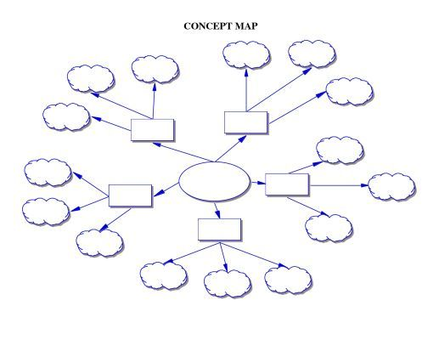
Teacher will review how to complete/use the note taking graphic organizer below.
Ways to adapt to
weightlessness
Conditions that
Affect the body
Survival in Space
Spacesuits help
People in Space
Support System for
Life on spacecraft
Resources
Conserved by..

Slide 6
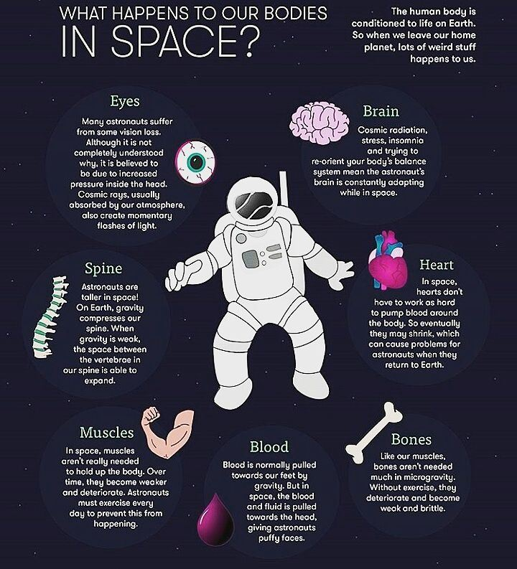
Space is a vacuum… So, how does that mean for us?
This means it has no air to breath.
No air means there is no air pressure.
The human body needs air pressure to keep their form/shape.

Slide 7
Weightlessness is…
Weightlessness is the apparent loss of weight of an object that is falling freely due to gravity.
Ok… but what does that mean??
When in space the gravitational attraction in crewed spacecraft is a
little less then on Earth.
Astronauts and space crafts are always falling toward Earth when in orbit.
But they are moving so fast that Earth is able to stay in orbit.
This free fall produces weightlessness.

Slide 8
Radiation… Good or Bad Thing?
Radiation in space includes electromagnetic radiation and highly charged particles.
How does it affect your body?
Causes damage to DNA and tissues
Increases risk of cancer
https://www.youtube.com/watch?v=uujpLFMCp-A
Radiations affect on human body in space

Slide 9
Meteoroids…. What could small particles of dust or do?
When meteoroids are moving at very high speeds so…
Per NASA website: Collision with these particles can cause serious damage or catastrophic failure to spacecraft or satellites and is a life threatening risk to astronauts conducting extra-vehicular activities in space

Slide 10
What is the main job of the support system on a spacecraft?
Maintains conditions that humans need to survive.
Controls air pressure
Controls temperature
Controls Air to breath
Handles the waste produced

Slide 11
How does the support system control oxygen and air pressure?
It supplies air to the cabin.
This air contains 80% nitrogen and 20% oxygen
Without air pressure the body would…
Expand to about twice it’s normal size

Slide 12
How does the support system handle waste?
It has to be managed very carefully due to limited space.
Carbon Dioxide exhaled is removed.
Limit the amount of garbage produced.
If the trash bag gets full , it is sealed off and stored till landing.
Toilets are designed to collect liquid and solid wastes.
Liquid (urine) waste is recycled
Solid waste (Feces) is compressed and stored

Slide 13
How does the support system supply food and drink?
All food and drink must be carried onto the spacecraft before lift off.
Food must to packaged for long-term use.
Drinking is done with straws or special zero-gravity cups.

Slide 14
How are resources conserved on the spacecraft?
Water Conservation:
Use washcloths or sponges rather running water
Waste water is reclaimed, treated and reused.
Example: Urine is recycled into drinking water.
Air Conservation:
Goes through the recycling system of spacecraft to be filtered and cleaned.
Levels of oxygen, carbon dioxide, and other gases are constantly maintained.
Oxygen is only supplied where and when it is needed most.

Slide 15
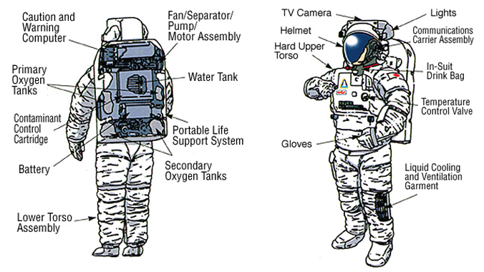
How does the spacesuit help in space?
Helps when astronaut is outside the spacecraft when in space.
The primary life support subsystem supplies oxygen and air pressure.

Slide 16
Spacesuit Continued…
It has many different layers.
Outer layer reflect sunlight and do not tear easily
Layers keep the temperature from changing inside the suit
Layers provide protection from micrometeoroids.
Inner layers keep astronaut cool by removing body heat and sweat.
Have special joints or tapers in fabric to allow movement.
The helmet is made of strong, clear materials that have a reflective coating to reduce glare
Helmet has transparent layer of gold reflective coating to protect from radiation.
https://www.youtube.com/watch?v=QGq-ywbyhUk
How spacesuits help astronauts?

Slide 17
How do astronauts adapt to weightlessness?
Special Cups to consume water with special stews to keep liquid from floating out
Sleep in sleeping bags that strapped down to keep from floating away
Cleaning without water, use special soap that can be wiped away without water.
Use a vacuum cleaner to catch floating objects.
https://www.youtube.com/watch?v=KsNajvy3Z7Y
How Astronauts eat, sleep and use bathroom in space

Slide 18
Does weightlessness cause long-term effects?
Causes muscles and bones in legs and lower back to lose strength
Bone density can decrease 0.6% to 5% each month in space
Length of spine increases, causing back pain
Due to this, Astronauts exercise daily when in space
No gravity causes blood and water to move to the head and upper body but not the lower body.
Amount of blood also decreases.
Heart becomes weaker due to not having to work as hard in space.

Slide 19
Let’s Review with NASA on the ISS, international space station
(29 mins.) https://www.youtube.com/watch?v=SGP6Y0Pnhe4

Slide 20
Do you need to re-pack for your space trip??
Make a new list of what you will pack for your trip into space.
Be sure to explain why you are bringing each item.

