Slide 1
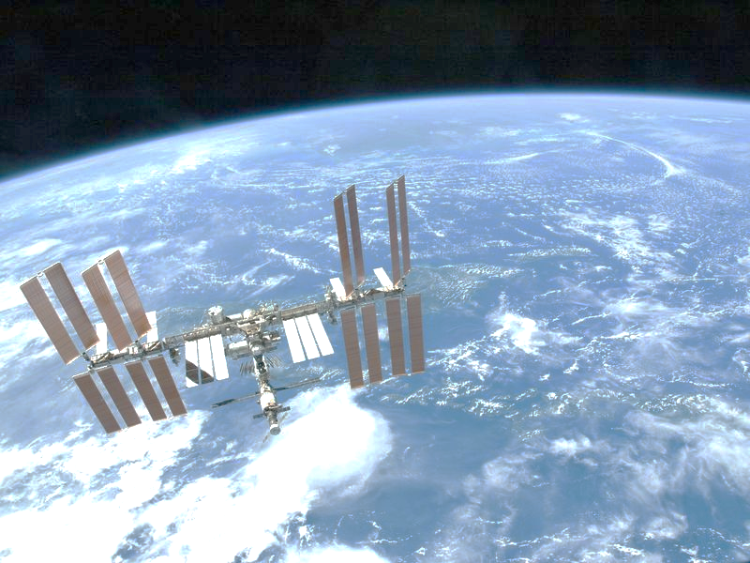
Survival In Space Quilt Project
Typed By: Katherine Pease
https://thumbs-prod.si-cdn.com/fPXeEYUT3dI9QII7s0GORZDCKrk=/800x600/filters:no_upscale()/https://public-media.smithsonianmag.com/filer/1e/75/1e75958e-0337-4c47-9b7f-5c97385e4a73/iss.jpg

Slide 2
TEK: 7.9 (B) identify the accommodations, considering the characteristics of our solar system, that enabled manned space exploration
We will create a “quilt” to help an astronaut to remember survival skills when in space.

Slide 3
Procedure:
1. Teacher will pass out “quilt” template and explain expectations/ procedures for completing it.
2. Students will use power points notes, Texas Fusion Textbook, and/or web link listed below
http://iss.jaxa.jp/kids/en/life/index.html
3. Students will work in small groups of 2 (table partner) using a whisper voice level
Directions: Write the heading (bold/underlined) in each quilt square as seen below. Answer the question for each quilt square below and illustrate/draw picture.

Slide 4
Food: What do they eat in space? Explain | Clothes: Do they need special clothes while living and working inside the space shuttle? Explain. | Bath: Do they take baths while living and working in the space shuttle? Explain why or why not.
Toilet: How do toilets work in space? Explain the mechanics of it. | Sleep: How can they sleep when they are floating in space? Explain. | Exercise: Do the need to exercise in space? Why or why not.
Cleaning: Do they sweep and clean up the inside of the space shuttle? Explain why/how or why not. | Sickness: What do they do if they get sick in space? Explain. | Entertainment: How do they spend their free time? Explain.

