Slide 1
Oct. 11, 2018
Collect PDN:Roller coaster from Green Basket, Coach Pease at the door
Sharpen Pencil
Sit in assigned seat
Complete PDN on own, NO DEVICES
Login to google classroom
Click on Classwork
Click on Roller coaster Builder Game

Slide 2
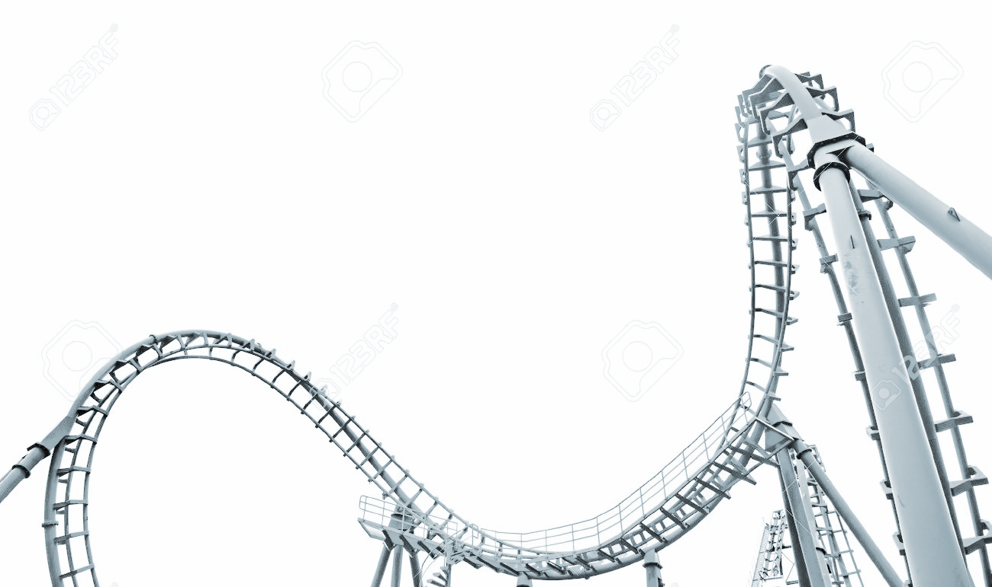
TEK 6.8A
(8) Force, motion, and energy. The student knows force and motion are related to potential and kinetic energy. The student is expected to:
(A) compare and contrast potential and kinetic energy

Slide 3
LO
Students will create a diagram of a roller coaster to show how potential energy / kinetic energy work together to assist with the coasters movement.

Slide 4
DOL
Students will complete 5/5 questions that compare/contrast different ways potential/kinetic energy can be used with 80% accuracy or higher.

Slide 5
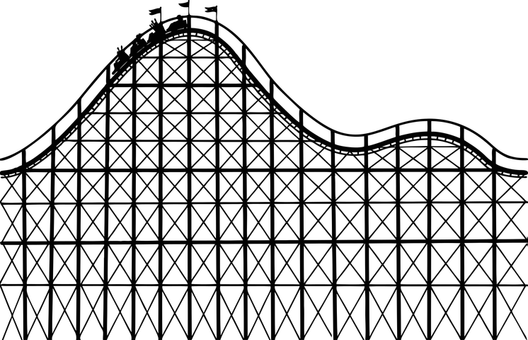
Roller Coaster Builder Game
https://www.learn4good.com/games/building-construction/rollercoastergame.htm
Practice making a roller coaster where the car can get from the beg to the end of coaster track on own.
This is for you to use when you are finished early and waiting for others to finish.

Slide 6
Roller Coaster Expectations
Talking: Whispers with Partner
Movement: Stay around desk/table you are working at
Help: Ask your group first
Participation: Group Work
Devices: None Needed
Collect diagram, colors, ruler to finish

Slide 7
Roller Coaster Diagram Poster
Diagram must have: 3 or more hills
1 coaster car per item listed below:
* Most Potential Energy * Most Kinetic Energy
*Least Potential Energy *Least Kinetic Energy * Equal Amounts of Potential and Kinetic Energy
1 Bar Graph per Car listed above
Key: P=___________ and so forth
K
P
T.E.

Slide 8
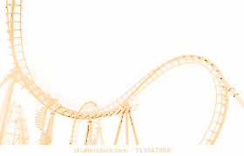
Roller Coaster Diagram Poster Cont.
Vocabulary: Potential Energy / Kinetic Energy / Law of Conservation of Energy
First/Last Name ____________________
Teacher:____________________
Period:___
Date: ___/___/____

