Slide 1
Oct. 10, 2018
Collect DOL: Kinetic Energy from Green Basket, Coach Pease at the door
Sharpen Pencil
Sit in assigned seat
Complete DOL on own, NO DEVICES
Login to google classroom
Click on Classwork
Click on Rollercoaster Game

Slide 2
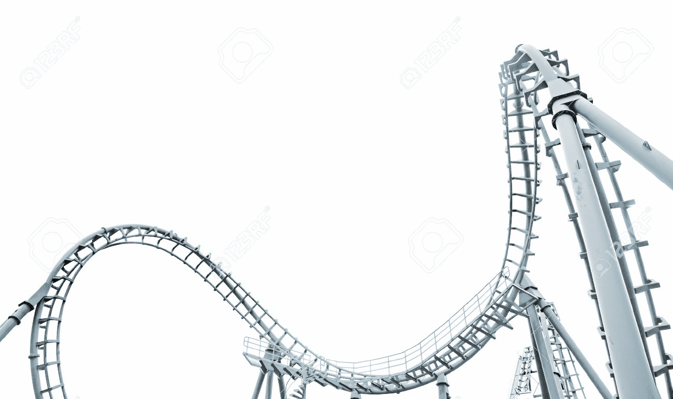
TEK 6.8A
(8) Force, motion, and energy. The student knows force and motion are related to potential and kinetic energy. The student is expected to:
(A) compare and contrast potential and kinetic energy

Slide 3
LO
Students will create a diagram of a roller coaster to show how potential energy / kinetic energy work together to assist with the coasters movement.

Slide 4
DOL
Students will complete 5/5 questions that compare/contrast different ways potential/kinetic energy can be used with 80% accuracy or higher.

Slide 5
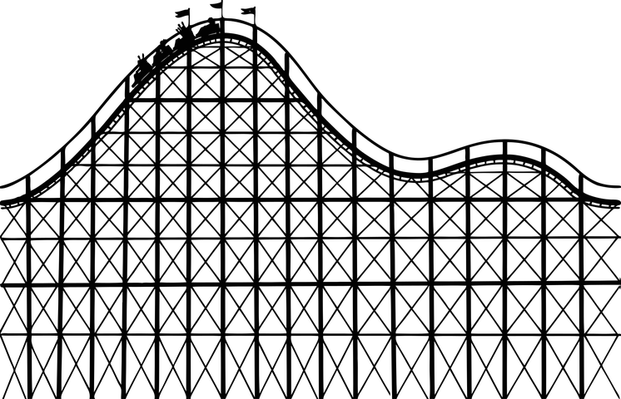
Roller Coaster Builder Game
https://www.learn4good.com/games/building-construction/rollercoastergame.htm
Practice making a roller coaster where the car can get from the beg to the end of coaster track on own.
Once complete roller coaster, draw a basic outline of coaster in science journal

Slide 6
Roller Coaster Diagram Poster
Diagram must have: 3 or more hills
1 coaster car per item listed below:
* Most Potential Energy * Most Kinetic Energy
*Least Potential Energy *Least Kinetic Energy * Equal Amounts of Potential and Kinetic Energy
1 Bar Graph per Car listed above
Key: P=___________ and so forth
K
P
T.E.

Slide 7
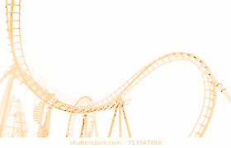
Roller Coaster Diagram Poster Cont.
Vocabulary: Potential Energy / Kinetic Energy / Law of Conservation of Energy
First/Last Name ____________________
Teacher:____________________
Period:___
Date: ___/___/____

