Slide 1
Lesson Objective:
You will be able to identify objects’ changes in motion on a speed-time graph.

Slide 4
Jiff walked on his hind legs 83 feet in 4 seconds. What is Jiff’s average speed?

Slide 5
What is Acceleration?

Slide 6
Acceleration
Acceleration is:
1. Speeding up
2. Slowing down
3. Changing direction

Slide 7
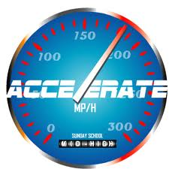
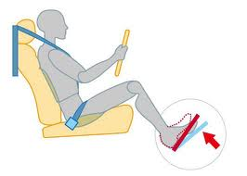
Acceleration
To speed up = accelerate.
To slow down = decelerate.

Slide 9
Where are the x-y axes?

Slide 10
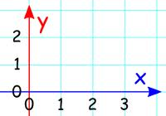
= speed
time =

Slide 11
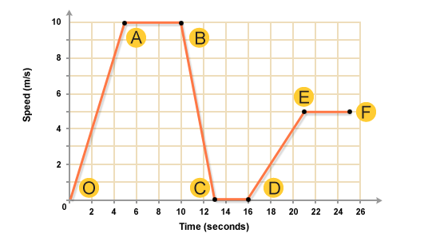

Slide 12
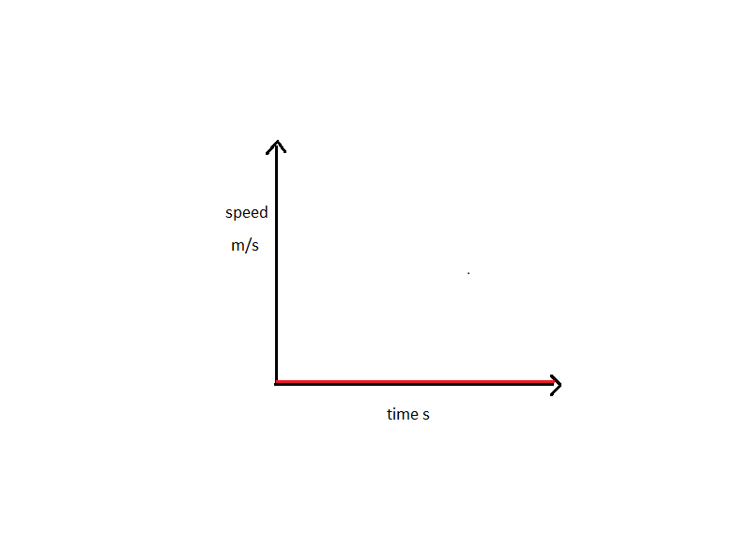

Slide 13
No Movement
A horizontal line at the BOTTOM of the graph = no movement.

Slide 14
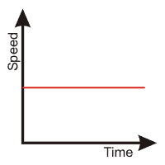

Slide 15
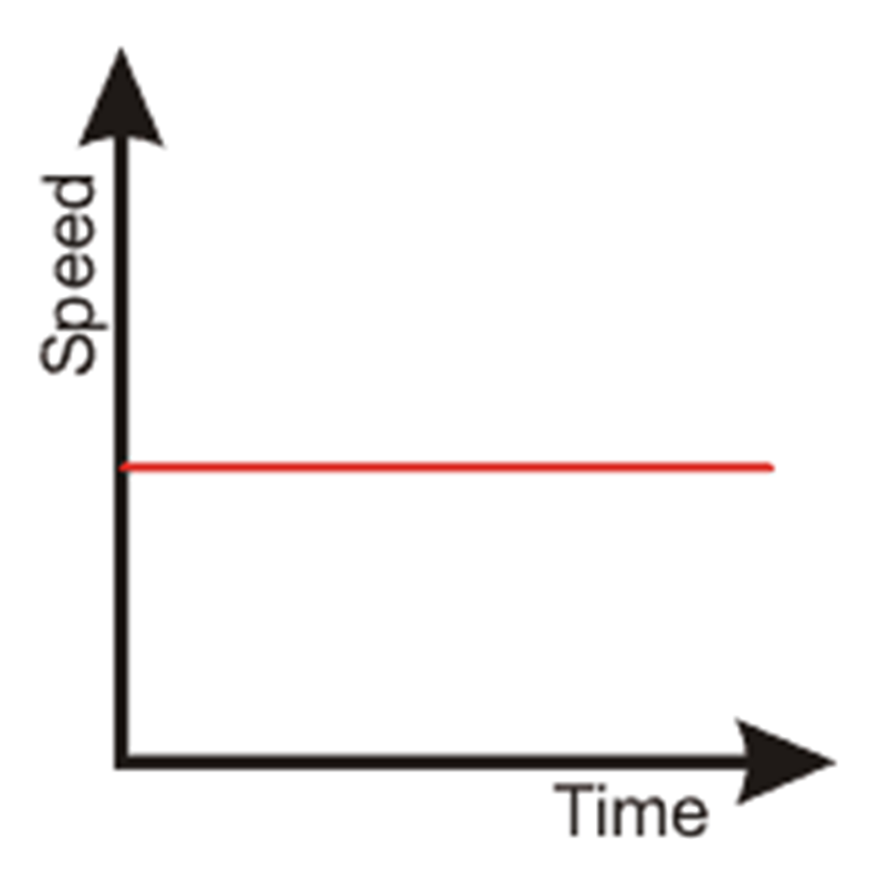
Constant Speed
A horizontal line in the graph = constant speed.

Slide 16
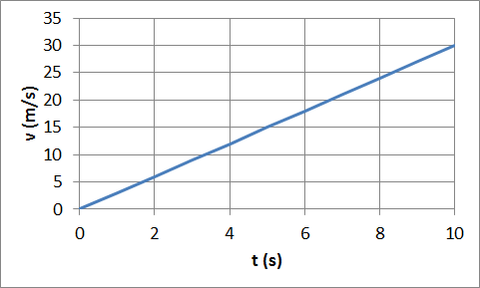

Slide 17
Acceleration
A line going up = acceleration (speeding up).

Slide 18
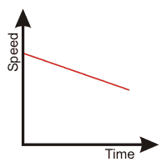

Slide 19
Deceleration
A line going down = deceleration (slowing down).

Slide 20
1 = No Movement 2 = Constant Speed 3 = Acceleration 4 = Deceleration

Slide 21
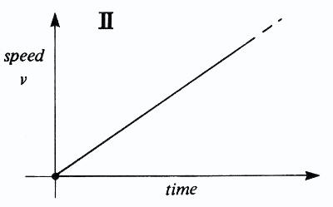

Slide 23
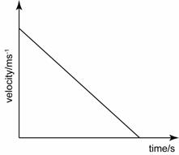

Slide 26
Labeling & Gluing in Graphs

Slide 27
Constant
Accelerating
Constant
Accelerating
Decelerating
Rest

Slide 28
Partner Practice

