Slide 1
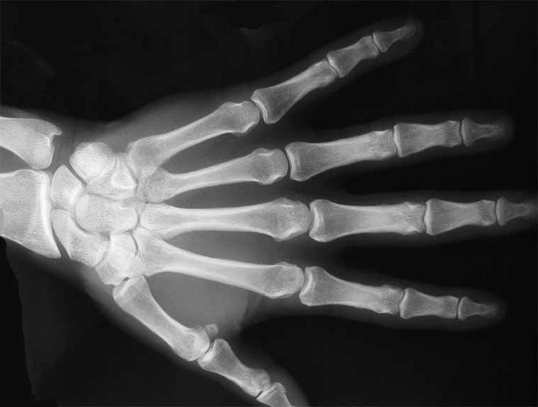
Skeletal System Quiz

Slide 2
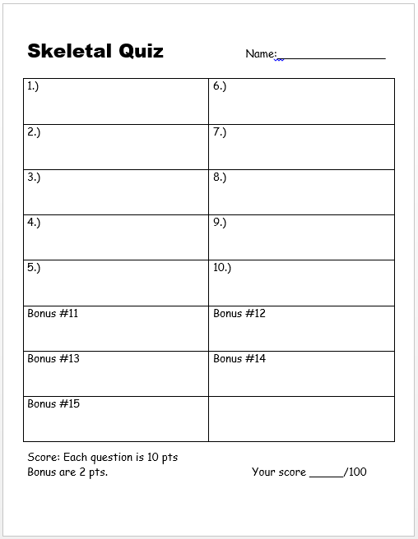
1-10 (and bonus) Quiz Sheet Available

Slide 3
1-10 Skeletal System Quiz (10 pts each)
With 5 Bonus Questions (2 pts each)

Slide 4
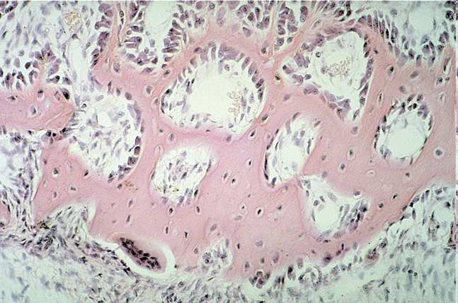
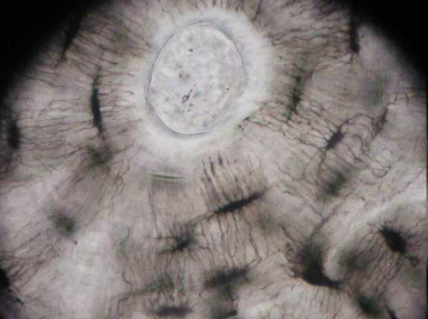
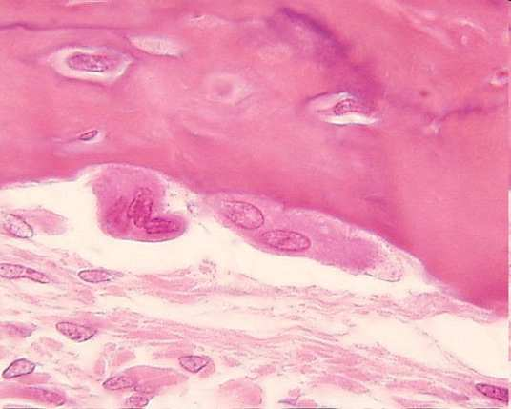
Bone Cells perform all of the following jobs except…
A.) Make new bone and help repair damage.
B.) Carry nutrients and waste products to and from blood vessels in the bone.
C.) Allows muscle fibers to contract and relax.
D.) Break down bone and help to sculpt and shape it.
Copyright © 2010 Ryan P. Murphy

Slide 5
What’s the soft fatty substance in the cavities of bones in which blood cells are produced?

Slide 6
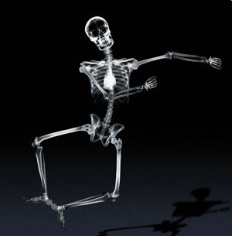
The Skeletal System performs all of the following jobs except for…
A.) Provides the shape and form.
B.) Supports.
C.) Protects.
D.) Produces blood.
E.) Provides Oxygen
F.) Allows movement.
G.) Stores minerals
Copyright © 2010 Ryan P. Murphy

Slide 7
The Skeletal System performs all of the following jobs except for…
A.) Provides the shape and form.
B.) Supports.
C.) Protects.
D.) Produces blood.
E.) Provides Oxygen
F.) Allows movement.
G.) Stores minerals
Copyright © 2010 Ryan P. Murphy

Slide 8
The Skeletal System performs all of the following jobs except for…
A.) Provides the shape and form.
B.) Supports.
C.) Protects.
D.) Produces blood.
E.) Provides Oxygen
F.) Allows movement.
G.) Stores minerals
Copyright © 2010 Ryan P. Murphy

Slide 9
The Skeletal System performs all of the following jobs except for…
A.) Provides the shape and form.
B.) Supports.
C.) Protects.
D.) Produces blood.
E.) Provides Oxygen
F.) Allows movement.
G.) Stores minerals
Copyright © 2010 Ryan P. Murphy

Slide 10
The Skeletal System performs all of the following jobs except for…
A.) Provides the shape and form.
B.) Supports.
C.) Protects.
D.) Produces blood.
E.) Provides Oxygen
F.) Allows movement.
G.) Stores minerals
Copyright © 2010 Ryan P. Murphy

Slide 11
The Skeletal System performs all of the following jobs except for…
A.) Provides the shape and form.
B.) Supports.
C.) Protects.
D.) Produces blood.
E.) Provides Oxygen
F.) Allows movement.
G.) Stores minerals
Copyright © 2010 Ryan P. Murphy

Slide 12
The Skeletal System performs all of the following jobs except for…
A.) Provides the shape and form.
B.) Supports.
C.) Protects.
D.) Produces blood.
E.) Provides Oxygen
F.) Allows movement.
G.) Stores minerals
Copyright © 2010 Ryan P. Murphy

Slide 13
The Skeletal System performs all of the following jobs except for…
A.) Provides the shape and form.
B.) Supports.
C.) Protects.
D.) Produces blood.
E.) Provides Oxygen
F.) Allows movement.
G.) Stores minerals
Copyright © 2010 Ryan P. Murphy

Slide 14
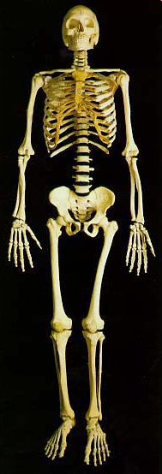
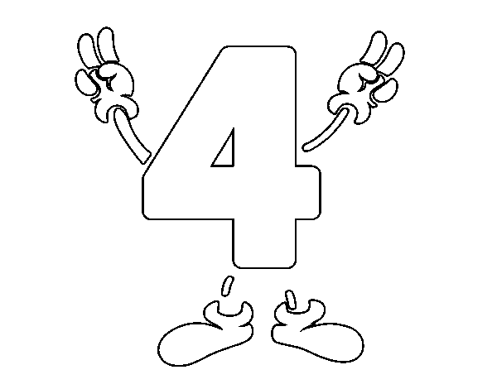
Which skeleton is the axial, and which is the appendicular?
A
B

Slide 15
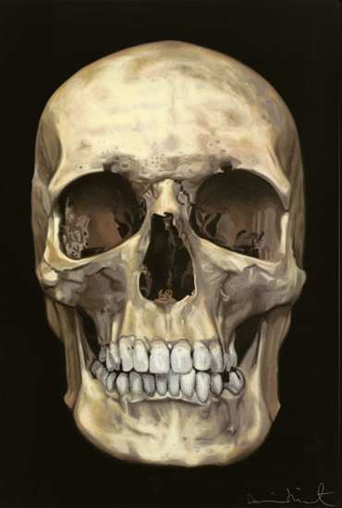
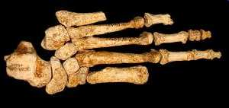
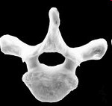
Which is a long bone, flat bone, irregular bone, and short bone?
B
Short Bone
D
Flat Bone
Long
Bone
A
C
Irregular Bone
Copyright © 2010 Ryan P. Murphy

Slide 16
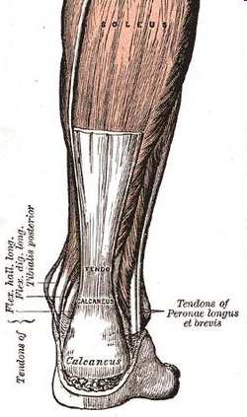
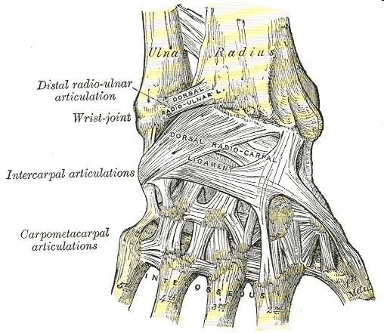
Name the two important connective tissues shown in the pictures below.
A
B
Copyright © 2010 Ryan P. Murphy

Slide 17
4
A
B
C
D

Slide 18
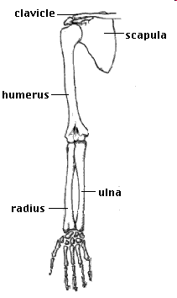
Please name the following bones in the picture below?
A
8
B
D
C
Copyright © 2010 Ryan P. Murphy

Slide 19
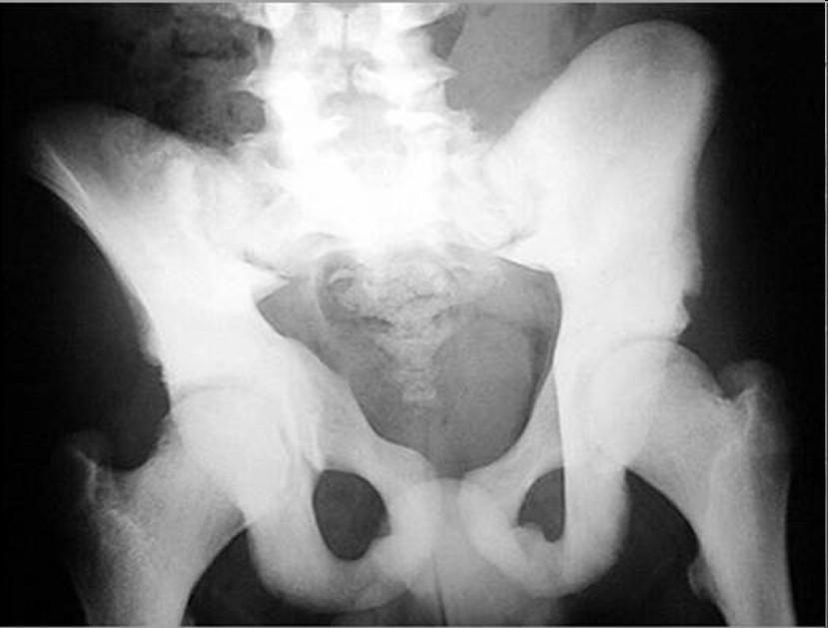
Please identify which letter below are long bones, flat bones, and irregular bones.
A
B
C
Copyright © 2010 Ryan P. Murphy

Slide 20
Please identify which letter below are long bones, flat bones, and irregular bones.
A
10
B
1 bonus point each if you can identify each bone (A, B, C)
C
Copyright © 2010 Ryan P. Murphy

Slide 21
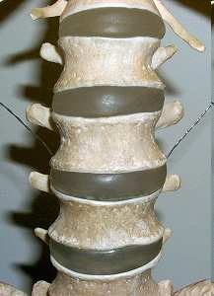
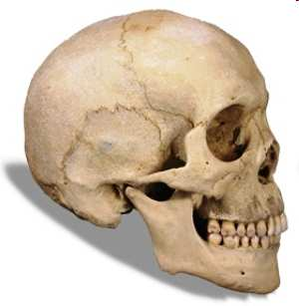
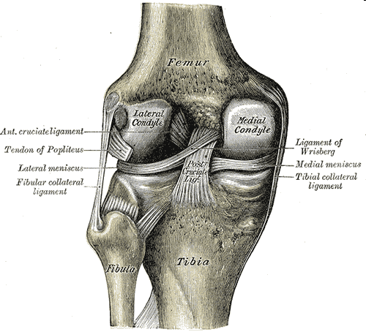
10
Which Joint is the following?
Fibrous (immovable)
Cartilagenous (partially movable)
Synovial (freely movable)
A
B
C
Copyright © 2010 Ryan P. Murphy

Slide 22
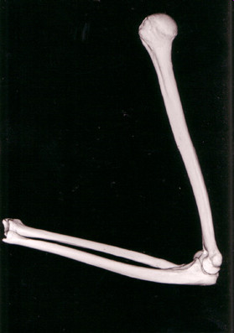
Please name the type of joint shown below?
11
Copyright © 2010 Ryan P. Murphy

Slide 23
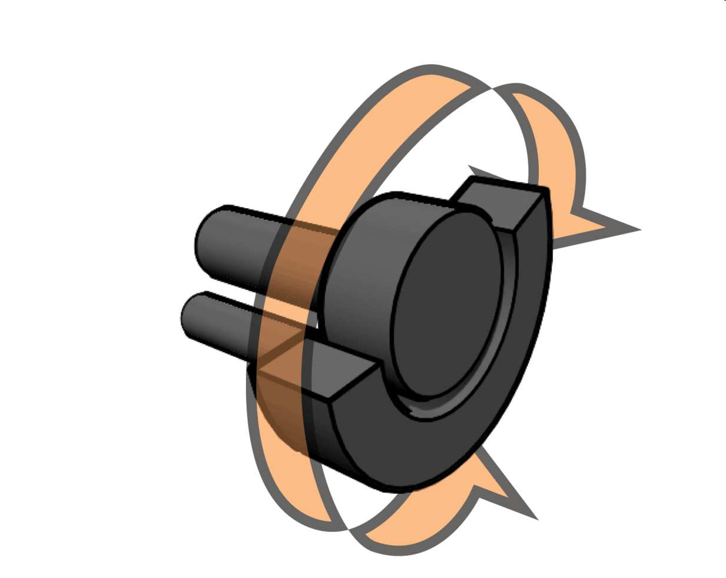
Please name the type of joint shown below?
12
Copyright © 2010 Ryan P. Murphy

Slide 24
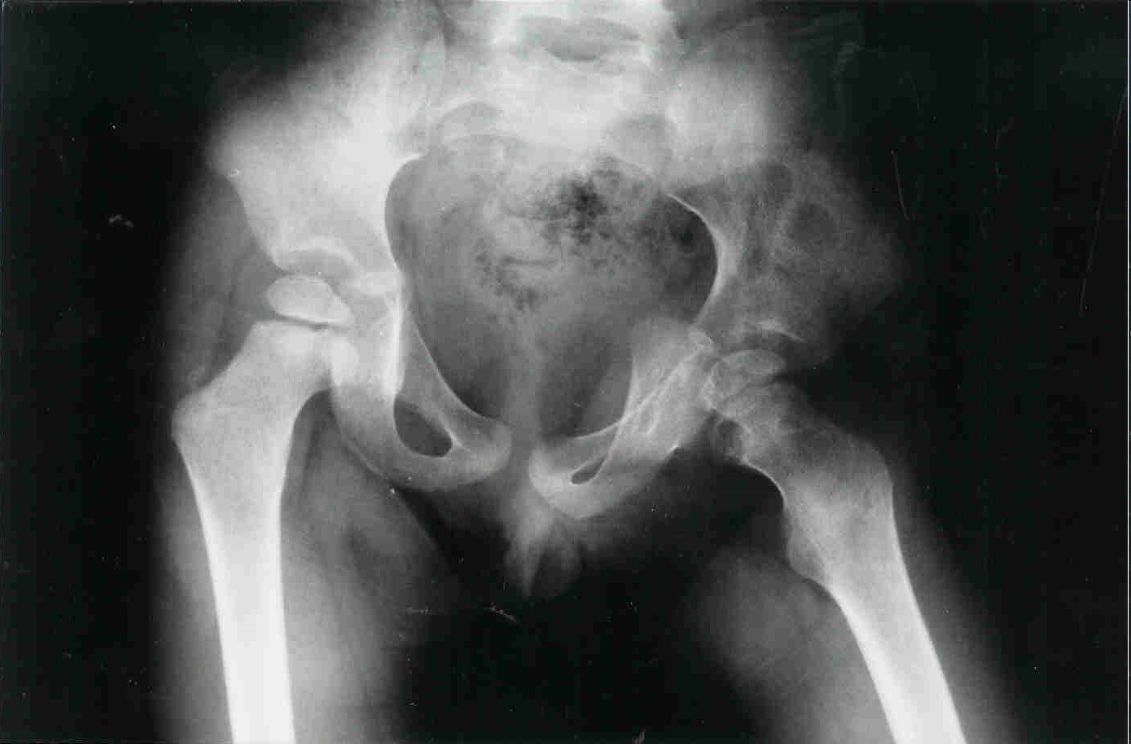
Please name the type of joint shown below?
*13
Copyright © 2010 Ryan P. Murphy

Slide 25
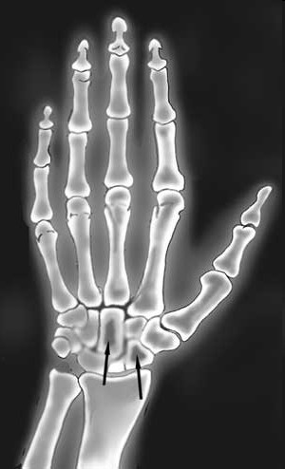
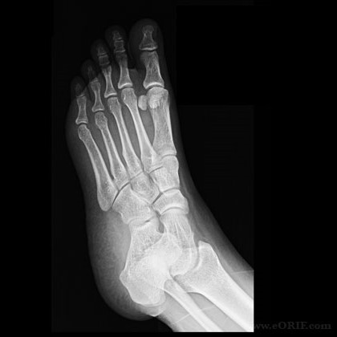
Please name the two types of joints shown below?
A
B
Copyright © 2010 Ryan P. Murphy

Slide 26
Name the character from this movie?
Jack Sparrow
*25
*15
Copyright © 2010 Ryan P. Murphy

Slide 27
1-10 Skeletal System Quiz (10 pts each)
With 5 Bonus Questions (2 pts each)
ANSWERS

Slide 28
Bone Cells perform all of the following jobs except…
A.) Make new bone and help repair damage.
B.) Carry nutrients and waste products to and from blood vessels in the bone.
C.) Allows muscle fibers to contract and relax.
D.) Break down bone and help to sculpt and shape it.
Copyright © 2010 Ryan P. Murphy

Slide 29
Bone Cells perform all of the following jobs except…
A.) Make new bone and help repair damage.
B.) Carry nutrients and waste products to and from blood vessels in the bone.
C.) Allows muscle fibers to contract and relax.
D.) Break down bone and help to sculpt and shape it.
Copyright © 2010 Ryan P. Murphy

Slide 30
Bone Cells perform all of the following jobs except…
A.) Make new bone and help repair damage.
B.) Carry nutrients and waste products to and from blood vessels in the bone.
C.) Allows muscle fibers to contract and relax.
D.) Break down bone and help to sculpt and shape it.
Copyright © 2010 Ryan P. Murphy

Slide 31
Bone Cells perform all of the following jobs except…
A.) Make new bone and help repair damage.
B.) Carry nutrients and waste products to and from blood vessels in the bone.
C.) Make muscle fibers contract and relax.
D.) Break down bone and help to sculpt and shape it.
Copyright © 2010 Ryan P. Murphy

Slide 32
Bone Cells perform all of the following jobs except…
A.) Make new bone and help repair damage.
B.) Carry nutrients and waste products to and from blood vessels in the bone.
C.) Make muscle fibers contract and relax.
D.) Break down bone and help to sculpt and shape it.
Copyright © 2010 Ryan P. Murphy

Slide 33
Bone Cells perform all of the following jobs except…
A.) Make new bone and help repair damage.
B.) Carry nutrients and waste products to and from blood vessels in the bone.
C.) Make muscle fibers contract and relax.
D.) Break down bone and help to sculpt and shape it.
and the answer is…
Copyright © 2010 Ryan P. Murphy

Slide 34
Bone Cells perform all of the following jobs except…
A.) Make new bone and help repair damage.
B.) Carry nutrients and waste products to and from blood vessels in the bone.
C.) Make muscle fibers contract and relax.
D.) Break down bone and help to sculpt and shape it.
and the answer is…
Copyright © 2010 Ryan P. Murphy

Slide 35
What’s the soft fatty substance in the cavities of bones in which blood cells are produced?

Slide 36
What’s the soft fatty substance in the cavities of bones in which blood cells are produced?
Bone Marrow

Slide 37
What’s the soft fatty substance in the cavities of bones in which blood cells are produced?
Bone Marrow
Red =

Slide 38
What’s the soft fatty substance in the cavities of bones in which blood cells are produced?
Bone Marrow
Red = Creates Blood Cell

Slide 39
What’s the soft fatty substance in the cavities of bones in which blood cells are produced?
Bone Marrow
Red = Creates Blood Cell
Yellow =

Slide 40
What’s the soft fatty substance in the cavities of bones in which blood cells are produced?
Bone Marrow
Red = Creates Blood Cell
Yellow = Fatty

Slide 41
The Skeletal System performs all of the following jobs except for…
A.) Provides the shape and form.
B.) Supports.
C.) Protects.
D.) Produces blood.
E.) Provides Oxygen
F.) Allows movement.
G.) Stores minerals
Copyright © 2010 Ryan P. Murphy

Slide 42
The Skeletal System performs all of the following jobs except for…
A.) Provides the shape and form.
B.) Supports.
C.) Protects.
D.) Produces blood.
E.) Provides Oxygen
F.) Allows movement.
G.) Stores minerals
Copyright © 2010 Ryan P. Murphy

Slide 43
The Skeletal System performs all of the following jobs except for…
A.) Provides the shape and form.
B.) Supports.
C.) Protects.
D.) Produces blood.
E.) Provides Oxygen
F.) Allows movement.
G.) Stores minerals
Copyright © 2010 Ryan P. Murphy

Slide 44
The Skeletal System performs all of the following jobs except for…
A.) Provides the shape and form.
B.) Supports.
C.) Protects.
D.) Produces blood.
E.) Provides Oxygen
F.) Allows movement.
G.) Stores minerals
Copyright © 2010 Ryan P. Murphy

Slide 45
The Skeletal System performs all of the following jobs except for…
A.) Provides the shape and form.
B.) Supports.
C.) Protects.
D.) Produces blood.
E.) Provides Oxygen
F.) Allows movement.
G.) Stores minerals
Copyright © 2010 Ryan P. Murphy

Slide 46
The Skeletal System performs all of the following jobs except for…
A.) Provides the shape and form.
B.) Supports.
C.) Protects.
D.) Produces blood.
E.) Provides Oxygen
F.) Allows movement.
G.) Stores minerals
Copyright © 2010 Ryan P. Murphy

Slide 47
The Skeletal System performs all of the following jobs except for…
A.) Provides the shape and form.
B.) Supports.
C.) Protects.
D.) Produces blood.
E.) Provides Oxygen
F.) Allows movement.
G.) Stores minerals
Copyright © 2010 Ryan P. Murphy

Slide 48
The Skeletal System performs all of the following jobs except for…
A.) Provides the shape and form.
B.) Supports.
C.) Protects.
D.) Produces blood.
E.) Provides Oxygen
F.) Allows movement.
G.) Stores minerals
Copyright © 2010 Ryan P. Murphy

Slide 49
The Skeletal System performs all of the following jobs except for…
A.) Provides the shape and form.
B.) Supports.
C.) Protects.
D.) Produces blood.
E.) Provides Oxygen
F.) Allows movement.
G.) Stores minerals
answer is…
Copyright © 2010 Ryan P. Murphy

Slide 50
The Skeletal System performs all of the following jobs except for…
A.) Provides the shape and form.
B.) Supports.
C.) Protects.
D.) Produces blood.
E.) Provides Oxygen
F.) Allows movement.
G.) Stores minerals
answer is…
Copyright © 2010 Ryan P. Murphy

Slide 51
Which skeleton is the axial, and which is the appendicular?
A
B

Slide 52
Which skeleton is the axial, and which is the appendicular?
A
B

Slide 53
Which skeleton is the axial, and which is the appendicular?
A
B
Axial

Slide 54
Which skeleton is the axial, and which is the appendicular?
A
B
Axial

Slide 55
Which skeleton is the axial, and which is the appendicular?
A
B
Appendicular
Axial

Slide 56
Which skeleton is the axial, and which is the appendicular?
A
B
Appendicular
Axial

Slide 57
Which skeleton is the axial, and which is the appendicular?
A
B
Appendicular
Axial

Slide 58
Which skeleton is the axial, and which is the appendicular?
A
B
Appendicular
Axial

Slide 59
Which is a long bone, flat bone, irregular bone, and short bone?
B
Short Bone
D
Flat Bone
Long
Bone
A
C
Irregular Bone
Copyright © 2010 Ryan P. Murphy

Slide 60
B
Short Bone
D
Flat Bone
Long
Bone
A
C
Irregular Bone
Copyright © 2010 Ryan P. Murphy

Slide 61
B
Short Bone
D
Flat Bone
Long
Bone
A
C
Irregular Bone
Copyright © 2010 Ryan P. Murphy

Slide 62
B
Short Bone
D
Flat Bone
Long
Bone
A
C
Irregular Bone
Copyright © 2010 Ryan P. Murphy

Slide 63
?
B
Short Bone
D
Flat Bone
Long
Bone
A
C
Irregular Bone
Copyright © 2010 Ryan P. Murphy

Slide 64
Which is a long bone, flat bone, irregular bone, and short bone?
Long Bone
B
Short Bone
D
Flat Bone
Long
Bone
A
C
Irregular Bone
Copyright © 2010 Ryan P. Murphy

Slide 65
?
B
Short Bone
D
Flat Bone
Long
Bone
A
C
Irregular Bone
Copyright © 2010 Ryan P. Murphy

Slide 66
B
Short Bone
D
Flat Bone
Long
Bone
A
C
Irregular Bone
Copyright © 2010 Ryan P. Murphy

Slide 67
?
B
Short Bone
D
Flat Bone
Long
Bone
A
C
Irregular Bone
Copyright © 2010 Ryan P. Murphy

Slide 68
Name the two important connective tissues shown in the pictures below.
A
B
Copyright © 2010 Ryan P. Murphy

Slide 69
Name the two important connective tissues shown in the pictures below.
A
B
Copyright © 2010 Ryan P. Murphy

Slide 70
Name the two important connective tissues shown in the pictures below.
A
B
T
TENDON
Copyright © 2010 Ryan P. Murphy

Slide 71
Name the two important connective tissues shown in the pictures below.
A
B
T
TENDON
Copyright © 2010 Ryan P. Murphy

Slide 72
Name the two important connective tissues shown in the pictures below.
A
B
T
L
TENDON
LIGAMENT
Copyright © 2010 Ryan P. Murphy

Slide 73
Name the two important connective tissues shown in the pictures below.
A
B
T
L
TENDON
LIGAMENT
Copyright © 2010 Ryan P. Murphy

Slide 74
4
A
B
C
D

Slide 75
4
A
B
C
D

Slide 76
4
A
Fibula
B
C
D

Slide 77
4
A
Fibula
B
C
D

Slide 78
4
A
Fibula
B
Tibia
C
D

Slide 79
4
A
Fibula
B
Tibia
C
D

Slide 80
4
A
Fibula
B
Tibia
Tarsals
C
D

Slide 81
4
A
Fibula
B
Tibia
Tarsals
C
D

Slide 82
4
A
Fibula
B
Tibia
Tarsals
C
Metatarsals
D

Slide 83
Please name the following bones in the picture below?
A
8
B
D
C
Copyright © 2010 Ryan P. Murphy

Slide 84
Please name the following bones in the picture below?
A
8
B
D
C
Copyright © 2010 Ryan P. Murphy

Slide 85
Please name the following bones in the picture below?
A
8
B
D
C
Copyright © 2010 Ryan P. Murphy

Slide 86
Please name the following bones in the picture below?
A
A
8
B
D
C
Copyright © 2010 Ryan P. Murphy

Slide 87
Please name the following bones in the picture below?
A
A
8
B
D
C
Copyright © 2010 Ryan P. Murphy

Slide 88
Please name the following bones in the picture below?
A
A
8
B
D
C
Copyright © 2010 Ryan P. Murphy

Slide 89
Please name the following bones in the picture below?
A
A
8
B
D
C
Copyright © 2010 Ryan P. Murphy

Slide 90
Please name the following bones in the picture below?
A
A
8
B
D
C
Copyright © 2010 Ryan P. Murphy

Slide 91
Please name the following bones in the picture below?
A
A
8
B
D
C
Copyright © 2010 Ryan P. Murphy

Slide 92
Please name the following bones in the picture below?
A
A
E
8
B
D
C
Copyright © 2010 Ryan P. Murphy

Slide 93
Please name the following bones in the picture below?
A
A
E
8
B
D
C
Copyright © 2010 Ryan P. Murphy

Slide 94
Please name the following bones in the picture below?
A
A
E
8
B
D
C
Copyright © 2010 Ryan P. Murphy

Slide 95
Please identify which letter below are long bones, flat bones, and irregular bones.
A
B
C
Copyright © 2010 Ryan P. Murphy

Slide 96
Please identify which letter below are long bones, flat bones, and irregular bones.
A
10
B
1 bonus point each if you can identify each bone (A, B, C)
C
Copyright © 2010 Ryan P. Murphy

Slide 97
Please identify which letter below are long bones, flat bones, and irregular bones.
A
10
B
C
Copyright © 2010 Ryan P. Murphy

Slide 98
Please identify which letter below are long bones, flat bones, and irregular bones.
A Irregular
10
B
C
Copyright © 2010 Ryan P. Murphy

Slide 99
Please identify which letter below are long bones, flat bones, and irregular bones.
A Irregular
10
B
C
Copyright © 2010 Ryan P. Murphy

Slide 100
Please identify which letter below are long bones, flat bones, and irregular bones.
A Irregular
10
B Flat Bones
C
Copyright © 2010 Ryan P. Murphy

Slide 101
Please identify which letter below are long bones, flat bones, and irregular bones.
A Irregular
10
B Flat Bones
C
Copyright © 2010 Ryan P. Murphy

Slide 102
Please identify which letter below are long bones, flat bones, and irregular bones.
A Irregular
10
B Flat Bones
C Long Bones
Copyright © 2010 Ryan P. Murphy

Slide 103
Please identify which letter below are long bones, flat bones, and irregular bones.
A Irregular
10
B Flat Bones
C Long Bones
Copyright © 2010 Ryan P. Murphy

Slide 104
Please identify which letter below are long bones, flat bones, and irregular bones.
A Irregular
10
*Vertebrae
B Flat Bones
C Long Bones
Copyright © 2010 Ryan P. Murphy

Slide 105
Please identify which letter below are long bones, flat bones, and irregular bones.
A Irregular
10
*Vertebrae
B Flat Bones
C Long Bones
Copyright © 2010 Ryan P. Murphy

Slide 106
Please identify which letter below are long bones, flat bones, and irregular bones.
A Irregular
10
*Vertebrae
B Flat Bones
*Pelvis
C Long Bones
Copyright © 2010 Ryan P. Murphy

Slide 107
Please identify which letter below are long bones, flat bones, and irregular bones.
A Irregular
10
*Vertebrae
B Flat Bones
*Pelvis
C Long Bones
Copyright © 2010 Ryan P. Murphy

Slide 108
Please identify which letter below are long bones, flat bones, and irregular bones.
A Irregular
10
*Vertebrae
B Flat Bones
*Pelvis
C Long Bones
*Femur
Copyright © 2010 Ryan P. Murphy

Slide 109
10
Which Joint is the following?
Fibrous (immovable)
Cartilagenous (partially movable)
Synovial (freely movable)
A
B
C
Copyright © 2010 Ryan P. Murphy

Slide 110
10
Which Joint is the following?
Fibrous (immovable)
Cartilagenous (partially movable)
Synovial (freely movable)
A
B
C
Copyright © 2010 Ryan P. Murphy

Slide 111
10
Which Joint is the following?
Fibrous (immovable)
Cartilagenous (partially movable)
Synovial (freely movable)
A
B
C
Cartilagenous
Copyright © 2010 Ryan P. Murphy

Slide 112
10
Which Joint is the following?
Fibrous (immovable)
Cartilagenous (partially movable)
Synovial (freely movable)
A
B
C
Cartilagenous
Copyright © 2010 Ryan P. Murphy

Slide 113
10
Which Joint is the following?
Fibrous (immovable)
Cartilagenous (partially movable)
Synovial (freely movable)
A
B
C
Fibrous
Cartilagenous
Copyright © 2010 Ryan P. Murphy

Slide 114
10
Which Joint is the following?
Fibrous (immovable)
Cartilagenous (partially movable)
Synovial (freely movable)
A
B
C
Fibrous
Cartilagenous
Copyright © 2010 Ryan P. Murphy

Slide 115
10
Which Joint is the following?
Fibrous (immovable)
Cartilagenous (partially movable)
Synovial (freely movable)
A
B
C
Fibrous
Cartilagenous
Synovial
Copyright © 2010 Ryan P. Murphy

Slide 116
Please name the type of joint shown below?
11
Copyright © 2010 Ryan P. Murphy

Slide 117
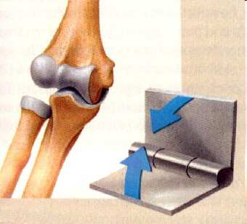
Please name the type of joint shown below?
11
Copyright © 2010 Ryan P. Murphy

Slide 118
Please name the type of joint shown below?
11
Hinge
Joint
Copyright © 2010 Ryan P. Murphy

Slide 119
Please name the type of joint shown below?
11
Joint
Hinge
Copyright © 2010 Ryan P. Murphy

Slide 120
Please name the type of joint shown below?
11
Joint
Hinge
Copyright © 2010 Ryan P. Murphy

Slide 121
Please name the type of joint shown below?
11
Joint
Hinge
Copyright © 2010 Ryan P. Murphy

Slide 122
Please name the type of joint shown below?
11
Hinge
Joint
Copyright © 2010 Ryan P. Murphy

Slide 123
Please name the type of joint shown below?
11
Joint
Hinge
Copyright © 2010 Ryan P. Murphy

Slide 124
Please name the type of joint shown below?
11
Joint
Hinge
Copyright © 2010 Ryan P. Murphy

Slide 125
Please name the type of joint shown below?
11
Joint
Hinge
Copyright © 2010 Ryan P. Murphy

Slide 126
Please name the type of joint shown below?
11
Hinge
Joint
Copyright © 2010 Ryan P. Murphy

Slide 127
Please name the type of joint shown below?
11
Joint
Hinge
Copyright © 2010 Ryan P. Murphy

Slide 128
Please name the type of joint shown below?
11
Joint
Hinge
Copyright © 2010 Ryan P. Murphy

Slide 129
Please name the type of joint shown below?
12
Copyright © 2010 Ryan P. Murphy

Slide 130
Please name the type of joint shown below?
12
Copyright © 2010 Ryan P. Murphy

Slide 131
Please name the type of joint shown below?
Pivot Joint
Copyright © 2010 Ryan P. Murphy

Slide 132
Please name the type of joint shown below?
Pivot Joint
Copyright © 2010 Ryan P. Murphy

Slide 133
Please name the type of joint shown below?
*13
Copyright © 2010 Ryan P. Murphy

Slide 134
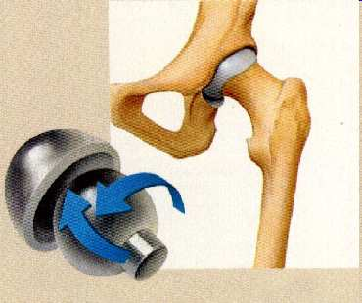
Please name the type of joint shown below?
*13
Ball and Socket
Copyright © 2010 Ryan P. Murphy

Slide 135
Please name the two types of joints shown below?
A
B
Copyright © 2010 Ryan P. Murphy

Slide 136
Please name the two types of joints shown below? 1 Bonus Point each to name the bones.
A
B
Copyright © 2010 Ryan P. Murphy

Slide 137
Please name the two types of joints shown below?
A
B
Copyright © 2010 Ryan P. Murphy

Slide 138
Please name the two types of joints shown below? A = Saddle
A Saddle
B
Copyright © 2010 Ryan P. Murphy

Slide 139
Please name the two types of joints shown below? A = Saddle
A Saddle
B
Copyright © 2010 Ryan P. Murphy

Slide 140
Please name the two types of joints shown below? A = Saddle B = Gliding Joint
A Saddle
B
Copyright © 2010 Ryan P. Murphy

Slide 141
Please name the two types of joints shown below? A = Saddle B = Gliding Joint
A Saddle
B
Copyright © 2010 Ryan P. Murphy

Slide 142
Please name the two types of joints shown below? A = Saddle B = Gliding Joint
A Saddle
B
Copyright © 2010 Ryan P. Murphy

Slide 143
Please name the two types of joints shown below? A = Saddle B = Gliding Joint
A Saddle
B
*Metacarpals
Copyright © 2010 Ryan P. Murphy

Slide 144
Please name the two types of joints shown below? A = Saddle B = Gliding Joint
A Saddle
B
*Metacarpals
Copyright © 2010 Ryan P. Murphy

Slide 145
Please name the two types of joints shown below? A = Saddle B = Gliding Joint
A Saddle
B
*Metacarpals
*Metatarsals
Copyright © 2010 Ryan P. Murphy

Slide 146
Please name the two types of joints shown below? A = Saddle B = Gliding Joint
A Saddle
B
*Metacarpals
*Metatarsals
Copyright © 2010 Ryan P. Murphy

Slide 147
Name the character from this movie?
Jack Sparrow
*25
*15
Copyright © 2010 Ryan P. Murphy

Slide 148
Name the character from this movie?
Jack Sparrow
*25
“My Metacarpals look weird in this light.”
*15
Copyright © 2010 Ryan P. Murphy

Slide 149
Name the character from this movie?
Jack Sparrow
*25
Jack Sparrow
“My Metacarpals look weird in this light.”
*15
Copyright © 2010 Ryan P. Murphy

Slide 150
1-10 Skeletal System Quiz (10 pts each)
With 5 Bonus Questions (2 pts each)
Grade arrgh emm papers and pass em to the bow.

Slide 151
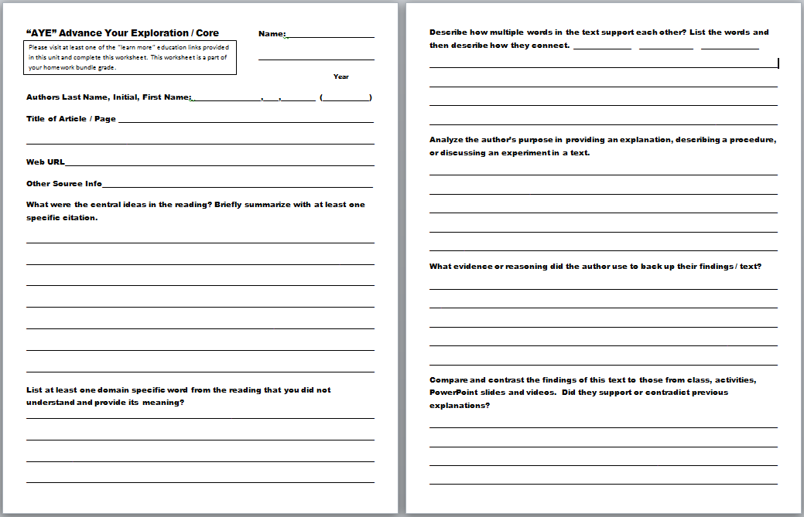
“AYE” Advance Your Exploration ELA and Literacy Opportunity Worksheet
Visit some of the many provided links or..
Articles can be found at (w/ membership to NABT and NSTA)
http://www.nabt.org/websites/institution/index.php?p=1
http://learningcenter.nsta.org/browse_journals.aspx?journal=tst
Please visit at least one of the “learn more” educational links provided in this unit and complete this worksheet.

Slide 152
“AYE” Advance Your Exploration ELA and Literacy Opportunity Worksheet
Visit some of the many provided links or..
Articles can be found at (w/ membership to NABT and NSTA)
http://www.nabt.org/websites/institution/index.php?p=1
http://learningcenter.nsta.org/browse_journals.aspx?journal=tst

Slide 153
The Skeletal System

Slide 154
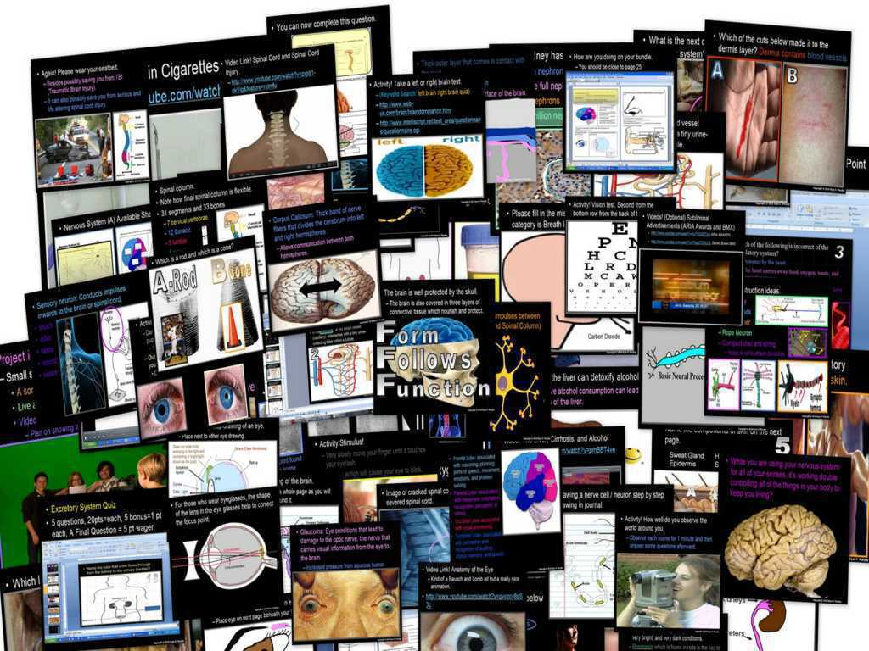
Human Body and
Health Topics Unit

Slide 155
Human Body and
Health Topics Unit
Areas of focus: Form Follows Function concept spread throughout. Levels of biological organization, cell basics, cells of the body, tissues, organs, organ systems, homeostasis, functions of the skeletal system, categories of bones, marrow, bones of the human body, bone disease, types of joints, muscular system, connective tissues, ligaments, tendons, muscles and energy use, types of muscle tissue, muscle fibers and movement, common muscles, biological molecules and important nutrients to the body (extensive), learning the contents of junk food, calories, obesity, fast food, eating disorders, anabolic steroids, digestive system, mechanical and chemical digestion, taste, enzymes, swallowing reflex, esophagus and peristalsis, organs of the GI Tract, focus on chemical digestion, duodenum, stomach, pancreas, liver, gall bladder, small intestine, villi and surface area, large intestine, appendix, rectum, cardiovascular system, cellular respiration, functions of the circulatory system, movement of blood, focus on the heart, blood vessels, cardiovascular disease, contents of blood, blood types, functions of the respiratory system, the nose, epiglottis, larynx and vocal cords, trachea, bronchus, lungs, alveoli, diaphragm, lung capacity, dangers of smoking, cancer, how to avoid cancer, skin cancer, what's inside a cigarette, smoking and advertising, excretory system, kidneys, urine, inside the nephron, ureters, bladder, urethra, kidney's role in detoxifying, cirrhosis of the liver, integumentary system (skin), functions of the skin, anatomy of skin, fingerprints, nervous system, stimulus, anatomy of a neuron, types of neurons, voluntary and involuntary functions, central and peripheral nervous systems, regions of the brain and roles, right brain vs. left brain, spinal cord injuries, anatomy of the eye and sight, lenses, rods and cones, night vision, anatomy of the nose and smell, dangers of inhalants, anatomy of the ear and hearing, noise induced hearing loss, sense of touch, the adolescent brain -whoa!, lobes of the brain, endocrine system, glands, hormones, activities in your body, endocrine system vs. nervous system, exocrine glands, puberty, body stability, parenting, male and female reproductive systems, sex cells, chromosomes, fertilization, menstrual cycle, placenta, embryo development, dangers of smoking and drinking while pregnant, immune system, diseases, how diseases are spread, the immune response, parasites, vaccines, virus prevention, HIV, HIV transmission, abstinence vs. prevention, AIDS, STD's, and much more. (8,500 Slides)

Slide 156
Human Body and
Health Topics Unit
Human Body Systems and Health Topics Unit on TpT
Hundreds of PowerPoint samples, the bundled homework package, unit notes, and much more can be previewed at…
Human Body and Health Topics Unit Preview Link
Anatomy Intro, Levels of Biological Organization Lesson Bundle
Skeletal System Lesson Bundle
Muscular System Lesson Bundle
Anatomy Intro, Skeletal, Muscular System Review Game
Healthy Eating, Molecules of Life Lesson Bundle
Obesity, Dangers of Fast Food, Eating Disorders
Healthy Eating and Living Review Game
Eating Disorders, Anabolic Steroids
Digestive System Lesson Bundle
Circulatory System and Respiratory System Lesson Bundle
Anti-Tobacco, Dangers of Smoking Lesson Bundle
Circulatory and Respiratory System Review Game
Excretory System Lesson Bundle
Nervous System Lesson Bundle
Nervous System Review Game
Endocrine System Lesson Bundle, Puberty, Hormones
Human Reproductive Lesson Bundle, Fertilization
Endocrine and Reproductive System Review Game
Immune System, HIV, AIDS, STD's Lesson Bundle
Immune System, HIV, AIDS, STD's Review Game
Anatomy Crossword Puzzle

Slide 157
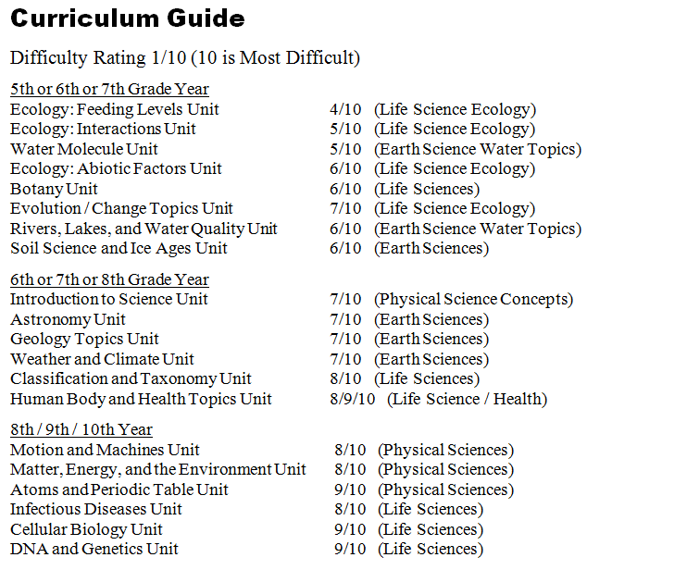

Slide 158
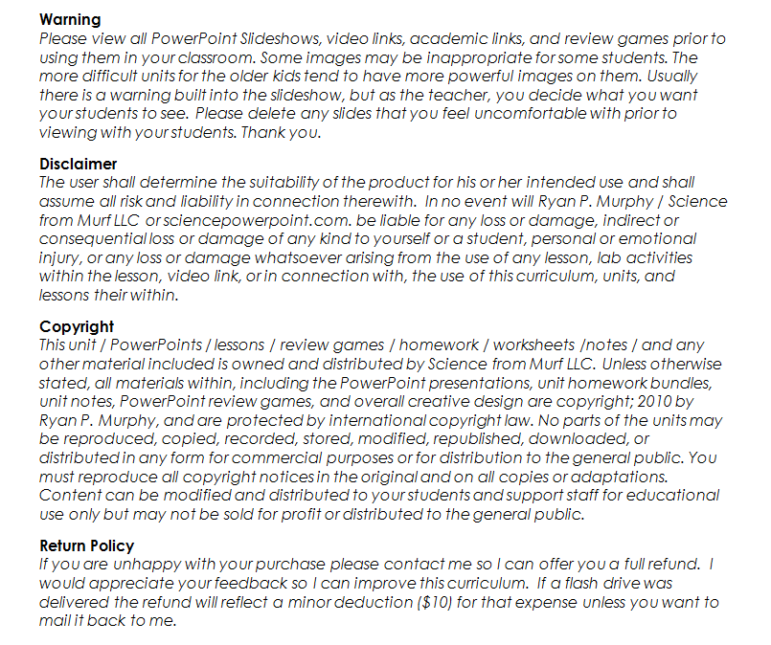

Slide 159
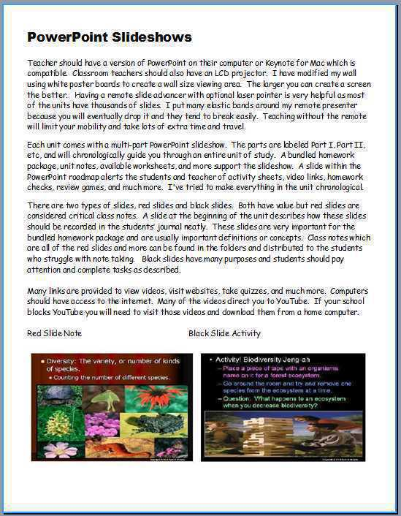
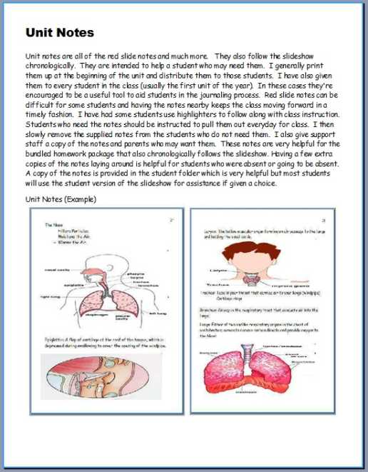
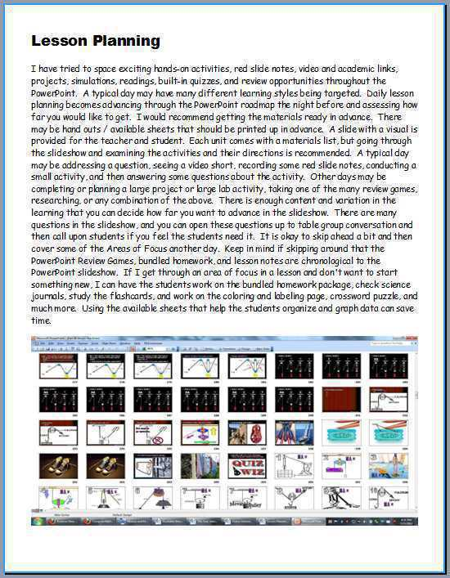
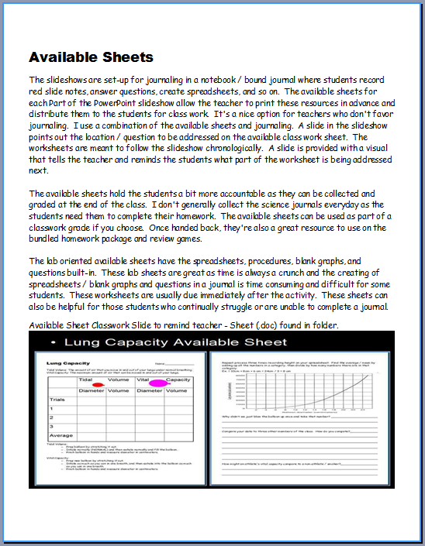
Please open the welcome / guide document on each unit preview.
This document will describe how to utilize these resources in your classroom and provide some curriculum possibilities.

Slide 160
This was a very brief tour. Please visit the links below to learn more and download detailed previews of the curriculum.
These units take me an extremely busy four years to complete with my middle level students.
Earth Science Unit Previews | Extended Tour Link and Curriculum Guide
Geology Topics Unit | Geology Topics Unit Preview Link
Astronomy Topics Unit | Astronomy Unit Preview Link
Weather and Climate Unit | Weather and Climate Unit Preview Link
Soil Science, Weathering, More | Weathering, Soil Science, Ice Ages, Glaciers Unit Preview Link
Water Unit | Water Unit Preview Link
Rivers Unit | Rivers, Lakes, and Water Quality Unit Preview Link
= Easier = More Difficult = Most Difficult
(5th – 7th grade) (6th – 8th grade) (8th – 10th grade)

Slide 161
Physical Science Unit Previews | Extended Tour Link and Curriculum Guide
Science Skills Unit | Science Skills Unit Preview Link
Motion and Machines Unit | Laws of Motion and Simple Machines Unit Preview Link
Matter, Energy, Envs. Unit | Matter, Energy, and the Environment Unit Preview
Atoms and Periodic Table Unit | Atoms and Periodic Table of the Elements Unit Preview Link
Life Science Unit Previews | Extended Tour Link and Curriculum Guide
Human Body / Health Topics | Human Body and Health Topics Unit Preview Link
DNA and Genetics Unit | DNA and Genetics Unit Preview Link
Cell Biology Unit | Cell Biology Unit Preview Link
Infectious Diseases Unit | Infectious Diseases Unit Preview Link
Taxonomy and Classification Unit | Taxonomy and Classification Unit Preview Link
Evolution / Natural Selection Unit | Evolution and Natural Selection Unit Preview Link
Botany Topics Unit | Botany Unit Preview Link
Ecology Feeding Levels Unit | Ecology Feeding Levels Unit Preview Link
Ecology Interactions Unit | Ecology Interactions Unit Preview Link
Ecology Abiotic Factors Unit | Ecology Abiotic Factors Unit Preview Link

Slide 162
Life Science Curriculum Link
Physical Science Curriculum Link
Earth Science Curriculum Link

Slide 163
Life Science Curriculum Link
Individual Lessons on TpT
Human Body Systems and Health Topics Unit
Anatomy Intro, Levels of Biological Organization Lesson Bundle
Skeletal System Lesson Bundle
Muscular System Lesson Bundle
Anatomy Intro, Skeletal, Muscular System Review Game
Healthy Eating, Molecules of Life Lesson Bundle
Obesity, Dangers of Fast Food, Eating Disorders
Healthy Eating and Living Review Game
Eating Disorders, Anabolic Steroids
Digestive System Lesson Bundle
Circulatory System and Respiratory System Lesson Bundle
Anti-Tobacco, Dangers of Smoking Lesson Bundle
Circulatory and Respiratory System Review Game
Excretory System Lesson Bundle
Nervous System Lesson Bundle
Nervous System Review Game
Endocrine System Lesson Bundle, Puberty, Hormones
Human Reproductive Lesson Bundle, Fertilization
Endocrine and Reproductive System Review Game
Immune System, HIV, AIDS, STD's Lesson Bundle
Immune System, HIV, AIDS, STD's Review Game
Anatomy Crossword Puzzle
DNA and Genetics Unit
DNA Lesson Bundle
DNA Lesson Review Game
DNA Crossword Puzzle
Cell Division, Mitosis and Meiosis Lesson Bundle
Cell Division Review Game
Mitosis and Meiosis Crossword Puzzle
Genetics Lesson Bundle
DNA and Genetics Crossword Puzzle
Genetics Review Game
Cellular Biology Unit
Introduction to Cells, Cell History, Cheek and Onion Cell Lab, Cell
Theory Lesson Bundle
Cell Review Game
Cell Transport Lesson Bundle, Osmosis, Diffusion, Active Transport
Cell Transport Review Game
Characteristics of Life Lesson
Cellular Organelles Lesson Bundle
Cellular Organelles Visual Quiz
Cellular Organelles Review Game
Cell Unit Crossword Puzzle
Cell Unit Flash Cards
Cellular Biology Unit Preview, Homework Bundle, Unit Notes, more
Life Science

Slide 164
Life Science Curriculum Link
Individual Lessons on TpT
Infectious Diseases Unit
Infectious Diseases Unit Intro and Virus Lesson Bundle
Virus Lesson Review Game
Bacteria Lesson Bundle
Bacteria Review Game
Parasites Lesson Bundle
Immune System, HIV, AIDS, STD's Lesson Bundle
Infectious Diseases Unit Crossword Puzzle
Immune System, HIV, AIDS, STD's Review Game
Evolution and Natural Selection
Evolution and Natural Selection Lesson Bundle
Evolution and Natural Selection Review Game
Human Evolution Lesson Bundle
Life Origins and Human Evolution Quiz Game
Geologic Timescale, Earth System History Lesson Bundle
Earth Geologic History Quiz Game
Life Origins and Human Evolution Quiz Game Life Origins, Miller Urey Experiment Lesson Bundle
Ecological Succession Lesson Bundle
Ecological Succession Review Game
Taxonomy and Classification Unit
Taxonomy and Classification Lesson Bundle
Taxonomy and Classification Review Game
Bacteria Lesson Bundle
Bacteria Review Game
Kingdom Protista Lesson Bundle
Kingdom Animal Lesson Bundle
Animal Phylums Visual Quiz
Class Mammalia Lesson Bundle
Kingdom Animalia Review Game and Mammalia
Kingdom Fungi Lesson Bundle
Kingdom Fungi Review Game
Kingdom Plantae Lesson Bundle
Botany Unit Review Game
Name the Kingdom, Phylum, Class Visual Challenge
Taxonomy and Classification Crossword Puzzle
Botany Unit
Botany Unit Intro, Non-vascular Plants, Plate Evolution Lesson Bundle
Student Botany Projects, Grow Study Lesson Bundle
Botany Unit Review Game
Plants, Seeds, Seed Dispersal Lesson Bundle
Plants Review Game
Plants, Roots, Leaves, Lesson Bundle
Monocotyledons and Dicotyledons Lesson Bundle
Dendrochronology, Tree Ring Dating Lesson Bundle
Plant Hormones Lesson Bundle
Botany Unit Crossword Puzzle
Leaf Identification Lesson Bundle
Botany Unit Review Game
Plant Life Cycles, Flowers, Fruits Lesson Bundle
Plant Life Cycles, Flowers, Fruits Review Game

Slide 165
Life Science Curriculum Link
Individual Lessons on TpT
Ecology Feeding Levels Unit
Ecology Food Chain Lesson Bundle
Biomagnification, Bioaccumulation of Pollution, Food Chain Lesson Bundle
Ecology Feeding Levels, Pyramid of Biomass, Number Lesson Bundle
Animal Dentition Lesson Bundle
Ecology Feeding Levels Unit Review Game
Ecology Feeding Levels Unit Crossword
Food Chain Board Game
Ecology Abiotic Factors Unit
Ecology Non-living Factors, Light Lesson Bundle
Ecology, Non-living Factor Temperature Lesson Bundle
Photosynthesis and Respiration, Biogeochemical Cycles Lesson Bundle
Ecology Non-living Factors Quiz Game
Island Biogeography Lesson Bundle
Nitrogen Cycle Lesson Bundle
Phosphorus Cycle and Nutrient Pollution Lesson Bundle
Plant Succession, Fire Ecology, Lesson Bundle
Ecological Succession Quiz Game
Ecology Flash Cards
Ecology Interactions Unit
Ecology Levels of Organization Lesson Bundle
Animal Habitats Lesson Bundle
Food Webs, Predator and Prey Cycles Lesson Bundle
Biodiversity and Population Sampling Lesson Bundle
Animal Competition Lesson Bundle
Animal Camouflage and Mimicry Lesson Bundle
Ecology, Camouflage, Mimicry, Population Sampling Review Game
Symbiosis Lesson Bundle
Invasive Exotic Species Lesson Bundle
Ecology Interactions Part III, IV Review Game, Symbiosis, Exotic Species
Ecology Interactions Unit Crossword Puzzle

Slide 166
Physical Science Curriculum Link
Individual Lessons on TpT
Laws of Motion and Simple
Machines Unit
Newton's Three Laws of Motion
Newton's Laws of Motion Review Game
Friction Lesson, Types of Friction
Kinetic and Potential Energy Lesson
Newton's Laws and Forces in Motion
Forces in Motion Review Game
Catapults and Trajectory Lesson
Simple Machines Lesson
Simple Machines Review Game
Laws of Motion and Simple Machines Unit Flashcards
Laws of Motion and Simple Machines Crossword Puzzle
Laws of Motion, Forces in Motion, Simple Machines Unit Preview, Homework, Notes
Science Skills Unit
Lab Safety Lesson Bundle
Microscopes and Magnification Lesson Bundle
Metric System / SI Lesson Bundle
Scientific Notation Lesson Bundle
Volume and Density Lesson Bundle
Scientific Method, Observation Skills Lesson Bundle
Science Skills Unit Flash Cards
Science Skills Unit Crossword Puzzle
Science Skills Unit Review Game
Science Skills Unit Preview, Homework Bundle, Notes
Matter, Energy, and the
Environment Unit
States of Matter, Physical Change, Chemical Change
States of Matter, Physical Change, Chemical Change Review Game
Gas Laws Introductory Lesson Bundle
Gas Laws Review Game
Viscosity Lesson Bundle
Forms of Energy Lesson Bundle
Heat Transfer, Convection, Conduction, Radiation Lesson Bundle
Electromagnetic Spectrum Lesson Bundle
Forms of Energy, Particles, Waves, EM Spectrum Review Game
Electromagnetic Spectrum Visual Quiz
Electricity and Magnetism Lesson Bundle
Electricity and Magnetism Review Game
Matter and Energy Crossword Puzzle and Solution
Matter, Energy, and the Environment Unit Preview, Homework Bundle, Notes
Environment Unit Bundle
Environment Unit Bundle Review Game
Atoms and the Periodic Table of the Elements Unit
Atoms, Atomic Number, Atomic Mass, Isotopes Lesson Bundle
Inside the Atom Lesson Bundle
Atoms Review Game
Atomic Theory, Electrons, Orbitals, Molecules Lesson Bundle
Atoms, Atomic Theory, Electrons, Orbitals, Molecules Review Game
Atomic Bonding, Balancing Chemical Equations, Reactions, Lesson Bundle
Atoms and the Periodic Table Crossword Puzzle and Solution
Atoms and Periodic Table Unit Preview, Homework Bundle, Unit Notes
Periodic Table of the Elements Unit Lesson Bundle
Periodic Table of the Elements Review Game
Physical Science

Slide 167
Earth Science Curriculum Link
Individual Lessons on TpT
Geology Topics Unit
Plate Tectonics, Continental Drift, Earth's Core,
Plate Boundaries Lesson Bundle
Dynamic Earth Review Game
Plate Boundaries Visual Quiz
Volcanoes Lesson Bundle
Types of Volcanoes
Volcanoes Review Game
Earthquakes Lesson Bundle
Earthquakes Review Game
Rock Deformation, Compression, Tension, Shearing
Minerals Lesson Bundle
Minerals Review Game
Rock or Mineral PowerPoint Quiz
Rocks and Minerals Lesson Bundle
Rocks and Minerals Flash Cards
Types of Rocks Visual Quiz
Rocks and the Rock Cycle Lesson Bundle
Rocks and Rock Cycle Review Game
Geologic Timescale, Earth System History Lesson Bundle
Earth Geologic History Quiz Game
Geology Unit Crossword Puzzle
Geology Unit Preview, Bundled Homework, Unit Notes
Astronomy Topics Unit
Solar System and Sun Lesson Bundle
Sun Lesson Bundle
Solar System and Sun Review Game
Solar and Lunar Eclipse Lesson Bundle
Inner Planets Lesson Bundle
Inner Planets Review Game
Moon, Phases of the Moon, Tides, Seasons, Lesson Bundle
Rocketry Lesson Bundle
Asteroid Belt, Meteors, Torino Scale Lesson Bundle
Asteroid Belt and Rocketry Review Game
Mission to the Moon, Apollo Lesson
Outer Planets Lesson Bundle
Outer Planets Review Game
Beyond the Solar System Lesson Bundle
Beyond the Solar System, Galaxies, Black Holes, Constellations Review Game
Galaxy Lesson, Hubble Exploration
Astronomy Unit Crossword Puzzle
Astronomy Unit in Spanish

Slide 168
Earth Science Curriculum Link
Individual Lessons on TpT
Weathering, Soil Science, Soil Conservation, Ice Ages, Glaciers Unit
Mechanical and Chemical Weathering Lesson Bundle
Mechanical and Chemical Weathering Review Game
Soil Science Lesson Bundle
Erosion, Soil Conservation Lesson Bundle
Soil Science, Erosion, Soil Conservation Review Game
Weathering, Soil Science Unit Flash Cards
Weathering and Soil Science Crossword Puzzle
Ice Ages and Glaciers Lesson Bundle
Ice Ages and Glaciers Review Game
Ice Ages and Glaciers Crossword Puzzle
Ice Ages, Glaciers Unit Flash Cards
Weathering, Soil Science, Soil Conservation, Ice Ages, Glaciers Unit Preview
Weather and Climate Unit
Atmosphere Lesson Bundle
Ozone Layer, Air Pollution, Skin Cancer
Atmosphere, Layers of the Atmosphere, Pollution Quiz Game
Air Pressure and Winds Lesson Bundle
Severe Weather Lesson Bundle, Hurricanes, Tornado, Blizzards
Seasons Lesson Bundle, Axial Tilt
Weather, Wind, Seasons, Quiz Game
Winds, Global Winds, Wind Chill Lesson Bundle
Oceans and Weather, Water Cycle, Clouds Lesson Bundle
Water Cycle and Clouds Lesson Bundle

Slide 169
Earth Science Curriculum Link
Individual Lessons on TpT
Rivers, Lakes, and
Water Quality Unit
Rivers and Watershed Lesson Bundle
Flooding Lesson Bundle
Benthic Macroinvertebrate Lesson Bundle
Lake Turnover Lesson Bundle
Salmon Lesson Bundle
Fish Lesson, Fashion a Fish, Lesson Bundle
Rivers, Lakes, and Water Quality Unit Review Game
Rivers, Lakes, and Water Quality Crossword Puzzle
Rivers, Lakes, and Water Quality Unit Preview, Homework Bundle, Unit Notes
Water Molecule Unit
Water Use, Water on Earth, Water Conservation Lesson Bundle
Groundwater, Groundwater Pollution Lesson Bundle
Properties of Water Lesson Bundle
Water Cycle Lesson Bundle
Water Unit Review Game
Water Unit Preview, Homework Package, Unit Notes, more

Slide 170
Individual units within the curriculum
Earth Science Units | Purchase Individual Unit Link on TpT
Geology Topics Unit | Geology Unit on TpT
Astronomy Topics Unit | Astronomy Unit on TpT
Weather and Climate Unit | Weather and Climate Unit on TpT
Soil Science, Weathering, More | Weathering, Soil Science, Ice-Ages, Glaciers Unit on TpT
Water Unit | Water Unit on TpT
Rivers Unit | Rivers, Lakes, and Water Quality Unit on TpT
= Easier = More Difficult = Most Difficult
(5th – 7th grade) (6th – 8th grade) (8th – 10th grade)

Slide 171
Physical Science Units | Purchase Individual Unit Link on TpT
Science Skills Unit | Science Skills Unit on TpT
Motion and Machines Unit | Newton's Laws of Motion, Forces in Motion and Simple Machines Unit
Matter, Energy, Envs. Unit | Matter, Energy, and the Environment Unit
Atoms and Periodic Table Unit | Atoms and Periodic Table of the Elements Unit on TpT
Life Science Units | Purchase Individual Unit Link on TpT
Human Body / Health Topics | Human Body Systems and Health Topics Unit on TpT
DNA and Genetics Unit | DNA and Genetics Unit on TpT
Cell Biology Unit | Cell Biology Unit on TpT
Infectious Diseases Unit | Virus, Bacteria, Parasites, Diseases Unit
Taxonomy and Classification Unit | Taxonomy and Classification Unit
Evolution / Natural Selection Unit | Evolution and Natural Selection Unit on TpT
Botany Topics Unit | Botany Unit
Ecology Feeding Levels Unit | Ecology Feeding Levels Unit on TpT
Ecology Interactions Unit | Ecology Interactions Unit on TpT
Ecology Abiotic Factors Unit | Ecology Abiotic Factors Unit on TpT

Slide 172
Curriculum Tour Link
Thank you for your time and interest. The curriculum link above will allow to see previews of the curriculum, bundled homework packages, review games, unit notes, the welcome guide, and much more. Thank you for your interest and feel free to contact me with any questions you may have. Best wishes.
Sincerely,
Ryan Murphy M.Ed
ryemurf@gmail.com

Slide 173
Entire Science Curriculum Link

