Slide 1
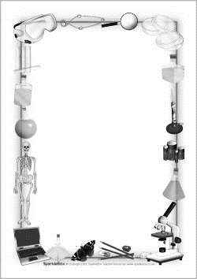
September 11, 2017
Collect PDN
7th Grade Collect TX Fusion Book / 6th Grade Collect ScienceSaurus
Sharpen Pencil
Sit in assigned seat
Complete PDN on own

Slide 2
7th Grade 6th Grade
LO: We will sequence the levels of organization in an organism.
LO: We will compare / contrast properties of matter to complete a foldable.

Slide 3
7th Grade 6th Grade
DOL: I will complete written assessment questions over levels of organization.
DOL: I will complete written assessment questions over properties of matter.

Slide 4
7th Grade 6th Grade
TEK7.12C
(C) recognize levels of organization in plants and animals, including cells, tissues, organs, organ systems, and organisms
TEK 6.6
(6) Matter and energy. The student knows matter has physical properties that can be used for classification.

Slide 5
7th Grade 6th Grade
1. PDN
2. Card Sort
3. Sequence Anchor Chart
4. DOL
PDN
Finish Properties of Matter Foldable
Finish Lemon Lab
DOL

Slide 6
7th Grade
We have all heard we are made up millions, and millions of cells, but yet when we look in the mirror all we see is 1 person. How could this be true? Explain.

Slide 7
Levels of Organization Video Clip / Sequence Chart
https://www.youtube.com/watch?v=ZRFykdf4kDc
https://www.youtube.com/watch?time_continue=28&v=EtWknf1gzKo
Watch Coach as she demonstrates how to fold paper for sequence chart
Fill in information as seen below
 | Name of level Picture Description | Name of level Picture Description | Name of level Picture Description | Name of level Picture Description | Name of level Picture Description
 | Name of level Picture Description | Name of level Picture Description | Name of level Picture Description | Name of level Picture Description | Name of level Picture Description
Smallest
Largest
Levels of Organization of an Animal
Smallest
Largest
Levels of Organization of a Plant

