Slide 1
September 8, 2016
NOTE:
To change images on this slide, select a picture and delete it. Then click the Insert Picture icon
in the placeholder to insert your own image.
Sharpen Pencil
Collect Textbook , Clicker
Sit in assigned seat
With table partners (people assigned to your table) work on the card sort
Transfer answers to next empty age in journal

Slide 2
7th Grade Tek7.5B
NOTE:
To change images on this slide, select a picture and delete it. Then click the Insert Picture icon
in the placeholder to insert your own image.
7.5B
Demonstrate and explain the cycling of matter within living systems such as decay of biomass in a compost bin

Slide 3
6th Grade Tek6.6B
NOTE:
To change images on this slide, select a picture and delete it. Then click the Insert Picture icon
in the placeholder to insert your own image.
6.6B
Calculate density to identify an unknown substance

Slide 4
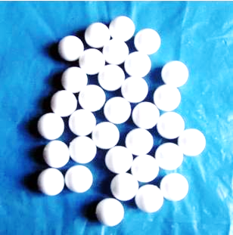
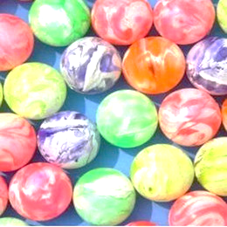
6th Grade Essential Question
Have you ever noticed that a plastic small ball and a small rubber ball are close to the same size but one is a lot heavier than the other? Why do think this is? Explain.

Slide 5
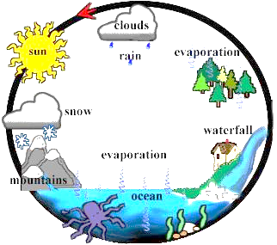
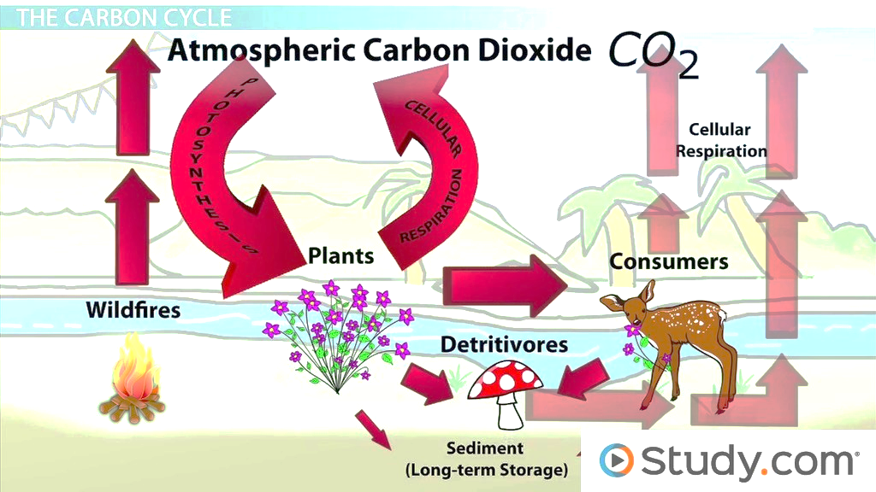
7th Grade Essential Question
Last year we learned that energy can never be created nor destroyed but then where does it go in our ecosystem? What happens to it and where does it reappear from? Explain

Slide 6
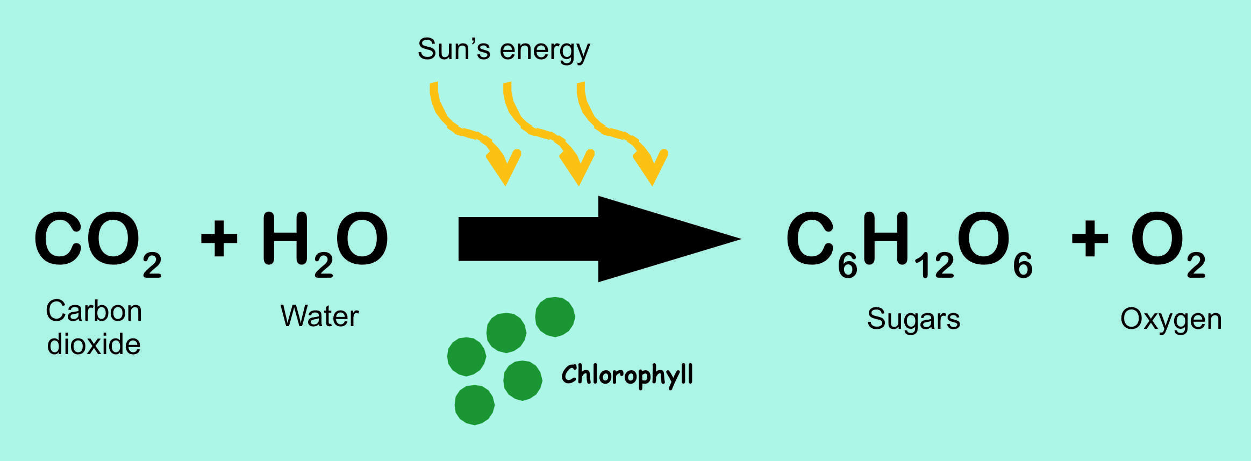
7th Grade PDN
NOTE:
To change images on this slide, select a picture and delete it. Then click the Insert Picture icon
in the placeholder to insert your own image.
Students will complete a card sort in small groups over photosynthesis.
Students will transfer answers to their journals on the next empty page.
Product
What goes in to produce energy
Reactant
What is produced

Slide 7
6th Grade PDN
NOTE:
To change images on this slide, select a picture and delete it. Then click the Insert Picture icon
in the placeholder to insert your own image.
Students will complete a card sort in small groups over metals, non-metals, and metalloids
Students will check/fix/add answers to their metals, non-metals, metalloid foldable in their journal.

Slide 8
7th Grade Agenda
PDN
Finish Cycles of Matter Book
Receive Homework that WILL be collected on Friday for a grade
DOL Quiz

Slide 9
6th Grade Agenda
1. PDN
2. DOL Quiz with Clickers
3. Essential Question
4. Density Foldable
5. Exit Slip

