Slide 1
September 6, 2017
Collect PDN 7th Grd / Scientific Method Sequence Sort Game 6th Grd
Sharpen Pencil
Sit 1 boy / 1 Girl per table
Complete PDN
Notes:
Grasslands
(Basic)
Note: This template is optimized for PowerPoint 2010 and uses a video background. If used in PowerPoint 2007, video elements will play, but all content will be covered by video background when in slideshow. If used in PowerPoint 2003, video will not play, but the poster frame of the videos will remain in place as a static image.
The video:
Plays automatically after each slide transition.
Is 30 seconds long.
Seamlessly loops for infinite playback.
To add slides or change layout, do the following:
To add a new slide, on the Home tab, in the Slides group, click the arrow under New Slide, then click under Motion Background Theme select the desired layout.
To change the layout of an existing slide, on the Home tab, in the Slides group, click Layout, then select the desired layout.
This template uses the “Pushpin” Theme Font. To access or change the Theme Font, do the following:
On the View tab in the Master Views group, select Slide Master.
In the Slide Master view, select slide 1 (the Master Slide for Master Layouts that use the video background).
On the Slide Master tab, in the Edit Theme group, click Fonts, and then select new theme fonts.
Using animated elements:
Any animated element will begin after the slide transition and the background video has started.

Slide 2
7th Grd
LO: We will compare / contrast organic versus inorganic compounds.
6th Grade
LO: We will investigate the physical properities of matter thru observation of a lemon

Slide 3
7th Grd
DOL: I will complete written assement questions over organic compounds.
6th Grade
DOL: I will complete written assessment questions over properties of matter.

Slide 4
7th Grd
1. PDN
2. Organic Compounds all in learning
3. Card Sort
4. DOL
6th Grade
Sequence Card Sort
Lemon Observation Lab
DOL

Slide 5
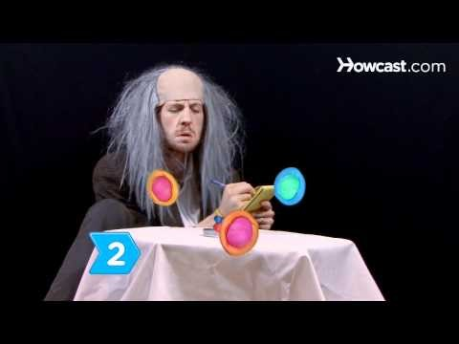
What is the Scientific Method?

Slide 6
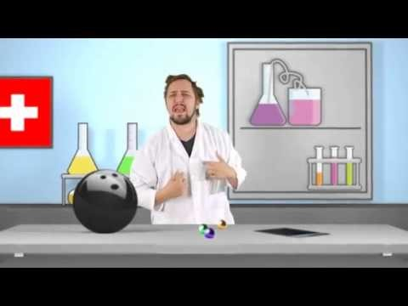

Slide 7
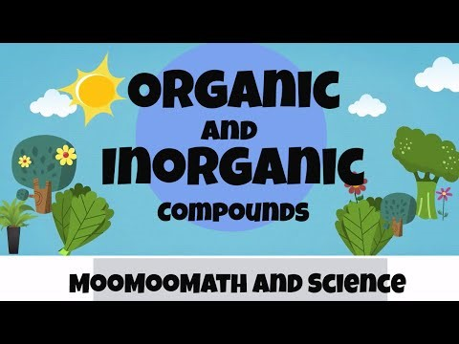
Organic Compounds???

Slide 8
Click on Link Below
http://study.com/academy/lesson/six-elements-common-to-biological-organisms.html

Slide 9
Section divider layout
Subtitle Here

