Slide 1
September 5, 2017
Collect PDN from Blue Basket
Sharpen Pencil
Sit 1 boy / 1 girl per table (seating chart will be assigned after attendance)
Complete PDN on own

Slide 2
7th Grade
LO: We will identify what an element versus a compound is thru the use of the periodic table.
6th Grade
LO: We will organize / set up our inter-active Science Journals.
We will review the scientific method by completing a card sort.

Slide 3
7th Grade
DOL: I will compare / contrast an element vs a compound in an exit slip.
6th Grade
DOL: I will explain what the purpose of the scientific method is in an exit slip.

Slide 4
Agenda
7th Grade
1. PDN
2. SOS Periodic Table Activity
3. Periodic Table Tic- Tac Toe Game
4. DOL
6th Grade
PDN
Set up Science Journal
Scientific Method Card Sort
DOL

Slide 5
6th Grade Inter-Active Journal Set Up
Cover Name Tag
First page of lined paper (Name, Period, Rm 107 )
Periodic Table on back / inside of Journal Cover
Second page of lined paper (Table of Contents)
Back of 2nd page of lined paper (Zip-lock baggie)

Slide 6
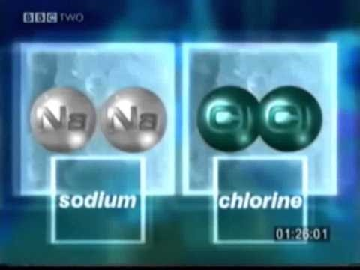
Element / Compound / Periodic Table Video Clip

Slide 7
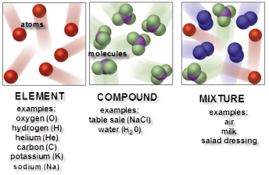
Name: ___________________________________________ Period: ____
1. What is an atom?
2. What is a compound?
3. How can you tell if the symbols represent a single element?
4. How can you tell if the symbols represent a compound?

