Slide 1
September 28, 2016 / 7th Grade
Sharpen Pencil
Collect Textbook, Chrome Book
Login to www.coachpease.com
Click on 1st 6 Weeks
Click on Work, Force, Distance Lab link
Finish Lab

Slide 2
September 28, 2016 / 6th Grade
1. Sharpen Pencil
2. Collect Textbook, Chrome Book
3. Sit with partner for poster project
4. Continue Research for poster project

Slide 3
7th Grade TEK
7.5C (C) demonstrate and illustrate forces that affect motion in everyday life such as emergence of seedlings, turgor pressure, and geotropism.

Slide 4
6th Grade TEK
6.(5) Matter and energy. The student knows the differences between elements and compounds. The student is expected to:
6.5(A) know that an element is a pure substance represented by chemical symbols;6.
6.5(C) differentiate between elements and compounds on the most basic level; and
6.5(D) identify the formation of a new substance by using the evidence of a possible chemical change such as production of a gas, change in temperature, production of a precipitate, or color change.
6.(6) Matter and energy. The student knows matter has physical properties that can be used for classification. The student is expected to:
6.6(A) compare metals, nonmetals, and metalloids using physical properties such as luster, conductivity, or malleability;

Slide 5
7th Grade LO / DOL
LO: We will compare/contrast the different types of tropisms that a plant can exhibit by completing a foldable.
  TEK: 7.5(C) demonstrate and illustrate forces that affect motion in everyday life such as emergence of seedlings, turgor pressure, and geotropism.

Slide 6
7th Grade LO / DOL
DOL: I will complete 5 written assessment questions that compare/contrast plant tropisms via the all in learning clickers.

Slide 7
7th Grade
Have you ever noticed how plants tend to bend towards the sunlight or grab onto things as they grow up? What do you think causes this?
(Teacher will show example of plants)
    Pair share with table partner for 1 minute
    Class Discuss
    Watch clip below to see if we are correct….
      https://www.youtube.com/watch?v=ydMXaNeA0sI

Slide 8
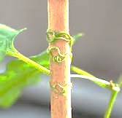
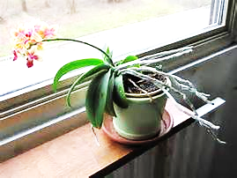
7th Grade Essential Question
Have you ever noticed how plants tend to bend towards the sunlight or grab onto things as they grow up? What do you think causes this?

Slide 9
7th Grade Foldable
Complete Foldable on the different types of tropism that a plant can exhibit.
Make sure you label and color your illustrations
Login to www.coachpease.com
Click on the Schoology Link
Click on link to go to schoology.
Click on Courses
Click on Class Period
Click on Plant Tropisms folder
Use the files available to complete foldable on own

