Slide 1
Sept. 18, 2018
Collect DOL from Coach Pease or small basket on front table
Sharpen Pencil
Sit in assigned seat
Complete DOL on own

Slide 2
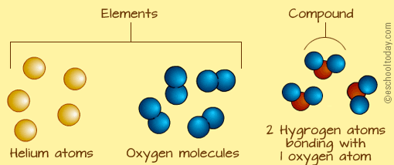
TEK 6.5
(A) know that an element is a pure substance represented by a chemical symbol and that a compound is a pure substance represented by a chemical formula

Slide 3
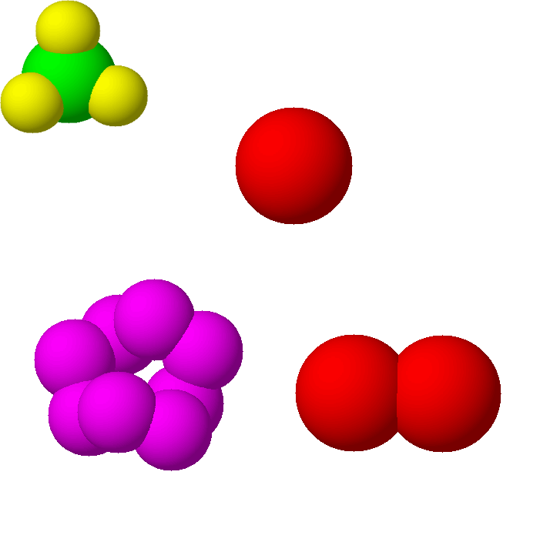
LO:
Regular
Students will compare/contrast models of atoms, elements and compounds to differentiate between the 3 through a card sort activity.
Honors
Students will create a compound molecule model to illustrate how elements form a compound.

Slide 4
DOL:
Students will complete 5/5 questions that differentiate between an atom, element and/or compound with 80% accuracy or higher.

Slide 5
Regular atoms, Elements, or Compounds Card Sort
Teacher will explain / model procedures for completing the card sort
Students will work in small groups to complete the card sort
Teacher will come to check your answers
Students will use information gathered to complete a graphic organizer to compare/contrast atoms, elements and compounds based on the card sort activity.

Slide 6
Atoms/Elements/Compounds Poster
Name: __________________________________________________________ Period: _____
 | Atoms | Elements | Compounds
Definition
Examples
How They are Alike
How They are Different

Slide 7
Periodic Table Square / Honors
Atomic #
Your Square must contain…
Name of element
Symbol of element
Atomic # / Mass
Pictures of Element
Properties of Element
Metal / Nonmetal/ Metalloid
Examples of objects used in
Symbol
Name of Element
Atomic Mass

Slide 8
Compound Molecule Model
Teacher will review expectations for models
Students will create model of a compound molecule
Students will create a Key to include with Model (See example for Hydrogen below)
Hydrogen Peroxide
H2 + O2 = 2HO
Light Blue = Oxygen
Pink = Hydrogen

Slide 9
DOL Atom / Element / Compound
Name: ___________________________________ Pease Period: _________________ Date: ____/_____/_______
Is this an example of an atom, element or compound?
A: Atom
B: Element
C: Compound
2. Is this an example of an atom, element or compound?
A: Atom
B: Element
C: Compound
3. Is this an example of an atom, element or compound?
A: Atom
B: Element
C: Compound
4. Is this an example of an atom, element or compound?
A: Atom
B: Element
C: Compound
5. Is this an example of an atom, element or compound?
A: Atom
B: Element
C: Compound
H O
2
Cl

