Slide 1
Sept. 17, 2018
Collect PDN from Coach Pease or small basket on front table
Sharpen Pencil
Sit in assigned seat
Complete PDN on own

Slide 2
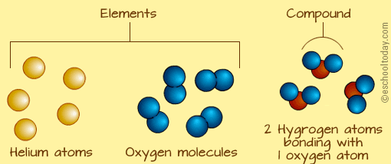
TEK 6.5
(A) know that an element is a pure substance represented by a chemical symbol and that a compound is a pure substance represented by a chemical formula

Slide 3
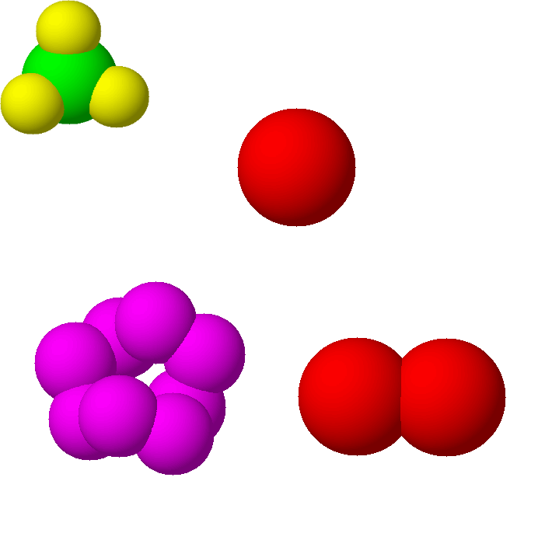
LO:
Regular
Students will create models of atoms, elements and compounds to differentiate between the 3 through a hands on activity.
Honors
Students will create a periodic table square by investigating an element and how it is part of a compound.

Slide 4
DOL:
Students will complete 5/5 questions that differentiate between an atom, element and/or compound with 80% accuracy or higher.

Slide 5
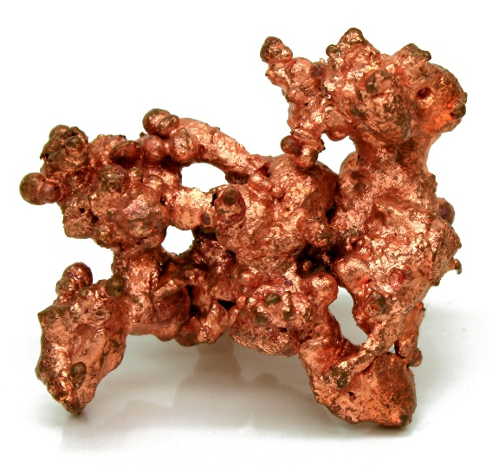
Review Element / Compound
What are atoms?
Atoms are the basic building block of all matter and are very small.

Slide 6
What is an Element? How is it related to an atom?
Some chemicals are made of only one type of atom and some are made of two or more atoms joined together
Elements are substances that are
made up of only one type of atom
They cannot be broken down into anything simpler

Slide 7
What is a compound? How is it related to a compound?
two elements
a compound
When two (or more) elements are chemically
joined together they form compounds

Slide 8
Let’s Practice Which box below is an example of an element and which is an example of a compound?
A
B
Which box represents a pure substance?
The box A is an element
– it is made of only one type of atom
The box B is a compound
-it contains 2 different elements in each molecule
Both boxes represent a pure substance

Slide 9
Lego Lab / Regular Science
*Teacher will hand out directions and explain / model expectations and procedures
*Students will collect uni-fix cubes in the place of legos as directed by teacher
*Students will work in small groups to complete lab as directed

Slide 10
Periodic Table Square / Honors
Atomic #
Your Square must contain…
Name of element
Symbol of element
Atomic # / Mass
Pictures of Element
Properties of Element
Metal / Nonmetal/ Metalloid
Examples of objects used in
Symbol
Name of Element
Atomic Mass

Slide 11
DOL Atom / Element / Compound
Name: ___________________________________ Pease Period: _________________ Date: ____/_____/_______
Is this an example of an atom, element or compound?
A: Atom
B: Element
C: Compound
2. Is this an example of an atom, element or compound?
A: Atom
B: Element
C: Compound
3. Is this an example of an atom, element or compound?
A: Atom
B: Element
C: Compound
4. Is this an example of an atom, element or compound?
A: Atom
B: Element
C: Compound
5. Is this an example of an atom, element or compound?
A: Atom
B: Element
C: Compound
H O
2
Cl

Slide 12
DOL Atom / Element / Compound
Name: ___________________________________ Pease Period: _________________ Date: ____/_____/_______
Is this an example of an atom, element or compound?
A: Atom
B: Element
C: Compound
2. Is this an example of an atom, element or compound?
A: Atom
B: Element
C: Compound
3. Is this an example of an atom, element or compound?
A: Atom
B: Element
C: Compound
4. Is this an example of an atom, element or compound?
A: Atom
B: Element
C: Compound
5. Is this an example of an atom, element or compound?
A: Atom
B: Element
C: Compound
H O
2
Cl

Slide 13
DOL Atom / Element / Compound
Name: ___________________________________ Pease Period: _________________ Date: ____/_____/_______
Is this an example of an atom, element or compound?
A: Atom
B: Element
C: Compound
2. Is this an example of an atom, element or compound?
A: Atom
B: Element
C: Compound
3. Is this an example of an atom, element or compound?
A: Atom
B: Element
C: Compound
4. Is this an example of an atom, element or compound?
A: Atom
B: Element
C: Compound
5. Is this an example of an atom, element or compound?
A: Atom
B: Element
C: Compound
H O
2
Cl

Slide 14
DOL Atom / Element / Compound
Name: ___________________________________ Pease Period: _________________ Date: ____/_____/_______
Is this an example of an atom, element or compound?
A: Atom
B: Element
C: Compound
2. Is this an example of an atom, element or compound?
A: Atom
B: Element
C: Compound
3. Is this an example of an atom, element or compound?
A: Atom
B: Element
C: Compound
4. Is this an example of an atom, element or compound?
A: Atom
B: Element
C: Compound
5. Is this an example of an atom, element or compound?
A: Atom
B: Element
C: Compound
H O
2
Cl

