Slide 1
Sept. 26, 2018
Sharpen Pencil
Sit in assigned seat
Take out Evidence of Chemical Change Flashcards
Complete flashcards / Study flashcards

Slide 2
TEK’s (Prep for 1st 6 Weeks Test)
6.11 A/B/C
(11) Earth and space. The student understands the organization of our solar system and the relationships among the various bodies that comprise it. The student is expected to:
(A) describe the physical properties, locations, and movements of the Sun, planets, moons, meteors, asteroids, and comets;
(B) understand that gravity is the force that governs the motion of our solar system; and
(C) describe the history and future of space exploration, including the types of equipment and transportation needed for space travel.
6.5 A/B/C
(5) Matter and energy. The student knows the differences between elements and compounds. The student is expected to:
(A) know that an element is a pure substance represented by a chemical symbol and that a compound is a pure substance represented by a chemical formula;
(B) recognize that a limited number of the many known elements comprise the largest portion of solid Earth, living matter, oceans, and the atmosphere; and
(C) identify the formation of a new substance by using the evidence of a possible chemical change such as production of a gas, change in temperature, production of a precipitate, or color change.

Slide 3
LO:
Students will apply knowledge learned over objects in space, gravity in space, space exploration, elements/compounds, Earth’s 4 spheres, and Evidence of a chemical reaction to complete a 1st 6 weeks test review.

Slide 4
DOL
Students will complete a 1st 6 weeks review packet over objects in space, gravity in space, space exploration, elements/compounds, Earth’s 4 spheres, and Evidence of a chemical reaction with 100% completion.

Slide 5
To Create Flashcards for 1st 6 Weeks Review...
Teacher will pass out paper for foldable
Teacher will model / walk class thru how to fold to create flashcards
Students will follow along with teacher to make 17 cards in all
Students will write the question on the front of the flashcard
Teacher will ask for volunteers to answer question
Students will write the correct answer on the back of flashcard

Slide 6
How to set up flashcard...
Front of Card
Back of Card
Write The Question
Write The Answer
Here
Here

Slide 7
1st 6 Weeks
District Test Review
Written and typed by: K. Pease 2018

Slide 8
Procedure:
Teacher will explain / model procedure for completing the review packet
Students will use textbook / powerpoints / notes / website to complete packet in small groups of teacher choosing.

Slide 9
Vocabulary Review / Quizlets
Space 6.11 Vocab Practice
https://quizlet.com/252542612/tek-611-ab-celestial-bodies-in-space-gravity-flash-cards/
https://quizlet.com/28319981/6th-grade-science-vocabulary-611c-space-exploration-flash-cards/
6.5 A/B/C Element,Compound, Earth Spheres, Chemical Reactants
https://quizlet.com/242425235/atoms-elements-and-compounds-flash-cards/
https://quizlet.com/155996236/atoms-elements-and-compounds-flash-cards/
https://quizlet.com/155996236/atoms-elements-and-compounds-flash-cards/
https://quizlet.com/295731617/physical-and-chemical-changes-middle-school-flash-cards/
6.5C evidence of a chemical change
https://quizlet.com/311791776/evidences-of-a-chemical-reaction-flash-cards/

Slide 10
What are some characteristics that planets in our solar system have in common?
Shape of orbits around the sun
Affected by Earth’s gravity
Found in the Milky Way Galaxy

Slide 11
2. What must a substance have to be considered a pure substance?
All the atoms in the molecules of the element are the same
All the molecules in a compound must be the same

Slide 12
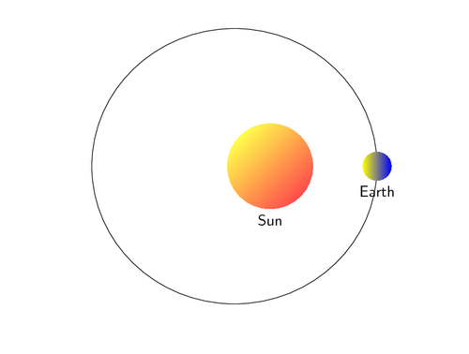
3. What would happen to the path of Earth’s orbit if the Sun’s gravity was to stop?
The Earth would go straight into space. It would no longer curve around a center (Sun) object.

Slide 13
4. During a chemical change what evidence below proves that a chemical reaction is taking place?
__ Bubbles (gas) are produced
__ It turns very hot (temperature change)
__ One liquid just disappears into the other liquid
__ a precipitate forms on the bottom of the container
T
T
F
T

Slide 14
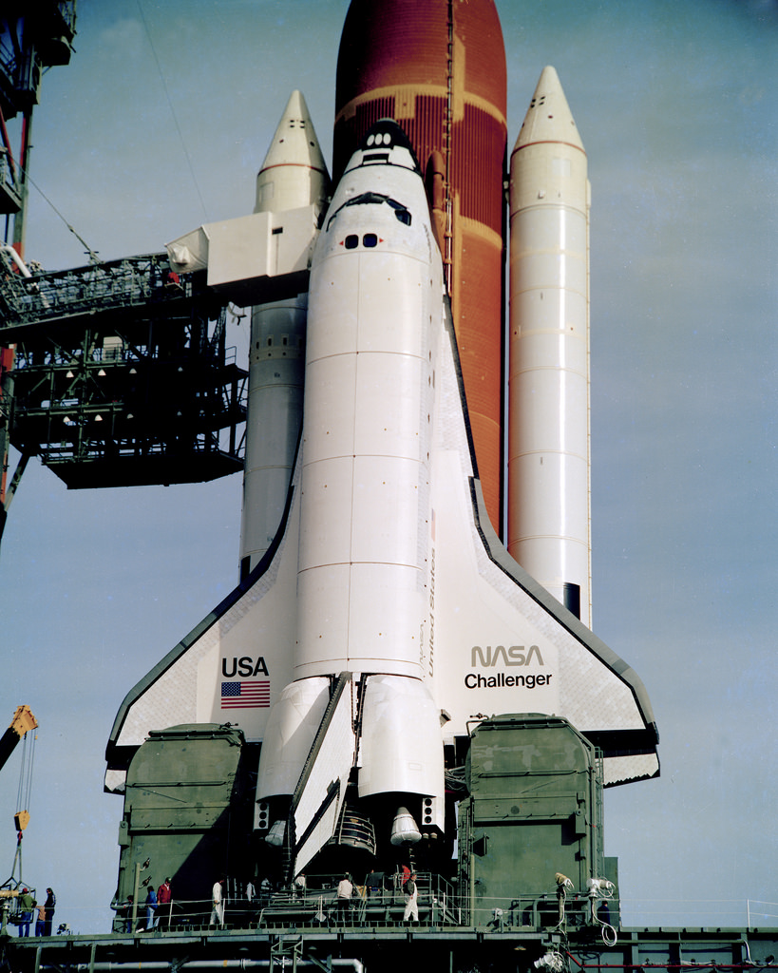
5. What made the space shuttle such a better way to get into space than the rockets previously used?
The space shuttle is reusable.
It is more cost effective, same $$$$

Slide 15
6. Label the molecules below as a compound or as an element.
compound
H O
element
compound
2
compound
compound
NaCl
Co
element
Cl
element
element

Slide 16
7. What determines how much gravitational pull a planet has?
The mass of the planet.
The greater the planet’s mass, the greater the gravitational pull.

Slide 17
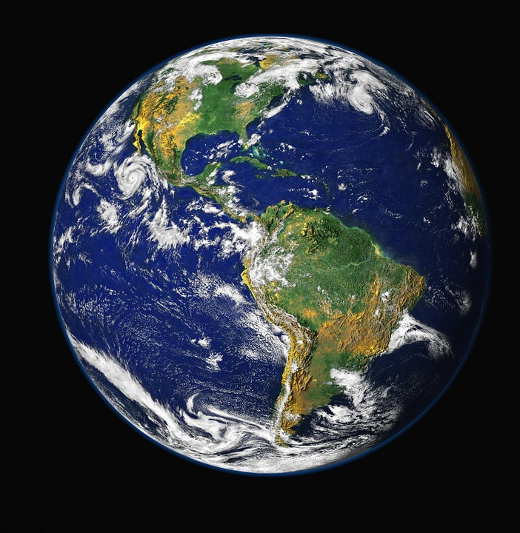
8. What are the major elements you would find in our Earth’s atmosphere?
Nitrogen (N2)
Oxygen (O2)
Carbon Dioxide (CO2)

Slide 18
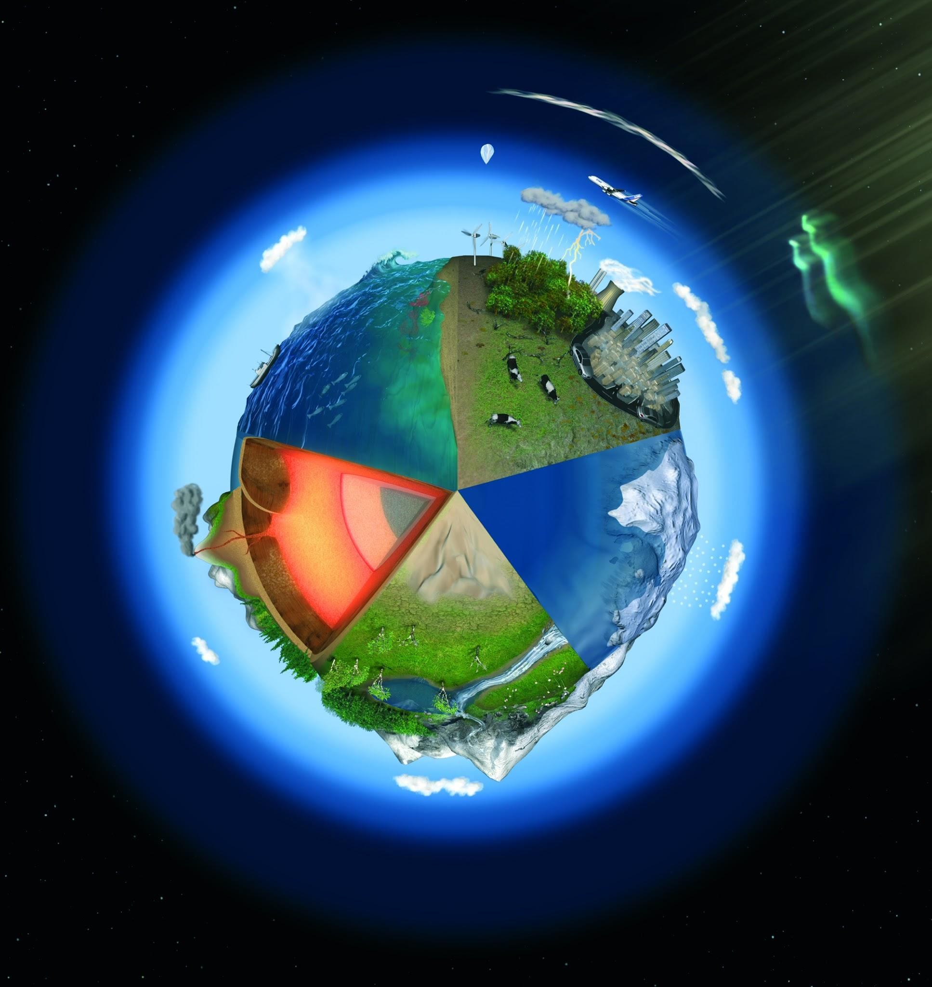
9. What is one of the things that makes it possible for Earth to have life and not any other planet?
A breathable atmosphere
Oxygen
Liquid water

Slide 19
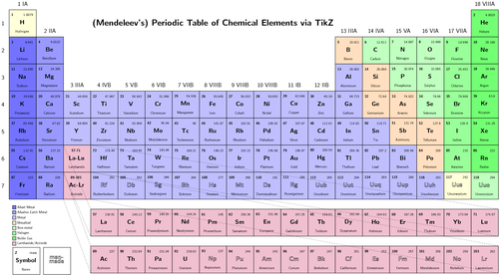
10. What is an element?
A pure substance that cannot be broken down into any smaller substance.
It contains 1 or more atoms of the same type

Slide 20
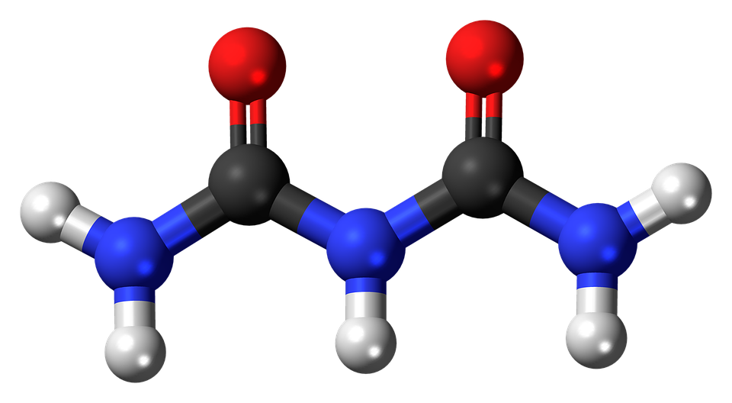
11. What is a compound?
Two or more different elements that are chemically combined

Slide 21
12. What affects all objects in space?
Gravitational attraction between all objects.
All planets, comets, meteoroids and so forth are affected by gravitational attraction

Slide 22
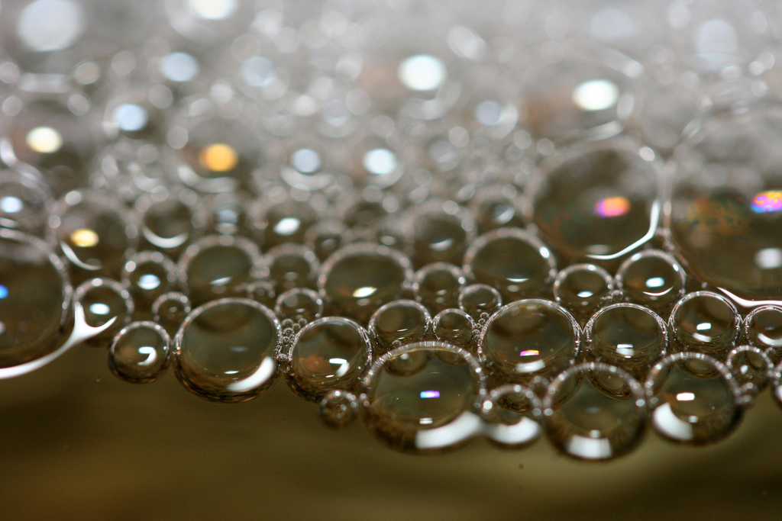
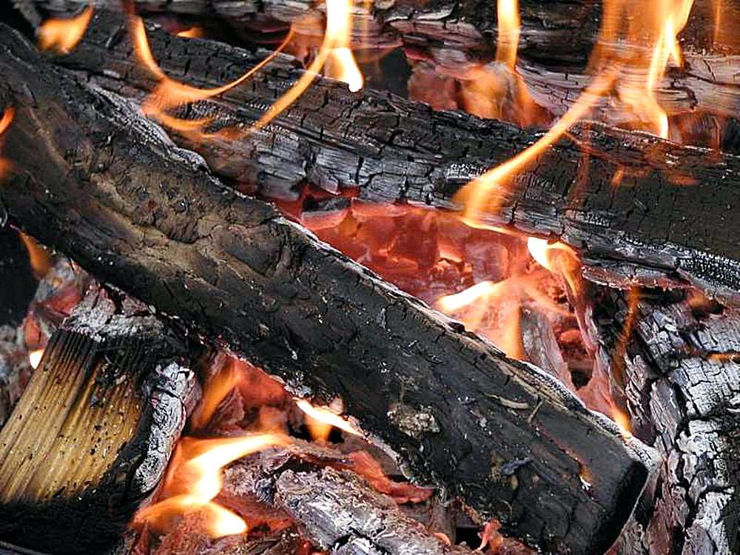
13. What types of evidence will be seen if a chemical reaction has taken place?
Color Change Precipitate Forms
Gas Produced Odor
Light
Temperature Change

Slide 23
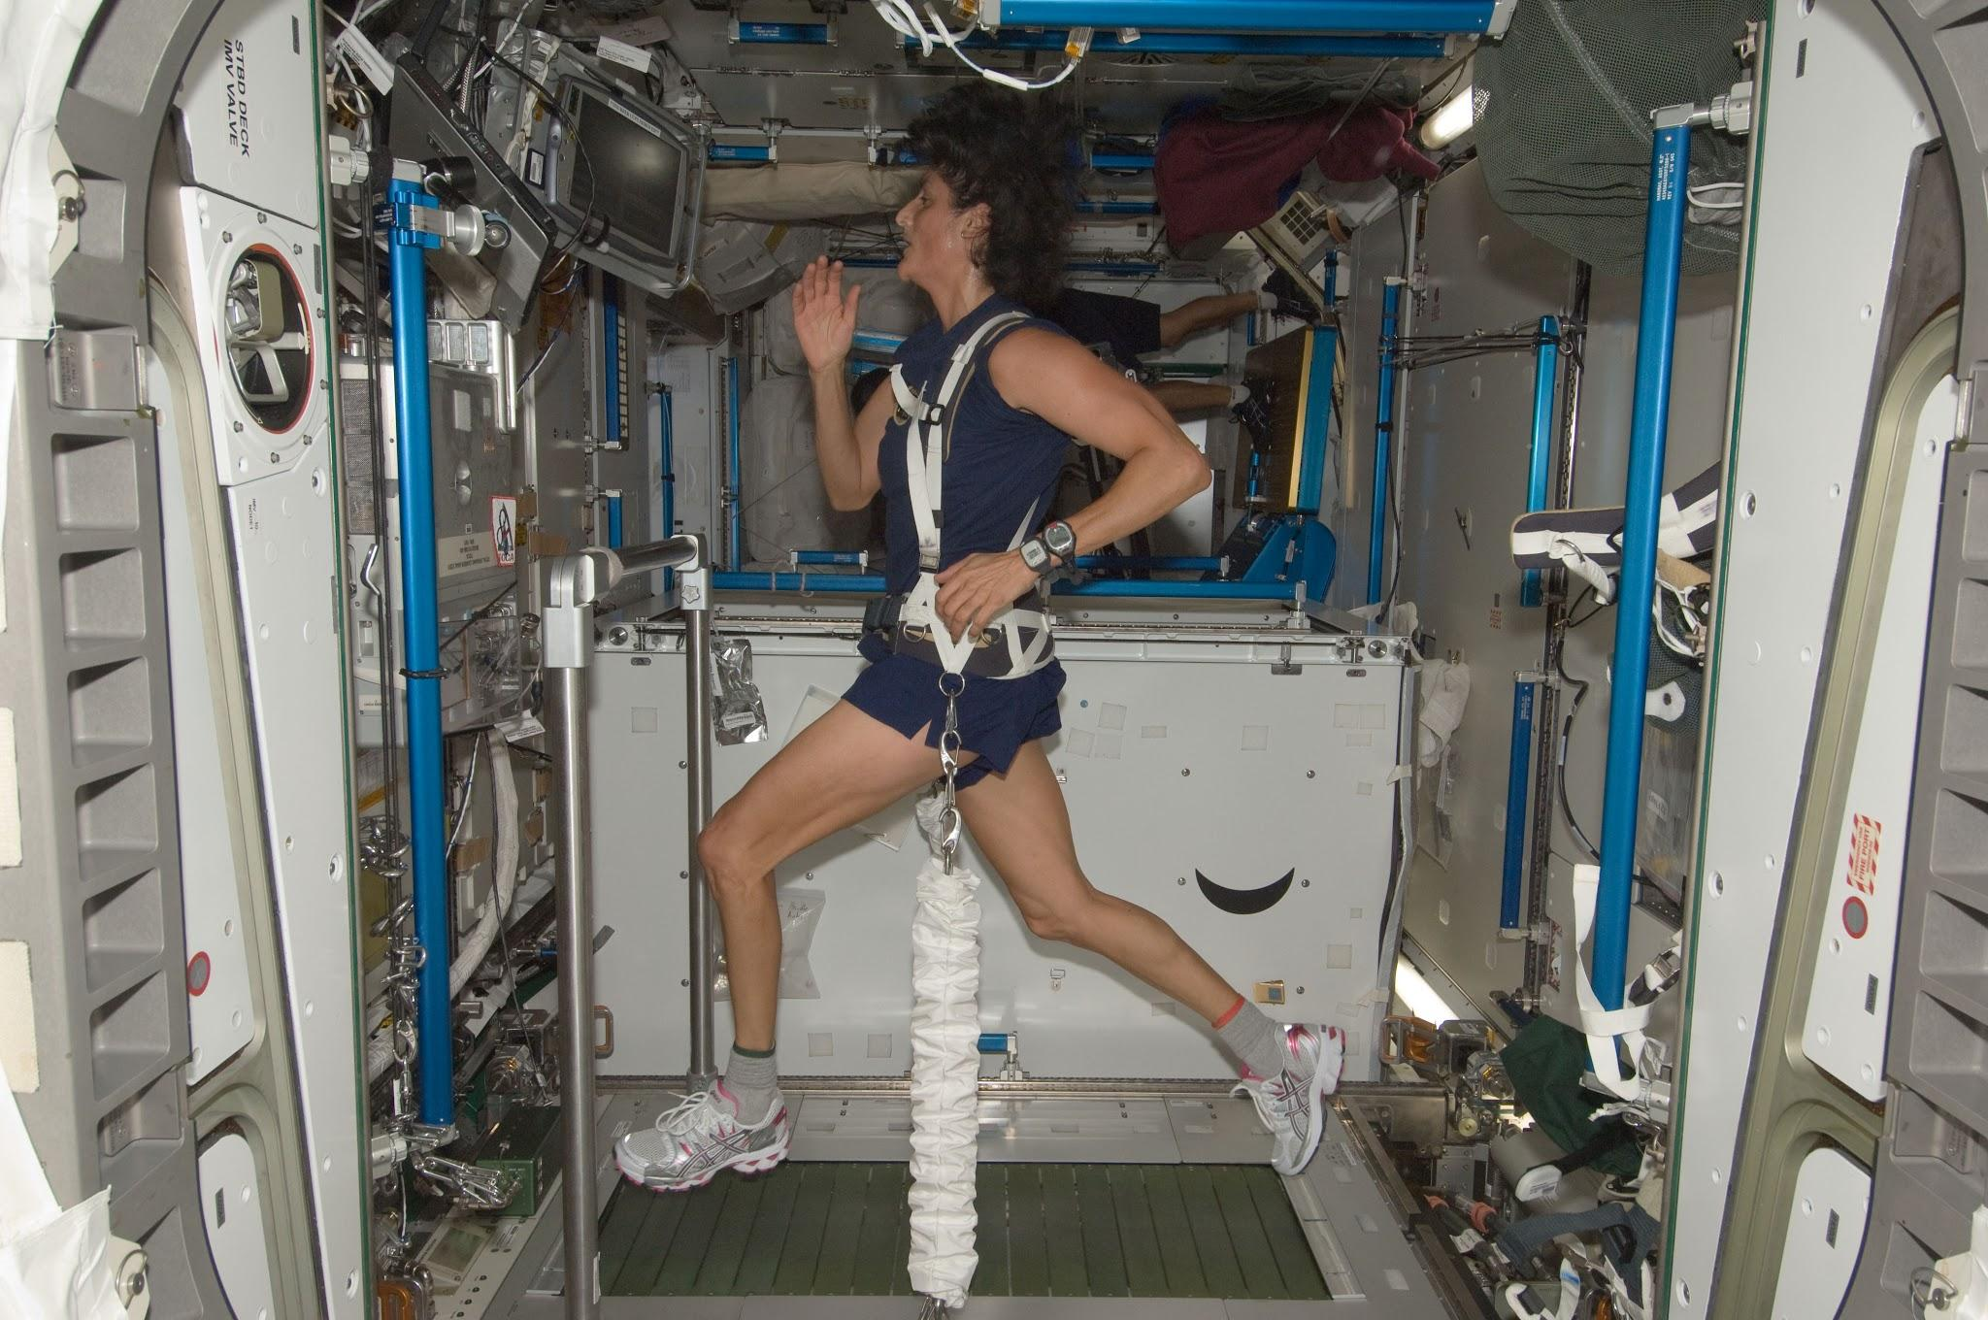
14. If scientists were to plan a trip to Mars and back to Earth for 20 months, what type of equipment would be very important to have on board?
Exercise equipment to help keep the astronauts strong and healthy

Slide 24
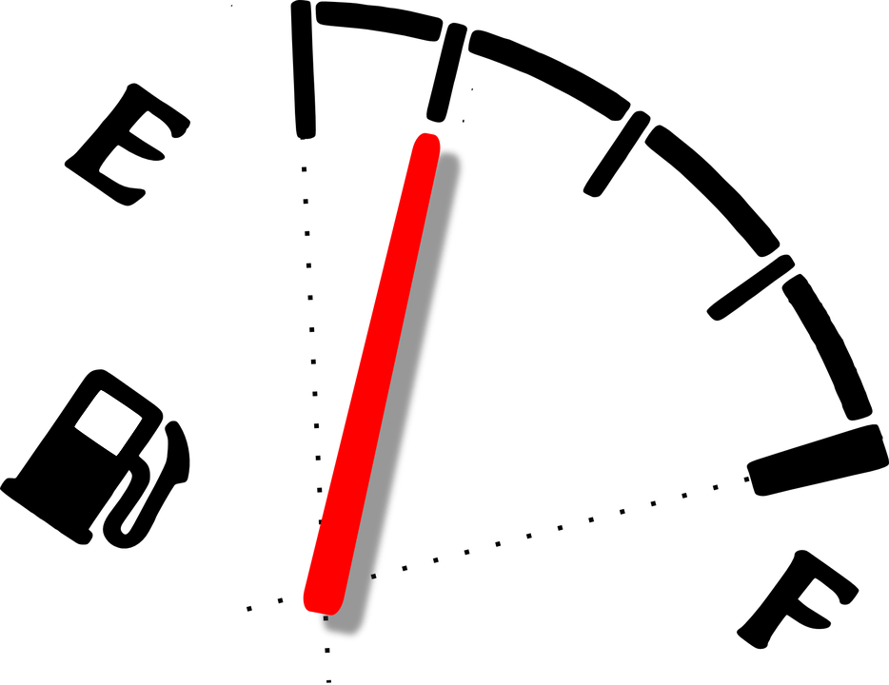
15. What is one of the biggest costs NASA must consider if they plan to travel to Mars?
Fuel that can be stored for long periods of time

Slide 25
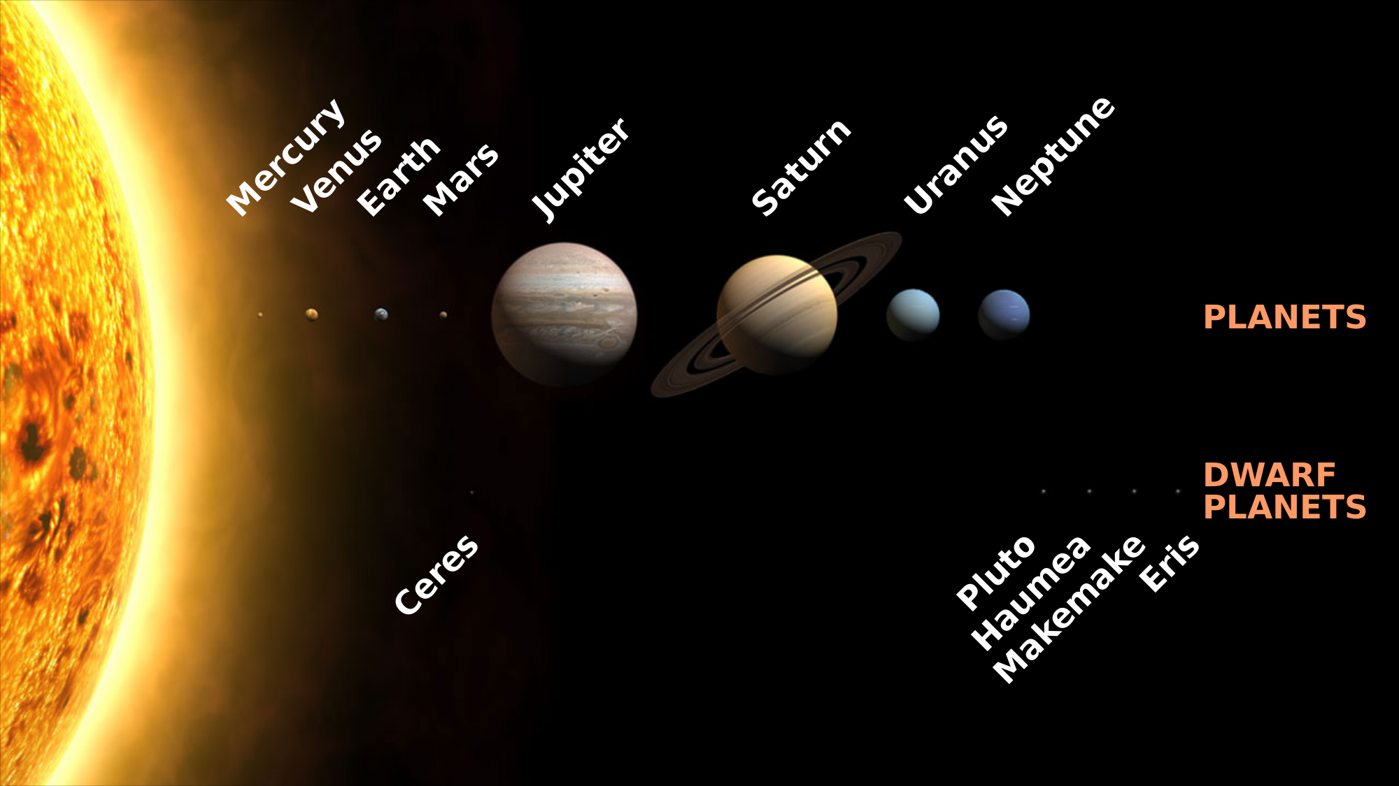
16. What is the correct order of the 8 planets if you go from the Sun out towards the end of our Solar System?

Slide 26
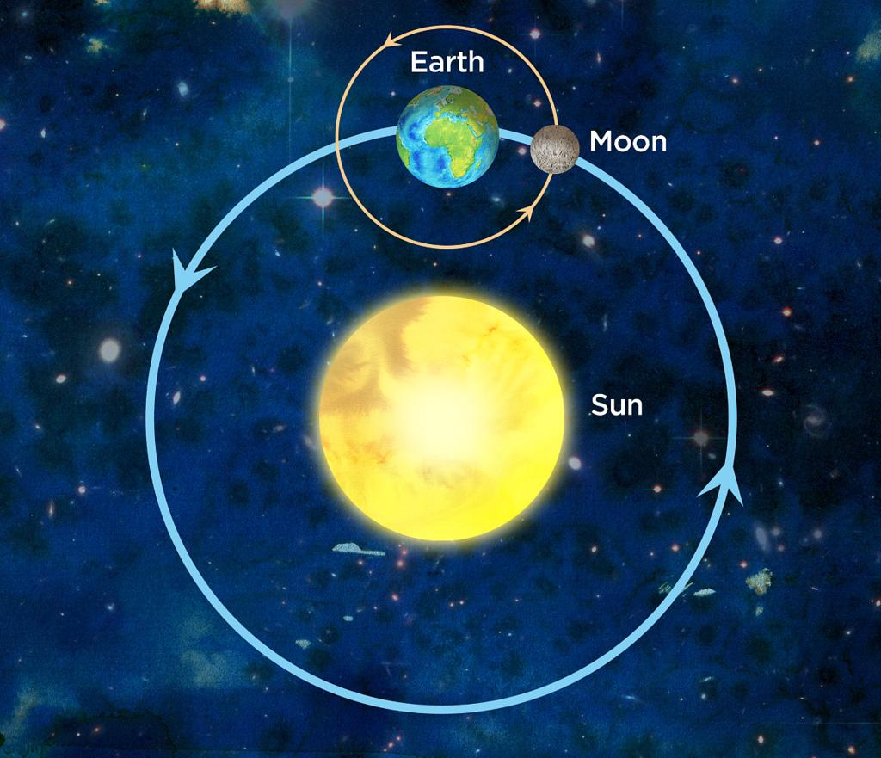
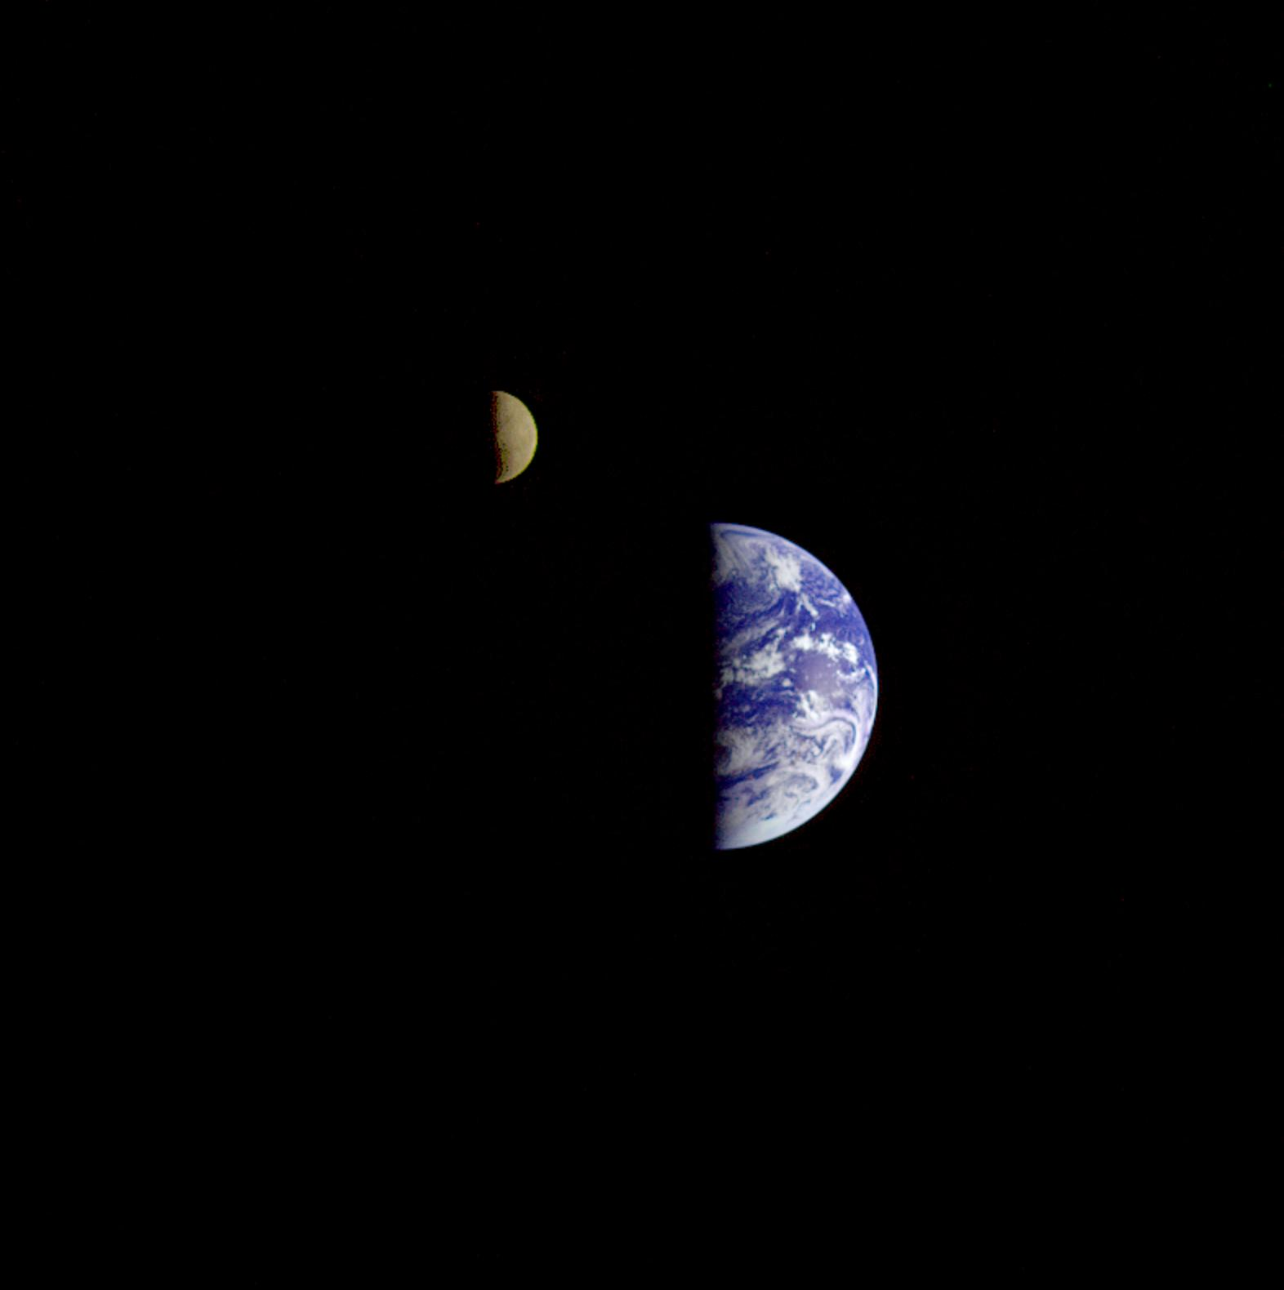
17. Why does our Moon orbit the Earth and not the Sun like all the other planets?
Gravitational attraction between the Moon and the Earth

Slide 27
Study Hard!!! You CAN do PASS this TEST!
The true champions know that it take hard work (studying) to reach their goals of success (100%)

