Slide 1
Sept. 24, 2018
Collect PDN from green basket or Coach at the door.
Collect Textbook
Sharpen Pencil
Sit in assigned seat
Complete PDN on own

Slide 2
PDN: Chemical Vs’ Physical Changes Textbook #1
1. A substance that undergoes a __ _ is still the same substance after the change.
2. When liquid water changes into water vapor it is going through a _ _.
3. When a substance transforms into another substance it is going through a _ _.
4. Another name for a chemical change is a _ _.
5. A chemical change forms new substances with new and different ___.

Slide 3
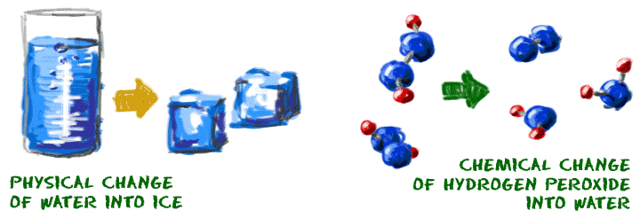
TEK 6.5C
identify the formation of a new substance by using the evidence of a possible chemical change such as production of a gas, change in temperature, production of a precipitate, or color change.

Slide 4

LO:
Students will investigate the difference between a chemical and physical change and determine what evidence proves which type of change has happened through a demo and/or card sort activity.

Slide 5
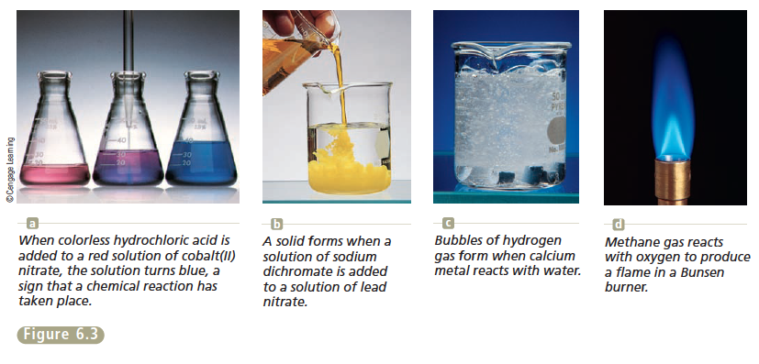
DOL:
Students will answer 5/5 questions over physical vs’ chemical changes and evidence of a change with 80% accuracy or higher.

Slide 6
Engage Demo
Take out journal, open to next empty page
Write Chemical / Physical Change at top of page
Follow teacher directions to observe demo (Goggles)
As student observes demo, record what happens in journal
Once Demo is complete, use notes gathered to answer question that follows…

Slide 7
Answer Questions Below in Journal… You will revisit it later in lesson.
Did you just observe a chemical or physical change? What did you observe that told you it was a chemical or physical change? Describe in detail.

Slide 8
Explore/Explain Video Clips
Moo Moo Math Chemical Vs’ Physical Changes
https://www.youtube.com/watch?v=yIJ2qnUOOwQ
Evidence of a chemical change
https://www.youtube.com/watch?v=cZMkqagL8Ps
Crash Course: Chemical Reactions (4mins)
https://www.youtube.com/watch?v=37pir0ej_SE
Bill Nye Chemical Reactions (4 mins)
https://www.youtube.com/watch?v=JSiBSSFKRwE
Good Thinking… Chemical Reactions in Action (10 mins)
(How atoms are changed during a chemical change)
https://www.youtube.com/watch?v=5iowJs6MryI

Slide 9
Explain/Explore Cont. Card Sort
1.Teacher will explain / model card sort procedure
2. Teacher will explain / model how information collected from card sort will assist with completing flash cards

Slide 10
3. Students will complete card sort in small groups (teacher choice)
4. Students will complete vocabulary flash cards using information gathered from video / card sort.

Slide 11
Website links / Sites to Assist
TEK 8.5 / 6.5C Information
https://www.weebly.com/weebly/images/file_icons/pdf.png

Slide 12

How to complete Flash Card….
Front Side of Flash Card
Vocabulary Word
Picture to Illustrate
Back Side of Flash Card….
Definition of Vocabulary Word

Slide 13
Flash Card Race Study Game
Shuffle all cards
Form a stack with the cards , the picture and word side faces up in the stack and the definition side faces down in the stack
Place the stack in the middle of the table
First person picks up first card off the stack and does NOT allow the other players to see the definition
Person shows the picture / word side to other player
The other player says the definition of the word, it does not have to be word for word but it needs to be on topic
If the other player guesses the definition correctly they get to keep the card but it they guess wrong the card holder reads the defintion allowed and puts the card back at the bottom of the stack
Now the person who was guessing the definition now takes next card off the stack and steps 5-7 are repeated
Play continues till teacher stops game or there are not longer any cards left in the pile
The person with the most cards wins.

Slide 14
Name: __________ Teacher: ____ Per: __ Date: __/__/____
DOL: Chemical Vs’ Physical Changes
Which of the following is a physical change?
A: Burning B: Rusting C: Freezing D: Oxidation
2. Which of the following is an example of chemical change?
A. Filling up a balloon with hot air.
B. Taking a glass of water and freezing it by placing it in the freezer.
C. A plant collecting sunlight and turning it into food.
D. Your dog ripping up your homework.
Please Turn Over

Slide 15
3. When a new substance is formed with different properties than the original substance it is called a
A.. Chemical change B: Physical Change
C: Freezing D: Boiling
4. Which is not a clue that could indicate a chemical change?
A. Change in color B. Change in shape
C. Change in energy D. Change in odor
5. Chemical changes result in new substances, physical changes do not. Which process is an example of a chemical change?
A: baking a cake B: Chopping a tree
C: Heating a cup of tea D: Drying clothes in the dryer

