Slide 1
Sept. 20, 2018 Advisory
Collect ½ sheet paper at door / blue basket
Sharpen Pencil
Sit in assigned seat
Explain 1 way you can help control your own impulsive behavior today in class.

Slide 2
Sept. 20, 2018
Collect DOL from Green Basket or Coach Pease at the door
Sharpen pencil
Sit in assigned seat
Complete DOL on own

Slide 3
DOL 6.5 A Elements/Compounds
Which of the following lists contains only elements AND a reason why they are elements?
H₂O, NaCl, N₂, CO₂ -- Substances are elements because they contain more than one chemical symbol
Kr, Ne, Ar, He -- Substances are elements because they are all noble gases
Cl₂, H₂, Na, He -- Substances are elements because they are pure
F₂, O₃, Li, H -- Substances are elements because they all have chemical symbols
2. During a game, students were asked to select the correct symbol with the element. All of the following would be correct EXCEPT --
Na -- sodium
H -- helium
O -- oxygen
C -- carbon

Slide 4
3. Which of the following is NOT considered an element?
Calcium C. Phosphorus
Water D. Sulfur
4. Evelyn read a book about a scientist who turned lead into gold. Her friend Justin told her that it is not possible to turn lead into gold because --
it is not possible to get the lead hot enough using typical lab equipment.
the ingredient needed to turn lead into gold is very hard to find on Earth.
the lead used by the scientist was mixed with another metal.
elements cannot be changed into another element by physical or chemical changes.
5. What is the smallest quantity of an element?
Compound C. Molecule
Atom D. Solution

Slide 5
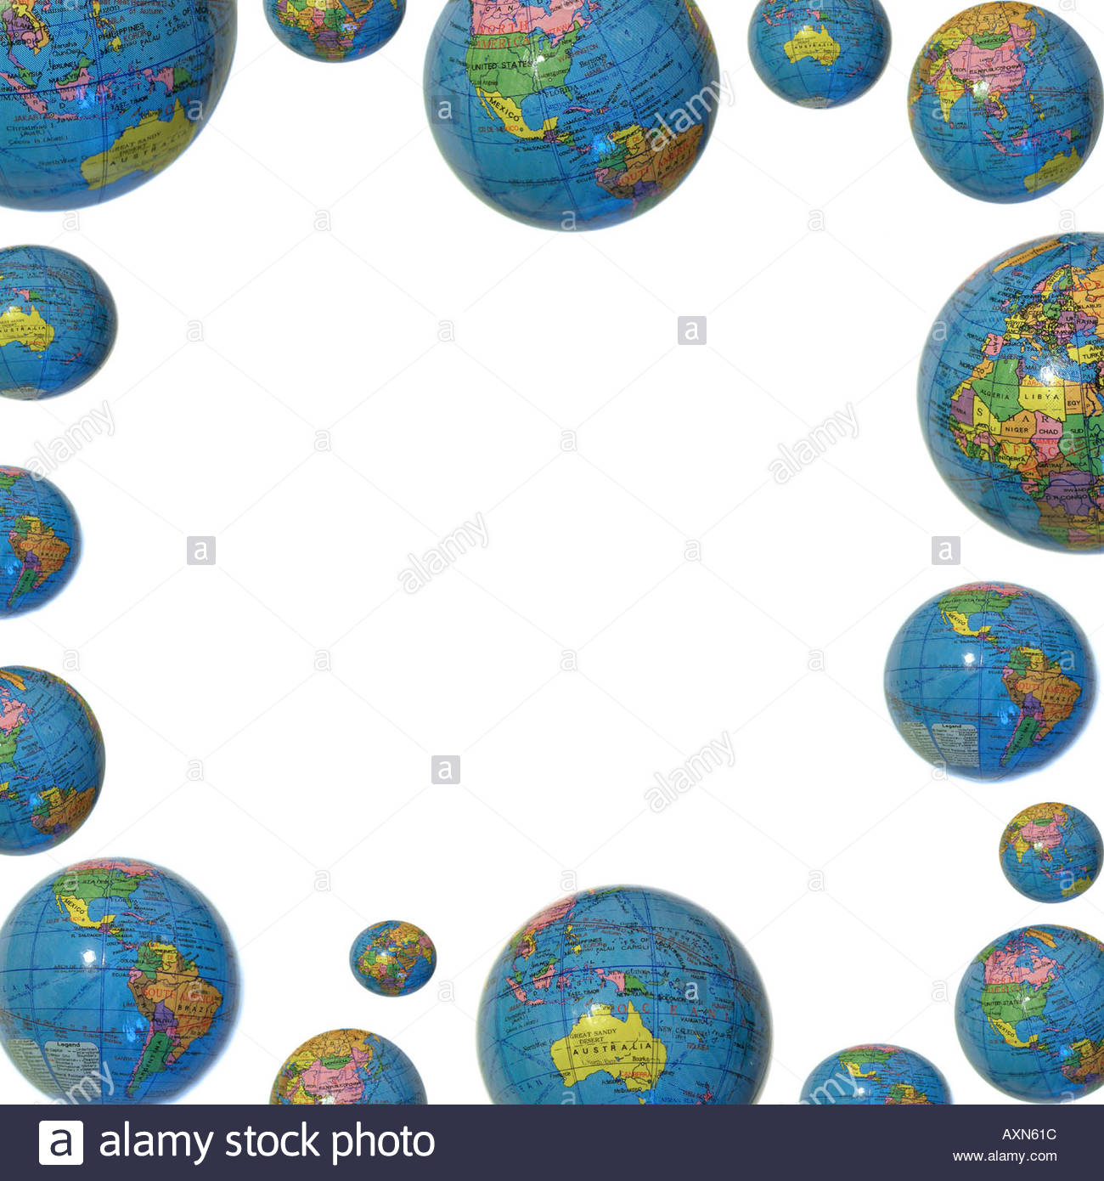
TEK 6.5 B
(B) recognize that a limited number of the many known elements comprise the largest portion of solid Earth, living matter, oceans, and the atmosphere

Slide 6
LO:
Students will compare/contrast the different types of elements found the Earth’s 4 spheres by completing a foldable / diagram.

Slide 7
DOL:
Students will complete 5/5 questions to compare/contrast the different types of elements found within the Earth’s spheres with 80% accuracy.

Slide 8
Procedure
1. Teacher will hand out model/ explain how to put the foldable together.
2. Students will follow along in completing the correct way to fold foldable. Students will write name/teacher/period/date at bottom of foldable on the back side.
3. Regulars: will follow along with teacher led presentation to complete foldable
Honors: Will use weblink provided, textbooks and video links to complete foldable with table partner.

Slide 9
Video Clip Links
Crash Course Earth Spheres Part 1
https://www.youtube.com/watch?v=VMxjzWHbyFM
Crash Course Earth Spheres Part 2
https://www.youtube.com/watch?v=UXh_7wbnS3A
Moo Moo Earth Spheres
https://www.youtube.com/watch?v=m4TnPv_b6WU

Slide 10
Web Links…
Earth Spheres Poster Virtual Link
https://www.youtube.com/watch?v=W4ixGKA076o
Earth Spheres Virtual Lab
http://www.classzone.com/books/earth_science/terc/content/visualizations/es0102/es0102page01.cfm
http://www.classzone.com/books/earth_science/terc/content/investigations/es0103/es0103page01.cfm
Numerous Power points on Earth Spheres
https://science.pppst.com/spheres.html

Slide 11
Additional Research Links:
https://www.classzone.com/books/earth_science/terc/content/investigations/es0103/es0103page08.cfm?chapter_no=investigation
http://www.cotf.edu/ete/ess/ESSspheres.html
http://www.kidsgeo.com/geography-for-kids/0024-b-earth-spheres-atmoshpere-lithosphere-hydrosphere.php
http://www.geogrify.net/GEO1/Lectures/IntroPlanetEarth/FourSpheres.html

Slide 12
Students will create a poster to compare/contrast the 4 different spheres’. Example of poster below
Litho-
Atmo-
%
%
spheres
Hydro-
Bio-
%
%

Slide 13
% of elements
Earth’s
Spheres
spheres
% of elements
% of elements

Slide 14
Items found in the...
Elements %
Elements %
Items found in the...
spheres
Elements %
Elements %
Items found in the...
Items found in the...

