Slide 1
September 18, 2017
Collect PDN 6th Grade / 7th Grade continue work on Cell Models
Sharpen Pencils
Sit in assigned seat
Complete PDN / Cell Model

Slide 2
6th Grade
LO: We will compare / contrast the physical and chemical properties of metals, metalloids, and non-metals thru completion of a cut/paste sorting project.
7th Grade
LO: We will compare/contrast animal/plant cell organelles thru a cell diagram/model.

Slide 3
7th Grade
DOL: I will answer star type written qustions over cell organelles structure and function.
6th Grade
DOL: I will answer straar type written qustions over metals, non-metals and metalloids.

Slide 4
7th Grade
TEK 7.12D
(D) differentiate between structure and function in plant and animal cell organelles, including cell membrane, cell wall, nucleus, cytoplasm, mitochondrion, chloroplast, and vacuole
6th Grade
TEK 6.6A
(6) Matter and energy. The student knows matter has physical properties that can be used for classification. The student is expected to:
(A) compare metals, nonmetals, and metalloids using physical properties such as luster, conductivity, or malleability

Slide 5
7th Grade
AGENDA
1. Finish Cell Diagrams
2. Label Diagrams
3. DOL
6th Grade
AGENDA
1. PDN
2. Review Properties of matter
3. CUT/Past activity over metals, non-metals and metalloids
4. DOL

Slide 6
6th Grade
1. Review Properties of Metals, Non-Metals, and Metalloids
Complete PDN to Review
2. Use information gathered to complete Cut/Paste project (TODAY ONLY TO COMPLETE)
https://www.bing.com/videos/search?q=properties+of+metals%2c+non-metals+and+metalloids&&view=detail&mid=E4102B6619051D6478B0E4102B6619051D6478B0&FORM=VRDGAR

Slide 7
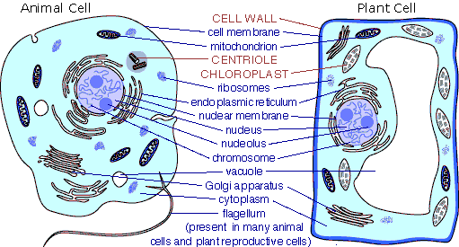
7th Grade : Label the Organelles and write the function they perform for the cell underneath the name/label of the organelle

