Slide 1
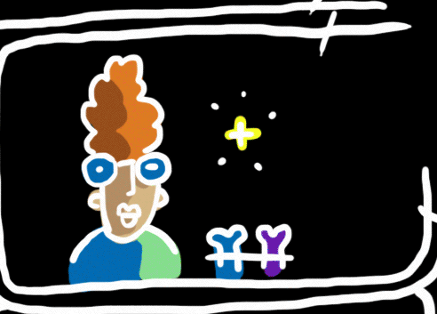
May 9, 2017
1. Sharpen Pencil
2. Collect PDN
3. Sit in assigned Seat
4. Work with table partner, if you have one to complete the PDN to the best of your ability

Slide 2
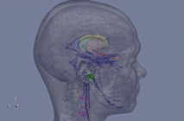
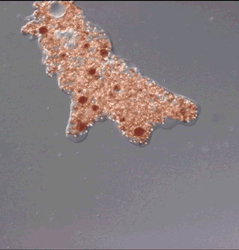
1st LO: We will investigate what scientific models are and how they are used in a science classroom through completion of a note outline.
2nd LO: We will review cell theory, prokaryotic and eukaryotic cells to prepare for the spring acp through card sorts and written assessment.

Slide 3
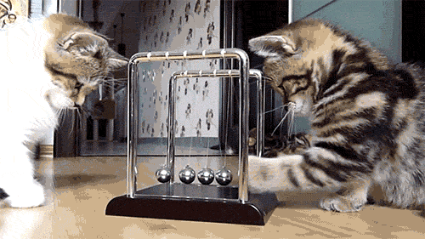
DOL: I will complete written assessment questions over scientific models via a test.

Slide 4
Scientific Models
Typed by : Katherine Pease

Slide 5
What are the three main types of scientific models?

Slide 6
A globe of the world is an example of a physical model because it shows the actual shape and location of the continents in our world.

Slide 7
What are 3 important things to remember about models?
1. They are tools that can help us.
2. They can be used when making a hypothesis, prediction.
3. They have limitations and due to this may vary somewhat from 1 model an object versus another model of the same object.

Slide 8
Is a mathematical or a conceptual model more accurate?
Mathematical Model

Slide 9
What is one of the biggest limitations that a model can have?
It can only show a portion of a system.

Slide 10
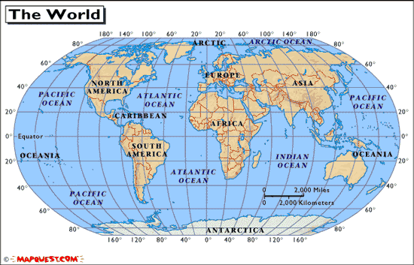
Which type of map, a globe or a flat map is a more accurate physical model of the world?
A globe
The world is not flat

Slide 11
Is the weather man always correct in his predictions? Is this possibly due to the mathematical models that use to predict the weather?
No they are not.
Yes it is due to the mathematical model they use.
So.. The mathematical model weather men use are not always accurate.

Slide 12
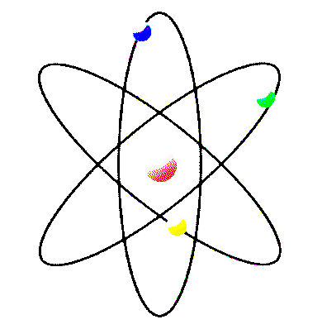
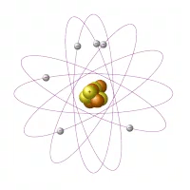
What would be the pro’s of using a model of an atom versus using a real atom?
It can be done far more easily than the system it shows.
A real atom is to small for our eyes to see naturally.
A model of atom is made larger so it is easier to see.

Slide 13
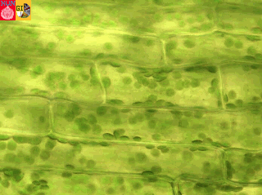
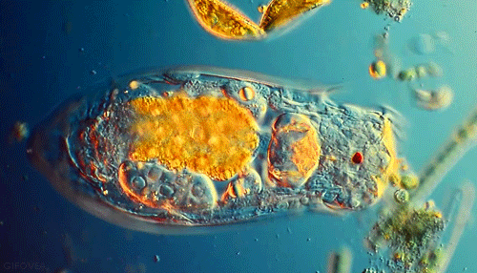
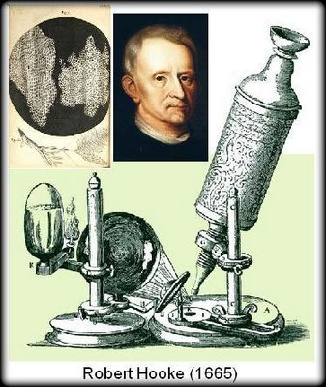
Why does a model of a cell that Robert Hooke may have made based on what he saw different from the model of a cell we use today?
New Technology
Better, more powerful microscopes

