Slide 1
Rube Goldberg Machine
By K. Pease
2018-19

Slide 2
What is a Rube Goldberg Machine???
Imagine this: Your drop a marble into a paper towel tube chute. The marble slides down and hits a chain of dominoes. The dominoes fall, and the final one hits a small toy car. The car pushes a dog treat off the edge of the table. Success! The family dog snatches up the treat when it falls to the floor.
This is an example of a Rube Goldberg machine, a complex contraption designed to achieve a simple task. It’s actually listed in Merriam-Webster’s dictionary as an adjective: “doing something simple in a very complicated way that is not necessary.”

Slide 3
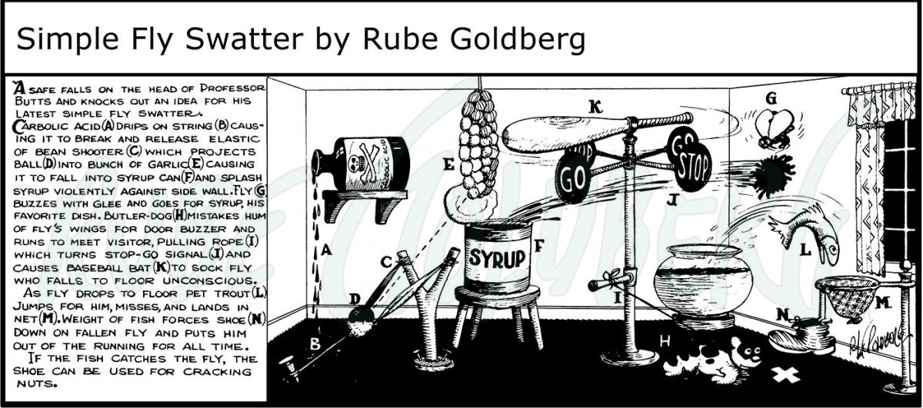

Slide 4
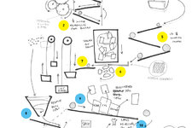
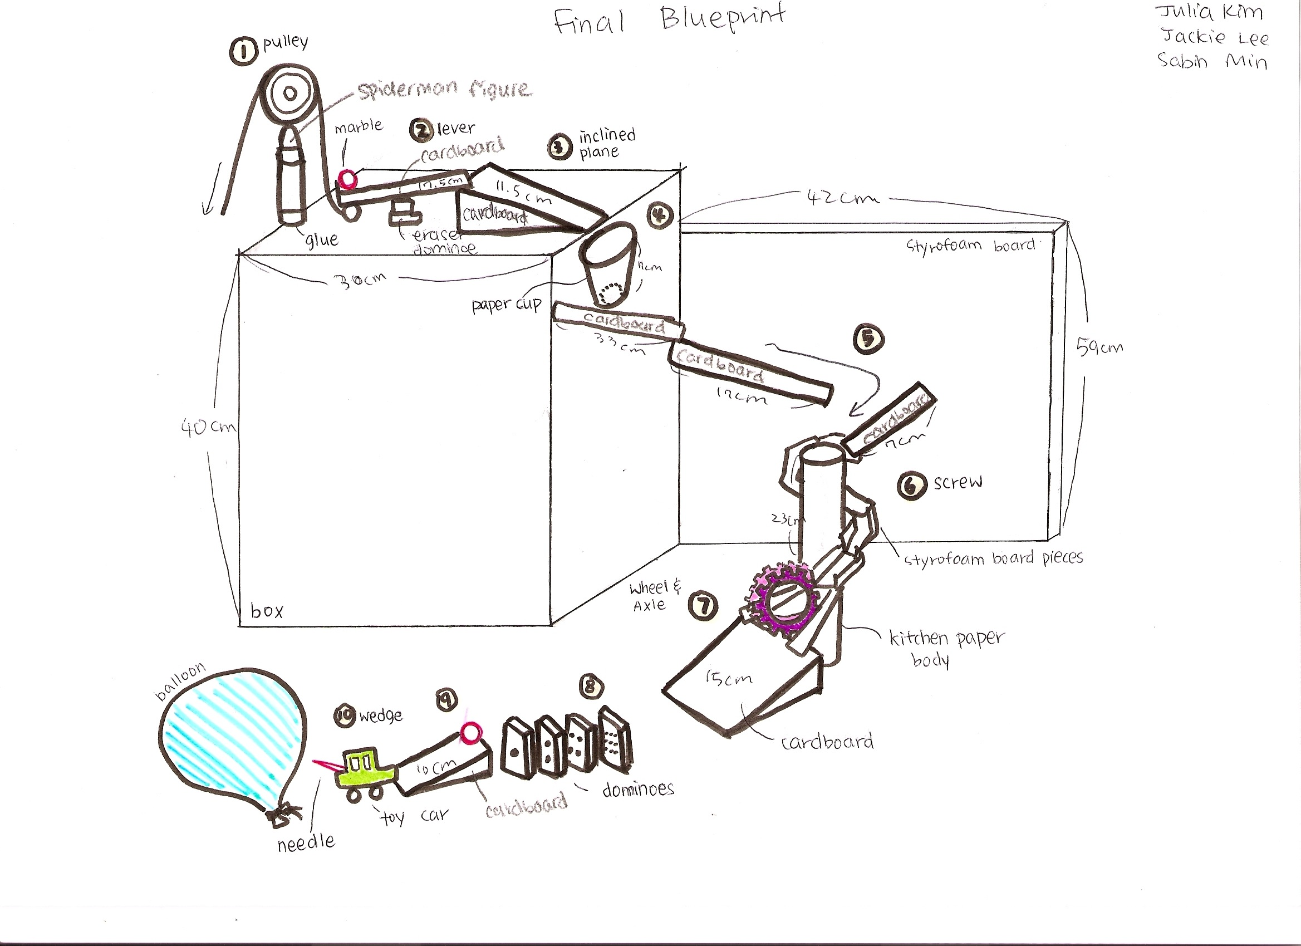
Examples:

Slide 5
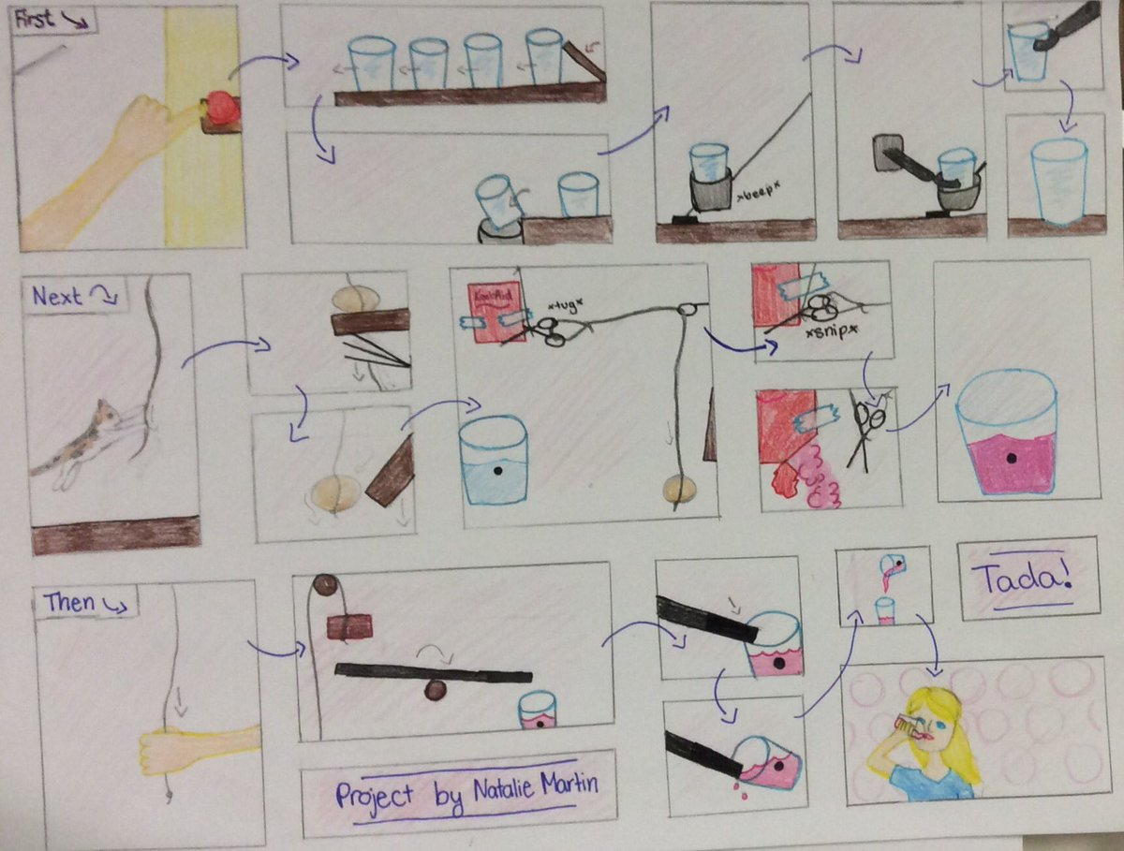
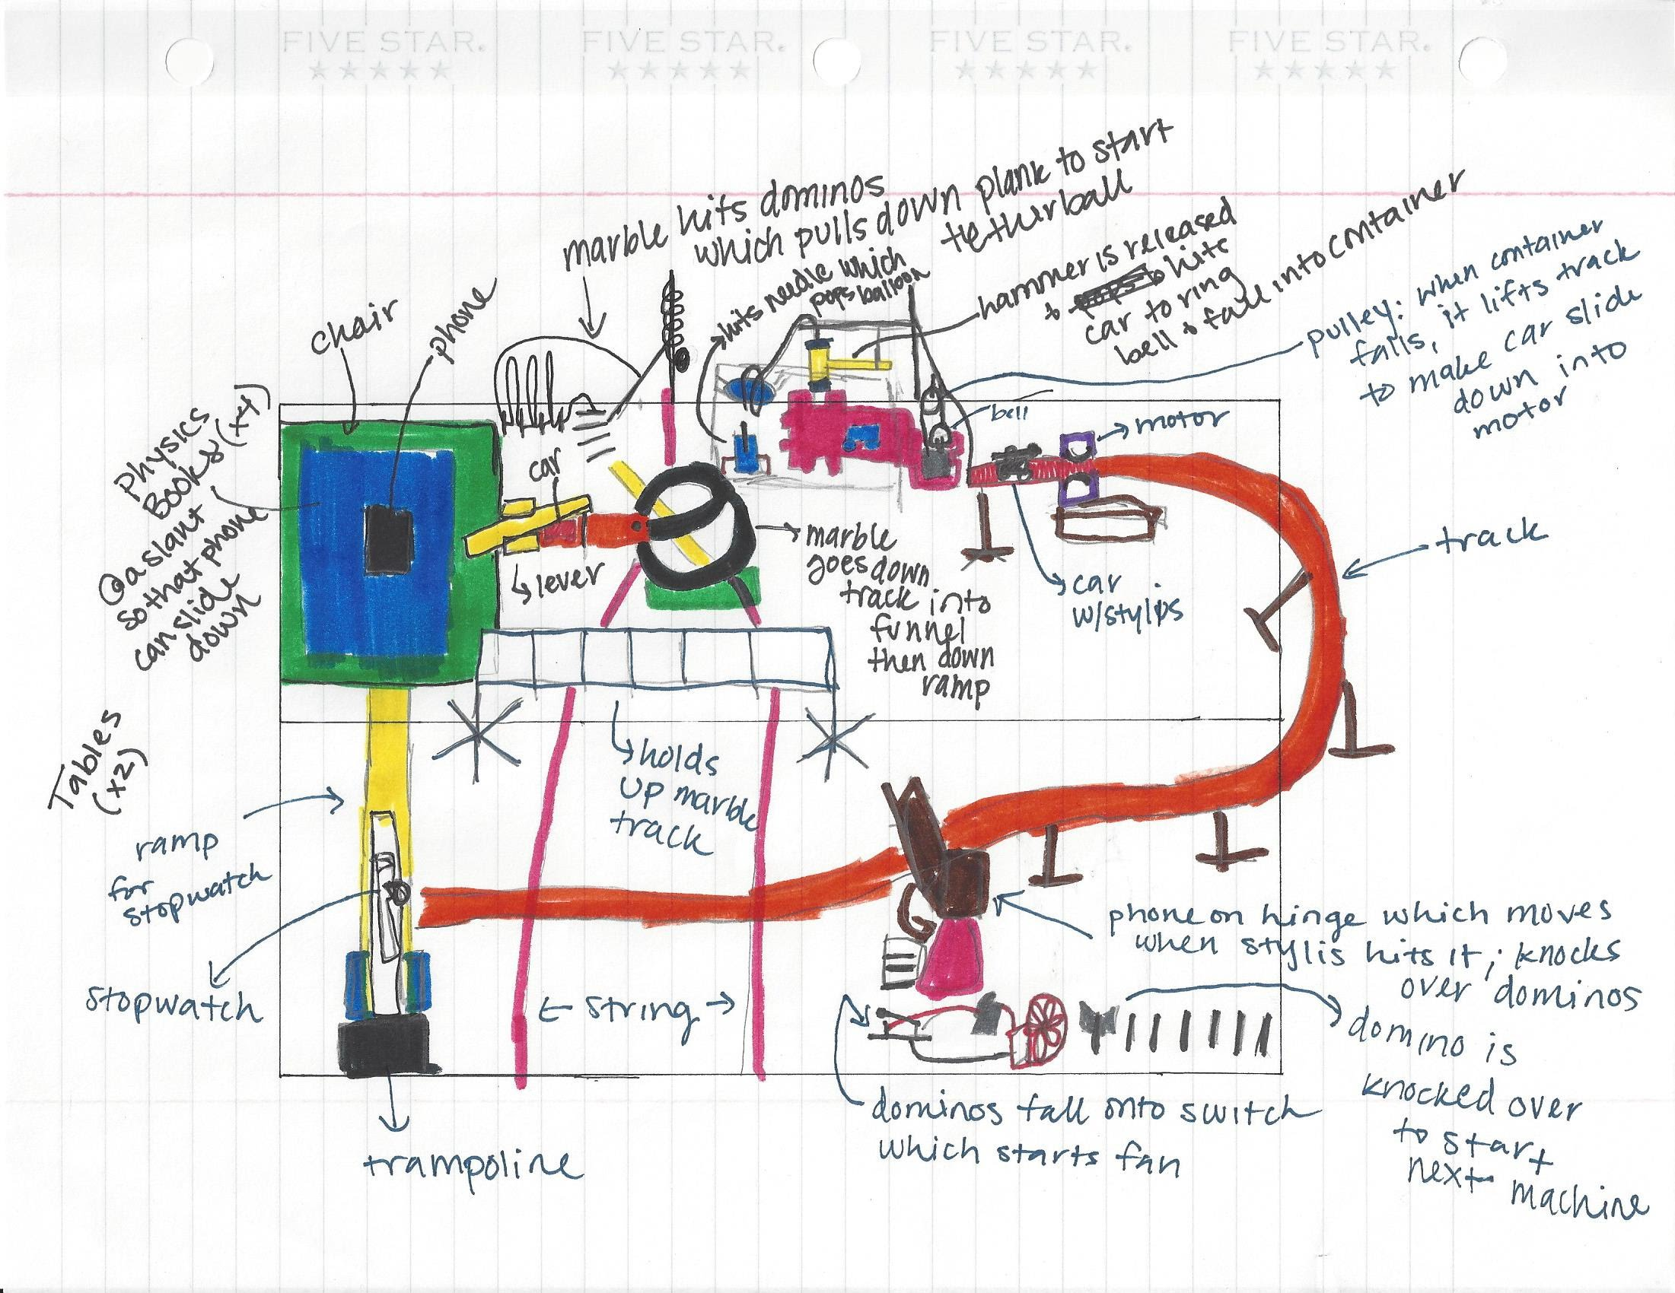
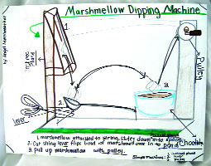
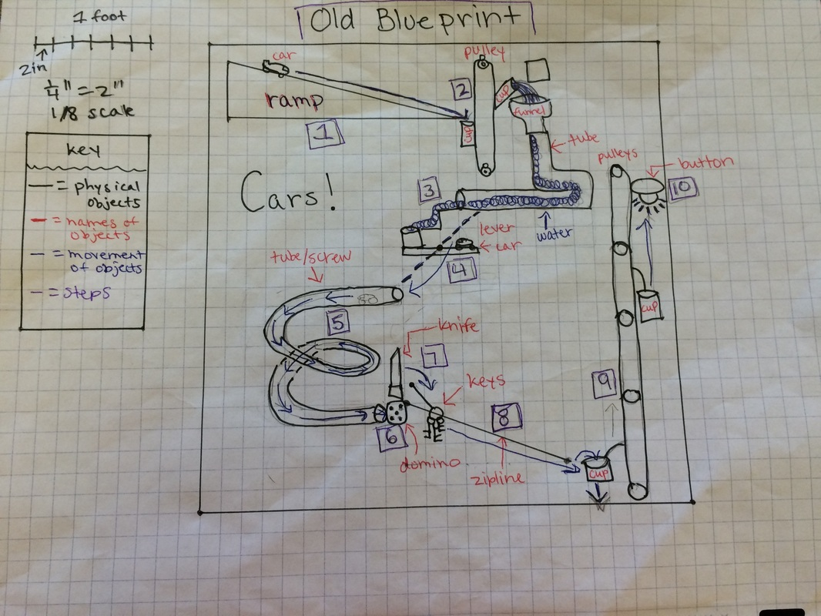

Slide 6
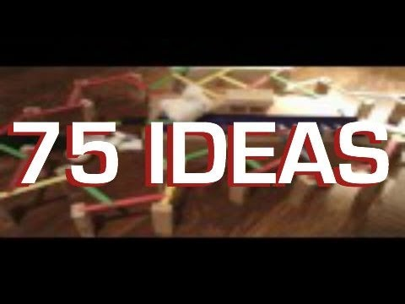
Watch the video below to see examples of rube goldberg machine for ideas.
https://www.youtube.com/watch?v=6FzUx2EFk8s

Slide 7
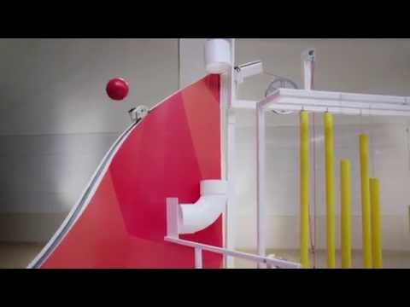
https://www.youtube.com/watch?v=GEzcO3nfjZk

Slide 8
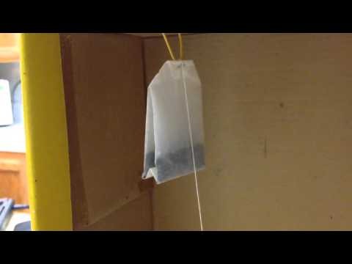
https://www.youtube.com/watch?v=w_12tenPbxM

Slide 9
Objective: To create a machine that will accomplish a task through using numerous energy transformations.
Procedure: Students will create a “blueprint” design (detailed diagram of project)
*Where a task is accomplished or an item is produced.
*Design must include 2 or more energy transfers.
*Students will also include description of where and what the
energy transfers are
*Final Designs will be judged on Monday, Dec. 10, 2018 3/4th per.
*Prizes will be available for 1st/2nd/3rd place

Slide 10
Additional Extra Credit for 3rd 6 Weeks
Due Monday, Dec. 10, 2018
Create a Rube Goldberg Machine that’s end result is to do a simple task such as spin a top.
“Steamposium Competition for 6th Grade Science”
Only the top 2 will be able to go to steamposium.
If want a chance to go, task must be to spin a top, see following slides for more information.
See slide that follows for explanation…

Slide 11
GISD Steamposium 6th Grade Competition: create a Rube Goldberg machine that spins a top.
Your challenge is to design and build a Rube Goldberg machine that will creatively perform the simple task of spinning a top.
Be creative! We encourage your team to use as many everyday items as possible and to include recycled and repurposed materials as well.
1. Your machine must take between 10 and 60 steps to complete the task.
2. Dimensions: no greater that length of 2 meters, depth of 1 meter, and a height of 2 meters. Tables will not be provided.

Slide 12
Cont. from previous slide...
3. Your engineering journal must reflect the engineering design process and contain a step list that explains each energy transformation.
4. The following are NOT allowed: AC or DC power cords, hazardous materials, explosives or flames, animals.
For more information see the website: www.gisdsteam.weebly.com

Slide 13
Possible Resources for Ideas...
https://blog.connectionsacademy.com/build-your-own-rube-goldberg-machine/
https://diy.org/skills/physicist/challenges/389/make-a-rube-goldberg-machine
https://sciencestruck.com/how-to-build-rube-goldberg-machine
https://www.teachengineering.org/activities/view/cub_simp_machines_lesson05_activity1
https://www.pinterest.com/ritacasey/rube-goldberg-ideas/?lp=true
https://study.com/academy/lesson/rube-goldberg-machine-ideas.html
https://www.pinterest.com/pin/571816483919507707/?lp=true
https://sciencing.com/rube-goldberg-project-ideas-13710542.html

