Slide 1
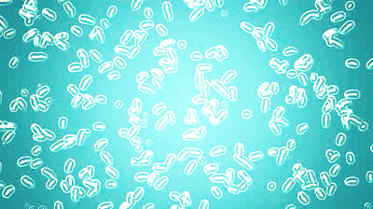
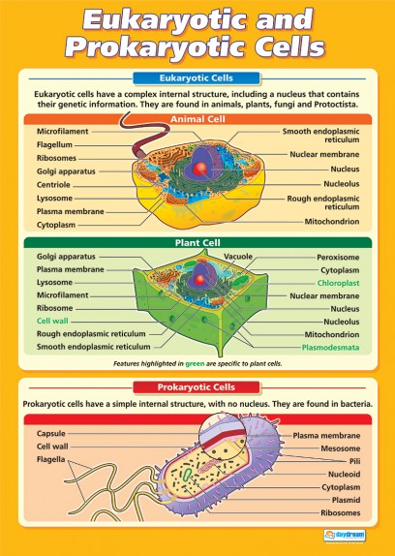
Prokaryotic Vs. Eukaryotic Cells
Foldable Powerpoint
By : Katherine Pease
Foldable by Chris Kesler; www.madsciencelessons.com

Slide 2
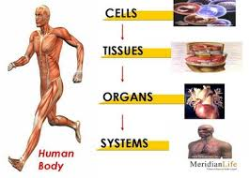
What is a cell?
the basic structural, functional, and biological unit of all known living organisms. Cells are the smallest unit of life that can replicate independently, and are often called the "building blocks of life".

Slide 3
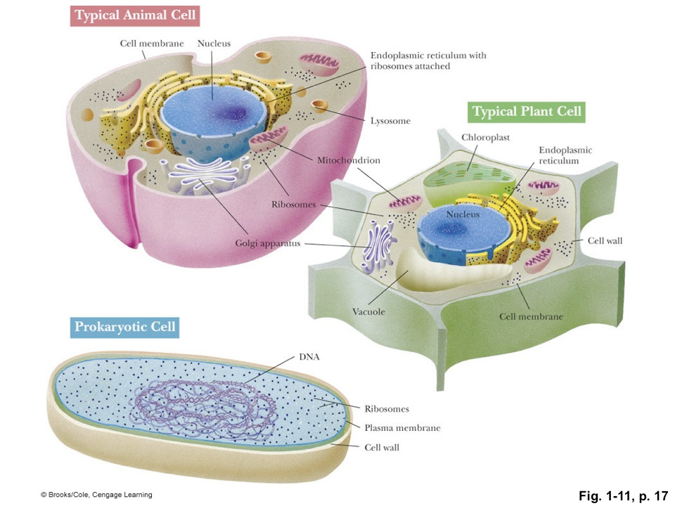
What are the two main types of cells?
Prokaryote
Eukaryote
http://oregonstate.edu/instruct/bb350/textmaterials/ch01.html

Slide 4
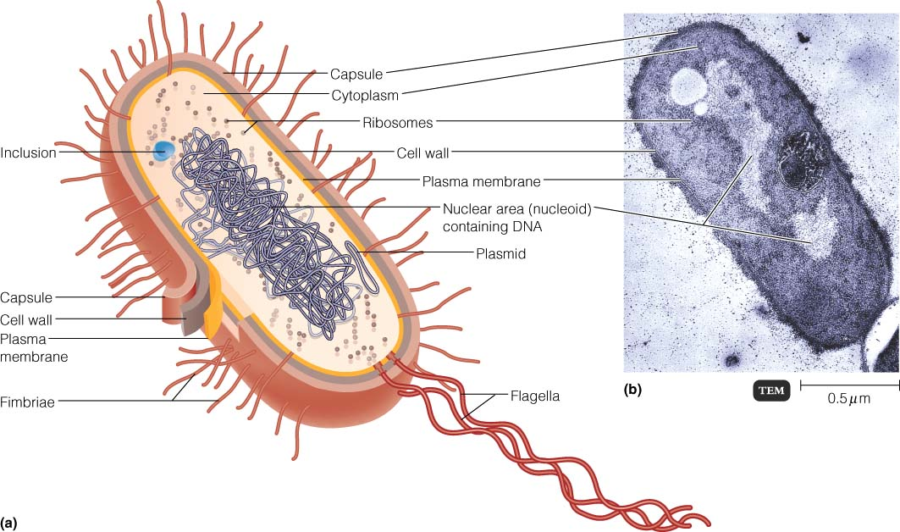
What is special about a prokaryotic cell?
Prokaryotes have no organized nucleus.
Prokaryotes have No chloroplasts, No mitochondria, No nucleus
Prokaryotes are very small.
Prokaryotes are uni-cellular.
Prokaryotes have a “tail” or Flagella to aid in movement.
Prokaryotes DNA is kind of floating around inside the cell.
Prokaryotes have hair like projections called pili.

Slide 5
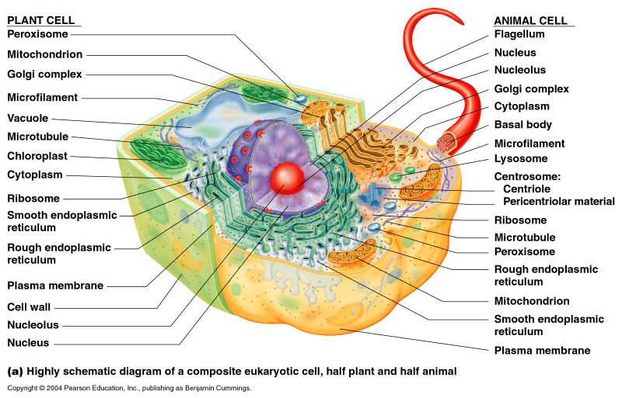
What is special about a eukaryotic cell?
Eukaryotes have a nucleus
Eukaryotes are Membrane Bound/ have a cell membrane
Eukaryotes have more organelles present
Eukaryotes are multi-cellular

Slide 6
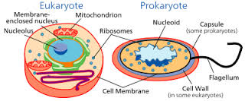
How are a prokaryotic and eukaryotic cell alike?
Click on the link below for answer to the above question
http://www.biologymad.com/resources/AS%20Cells.pdf

Slide 7
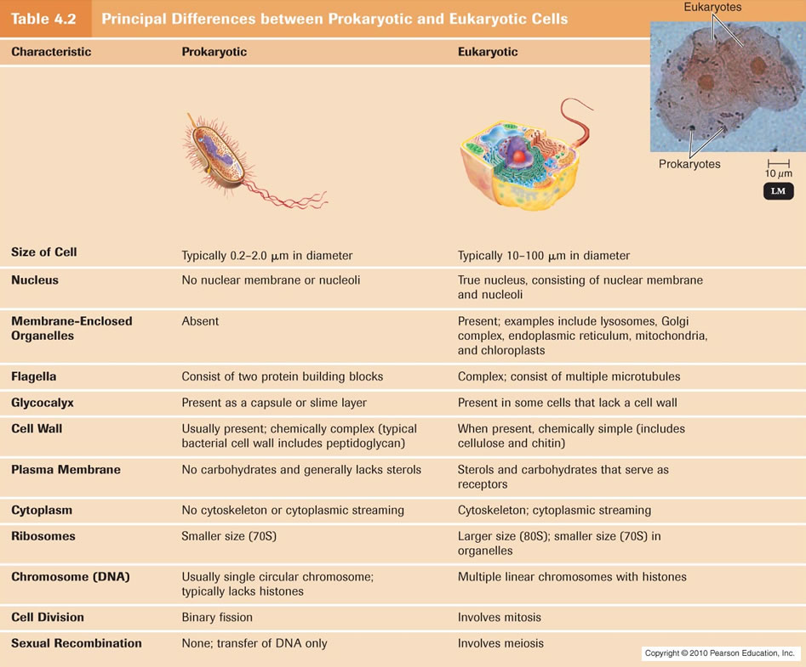
To complete the foldable see the chart below…
https://www.google.com/search?q=eukaryotic+cell+vs+prokaryotic+cell&biw=1366&bih=643&tbm=isch&tbo=u&source=univ&sa=X&ei=1B4rVeD8JoLisAXL94GIBg&ved=0CB0QsAQ&dpr=1#imgrc=TVdCCibz443LIM%253A%3BfWcrUcbkaHH5oM%3Bhttp%253A%252F%252Fclasses.midlandstech.edu%252Fcarterp%252Fcourses%252Fbio225%252Fchap04%252Ftable_04_02_labeled.jpg%3Bhttp%253A%252F%252Fclasses.midlandstech.edu%252Fcarterp%252Fcourses%252Fbio225%252Fchap04%252Flecture1.htm%3B947%3B785

Slide 8
To Review…. Click on the link below (6min. Youtube clip)
https://youtu.be/ruBAHiij4EA
<iframe width="854" height="510" src="https://www.youtube.com/embed/ruBAHiij4EA" frameborder="0" allowfullscreen></iframe>

