Slide 1
Please Do Now / Nov. 12, 2015
1. Sharpen Pencil
2. Sit in the same seat as yesterday
3. Take out planner, write in homework
-complete speed handout
4. Collect Please Do Now from Basket 1 for
Thursday
Collect Wednesday Please Do Now / DOL from
front table (make sure you pick up your paper)
5. Do the Please Do Now for Thursday, complete
Wednesday DOL with justifications if not
completed yesterday.

Slide 2
1. Take out journal 2. Write the question below at top of next empty page 3. Write what you think the answer to the question is on your own
If the speedometer on your car stopped working, how could you calculate how fast you were travelling?

Slide 3
Take 1 minute to pair/share your answer to the question with your small group at your table.
Draw a line under the what you thought the answer was
Write “Small Group Share” on next line
List ideas your group has to answer the question
Draw a line under the “small group share” information
As class discuss, record answers
As watch video clip record new information to help answer the question.
https://youtu.be/JZD3WlqtRyo
Nov. 12, 2015
If the speedometer on your car stopped working, how could you calculate how fast you were travelling?
Small Group Share

Slide 4
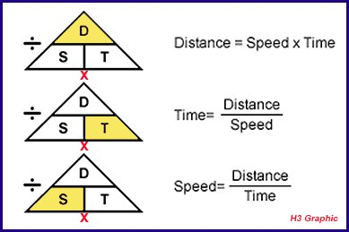
Take out Please Do Now for today. As we go through the triangle, check your answers with mine (correct as needed)

Slide 5
1. Use the link below to determine how fast the cars are moving by completing a virtual lab. 2. Use the information gathered in the lab to complete the data table and comprehensive questions over how fast the car is moving. 3. Use the triangle from the please do now to assist with the lab.
http://glencoe.com/sites/common_assets/science/virtual_labs/E12/E12.html

Slide 6
In the video on how to determine how fast a car is going they talked about using _____ to assist you.
graphs
Follow along with power point link to complete “How to Distance / Time Graphs Practice”
Location of Link…
1. Type in www.coachpease.com into URL line on chrome book
2. Click on the 3rd 6 Weeks Link
3. Scroll down to the “Distance Time Graphs” file under 6th Grade 2015-16
4. Click on the link “Distance Time Graphs”
5. Collect Handout from Teacher as loads
6. Once loads click on “present” in upper right corner
7. Begin completing the note outline / practice page.

