Slide 1
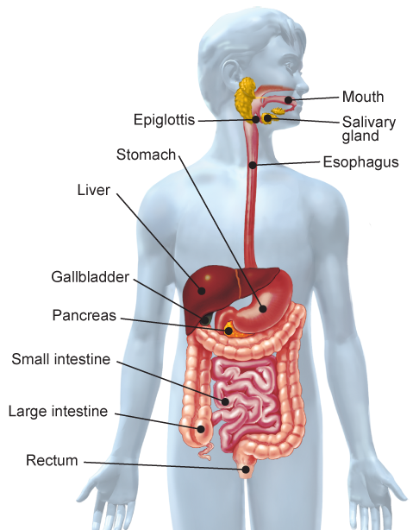
What is the digestive system?
The process by which your body breaks down food into small nutrient molecules is called digestion. Digestion of food involves both physical and chemical changes.
Physical changes involve the physical tearing, grinding, crushing, and churning of pieces of food. These processes increase surface area, which helps speed up the chemical changes of digestion.
During chemical changes, chemicals break foods into their building blocks.
The organs of the digestive system have three main functions: digestion, absorption, and elimination.

Slide 2
What changes occur in the mouth and stomach?
Food enters your body through your mouth, where physical and chemical changes begin.
Your teeth cut, tear, crush, and grind the food into small pieces. This is a physical change.
Saliva in your mouth brings about two physical changes. Saliva moistens food, making it easier to swallow. It also dissolves some foods, such as salt.
Saliva also brings about a chemical change. An enzyme in saliva begins the breakdown of starch into sugars. An enzyme is a protein that speeds up chemical reactions in your body.
(contd.)

Slide 3
When you swallow, food enters the esophagus. Peristalsis, waves of involuntary muscle contractions, push food toward the stomach. There, more physical and chemical changes occur.
Physical Changes Layers of smooth muscle in the stomach wall contract and produce a churning motion that mixes food with fluids in the stomach. Mucus in the fluids keeps the food moist and protects the stomach lining from other chemicals.
Chemical Changes Gastric fluids also mix with the food. These fluids contain the enzyme pepsin, which breaks down proteins into short chains of amino acids. Hydrochloric acid provides the acid environment in which pepsin works best. It also helps kill many bacteria that you swallow with your food.
1. Summarize What is the result of the chemical changes that occur in the mouth and stomach?

Slide 4
What changes occur in the small intestine?
Most of the chemical changes of digestion take place in the small intestine.
Starches and proteins that reach the small intestine are partly broken down by the time they reach the small intestine. Lipids are not.
Substances produced by the liver, pancreas, and lining of the small intestine help to complete the chemical changes that turn carbohydrates, proteins, and lipids into small molecules.
2. Infer At 6−7 meters in length, the small intestine makes up two-thirds of the length of the digestive system. Its diameter is 2−3 cm. From this, infer what gives the small intestine its name.
(contd.)

Slide 5
Glands in the small intestine release enzymes that help break down peptides into individual amino acids. Other glands produce enzymes that continue the digestion of complex sugars, producing the simple sugars the body uses for energy.
The liver produces bile, which is stored in the gallbladder and released into the small intestine through a duct. There, bile physically breaks up large lipid particles into smaller droplets.
Enzymes produced by the pancreas act on the droplets and chemically change them into smaller molecules. The pancreas also produces enzymes that help break down carbohydrates and proteins.
After these chemical changes occur, the small nutrient molecules are absorbed through the surface of the small intestine into the blood. Villi, tiny finger-shaped structures, cover the wall of the intestine and increase its surface area. This allows more nutrients to be absorbed.

Slide 6
What changes occur in the large intestine?
By the time material reaches the end of the small intestine, most nutrients have been absorbed.
The water and undigested food that remain move into the large intestine. There, most of the water is absorbed into the bloodstream. The material that is left is readied for elimination from the body through the rectum.
As wastes move through the 1.5-meter-long large intestine, bacteria feed on the material. These helpful bacteria make certain vitamins, including vitamin K.
3. Restate What physical changes occur as matter moves through the large intestine?

