Slide 1
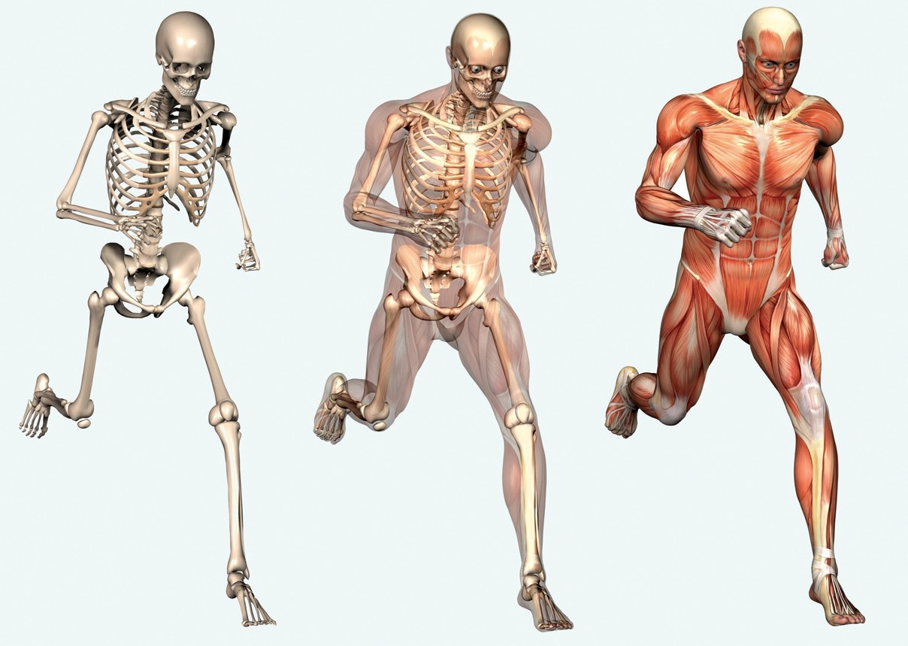
Skeletal System Play Dough Activity
Written By: Katherine Pease
https://encrypted-tbn0.gstatic.com/images?q=tbn:ANd9GcTkkdQars9oMDIpBbItG_sPwVfW_xvnLA9ubR2JLI3rbzqlVdhl

Slide 2
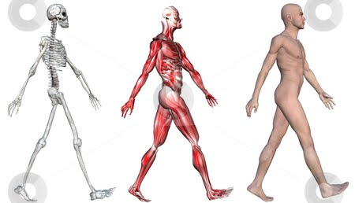
Essential Question:
What would happen if all our bones turned super soft like play dough? What 2 body systems would this effect? Explain.
https://sites.google.com/site/teachergenna/_/rsrc/1336240461353/lesson-2-the-skeletal-and-muscular-systems/cutcaster-photo-100060625-Skeleton-Muscles-of-a-Human-Male.jpg

Slide 3
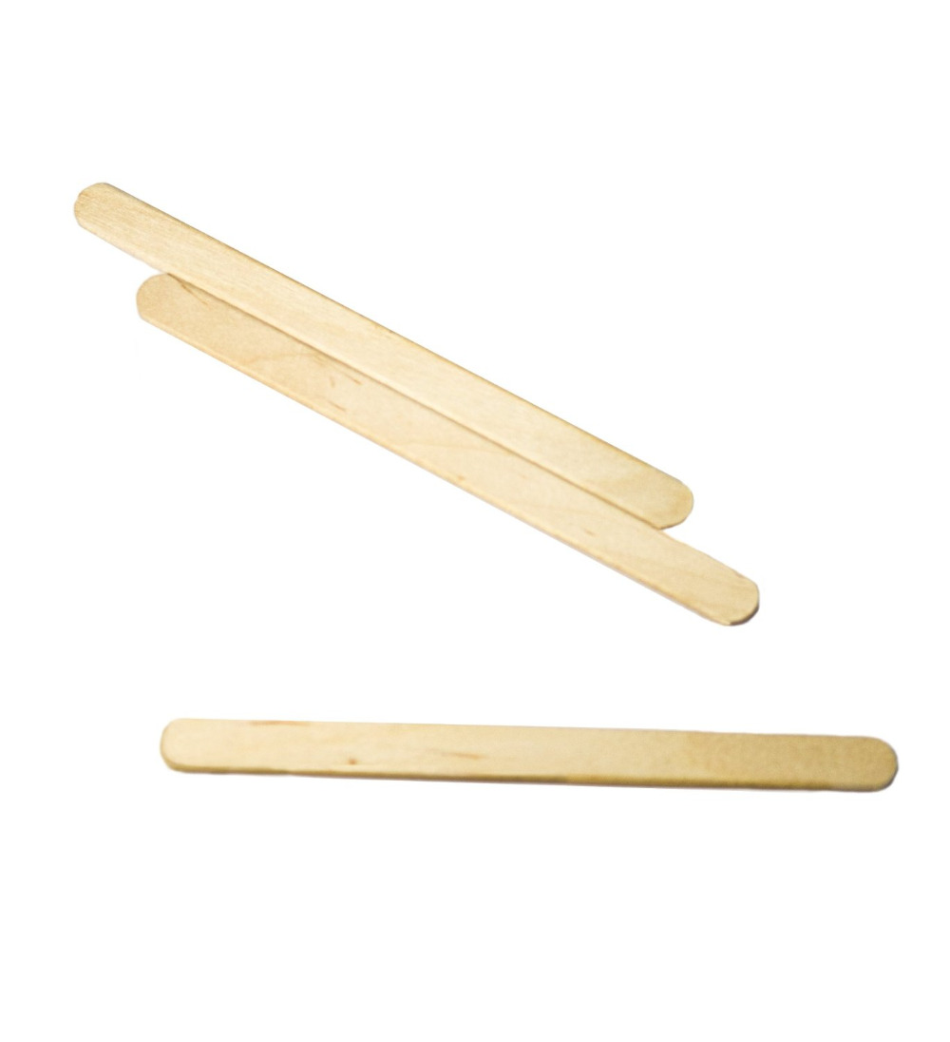
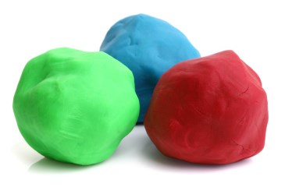
Materials for Lab…
2 pre-determined amounts of play dough (teacher pre-makes)
1 popsicle stick / craft stick
Paper towel
Journal to record data
Pen/Pencil that works
http://g02.a.alicdn.com/kf/HTB17Y4bJFXXXXcYXXXXq6xXFXXXG/50Pcs-Wooden-Popsicle-Stick-Kids-Hand-Crafts-Art-Ice-Cream-Lolly-Cake-DIY-Making.jpg
http://i.infopls.com/images/Basic_Uncooked_Play_Dough_H.jpg

Slide 4
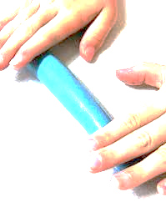
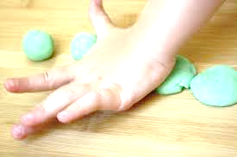
Procedure:
1. answer essential question in journal
2. Take out both pre-determined amount of play dough and roll both into a fat snake.
3. Take one “snake” and lay it flat on top of table, push down to flatten it like a pancake
4. Put the popsicle stick in the middle of your “pancake” and fold the sides up and over the popsicle stick so none of the stick can be seen
5. Re-roll this into a fat snake.

Slide 5
Procedure Continued:
6. Answer question in journal: What do you think the play dough / popsicle stick represent in your body?
7. Place both fat Snakes so they are reaching for the ceiling
8. Push down on top of the only play-dough snake
9. Write/Record what happens in journal
10. Push down on top the play-dough snake with the popsicle stick
11. Write/Record what happens in journal
12. Take the popsicle stick out of the play-dough
13. Roll both “snakes” of play dough back into 2 balls
14. Place the play-dough back into baggie and seal tight
15. Bring all supplies back to the counter
16. Return to table and answer questions on next slide in journal
Table Top

Slide 6
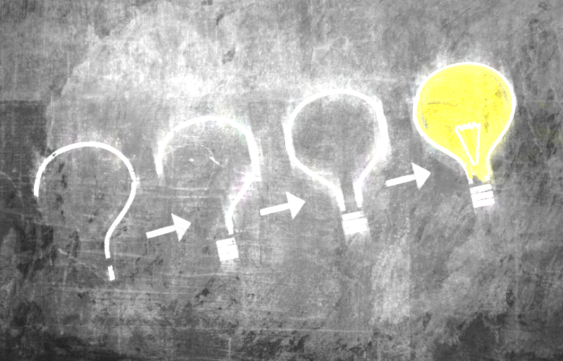
Conclusion To Lab Questions:
Directions: Write out question and answer in journal
1. What 2 body systems do you think this lab represented? Explain
2. What type of tissue does the play-dough represent? What body system does it belong to?
3. What organ does the popsicle stick represent? What body system does it belong to?
Questions Continue onto Next Slide

Slide 7
4. Explain what happened when you pushed down on the play-dough only. How does it relate to your body?
5. Explain what happened when you pushed down on the play-dough with the popsicle stick rolled inside it. How does this relate to your body?
6. Bases on your observations; explain what would happened to our muscular system if we did not have our skeletal system.
7. Based on your observations; explain what the main function of the skeletal system is.

