Slide 1
October 5, 2016 / 7th grd.
Sharpen Pencil
Collect PDN, Clicker
Take your assigned Seat
Use the Packet on the Clipboard to assist with PDN

Slide 2
October 5th, 2016 / 6th Grd
1. Sharpen Pencil
2. Collect PDN, Clicker, Textbook
3. Sit at assigned seat silently
4. Open Textbook and use information to complete PDN

Slide 3
PDN: Catastrophic Events / Human Impact
Directions: Use pg. 568-569 from the textbook Interactive Science (handout copy) and use the information to answer the questions below..
.
Answer | Key Word Bank
A | Activity
B | Wetland’s
C | Land-Use Practices
D | Prepared
E | Meteorologists
# | Question / Statement | Answer
1 | What are scientist that study weather called?
2 | What land area’s act as a sponge by soaking up water and then releasing it slowly over time called?
3 | Humans can not predict when a storm will hit but we can play a positive or negative role on how it effects the land through our _________________.
4 | One of the best ways to reduce the severity of a catastrophic event is to be ____________ before it hits.
5 | An example of safe ________________ is when San Antonio built a tunnel that passes under the city to divert floodwater.
E
B
A
D
C

Slide 4
PDN: Forms of Energy
Directions: Open your textbook to pg. 190-195 and use the information to answer the questions below.
Answer | Key Word Bank
A | Energy
B | Chemical Energy
C | Electrical Energy
D | Kinetic Energy
E | Thermal Energy
# | Question / Statement | Answer
1 | What can take on many different forms and have many different effects that can cause change?
2 | What type of kinetic energy is created when particles are moving faster when warm/hot and slower when cool/cold?
3 | What type of potential energy is found in the foods you eat, batteries, and matches?
4 | What type of energy moves within wire to create a current?
5 | What type of energy does an object have that is in motion?
A
E
B
C
D

Slide 5

7th Grade Essential Question
Have you ever experienced a natural disaster, such a hurricane, tornado or severe flood? What would you do to prepare if you knew one of these type of disasters were heading your way? Explain

Slide 6
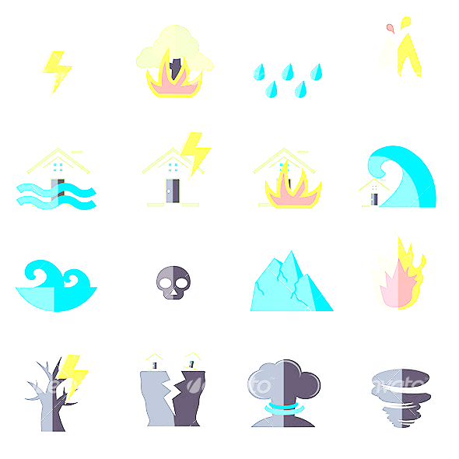
7th Grd. TEKS
7.8A Predict and describe how different types of catastrophic events impact ecosystems such as floods, hurricanes, or tornadoes.

Slide 7
7th Grd. LO / DOl
LO: We will investigate catastrophic events and the damage they cause through differentiated play list activities.
  TEK: 7.8A Predict and describe how different types of catastrophic events impact ecosystems such as floods, hurricanes, or tornadoes.

Slide 8
7th Grd. Lo / Dol
DOL: I will complete 5 written assessment questions over catastrophic events via the all in clickers.

Slide 9
6th Grd. TEKS
6.9 Force, Motion and energy. The student know what the law of conservation of energy states that energy can neither be created nor destroyed, it just changes forms.
6.9 A: Compare and contrast potential and kinetic energy
6.9C: The student is expected to demonstrate energy transformation such as energy in a flashlight battery changes from chemical energy to electrical energy to light energy.

Slide 10
6th Grd. LO / Dol
LO: We will compare/contrast energy and the different forms that it can be found in by creating a vocabulary flashcard game.
TEKS: 6.9 A: Compare and contrast potential and kinetic energy
6.9C: The student is expected to demonstrate energy transformation such as energy in a flashlight battery changes from chemical energy to electrical energy to light energy.

Slide 11
6th Grd. Lo / DOL
DOL: I will complete 5 written assessment questions over forms of energy via the all in clickers.

Slide 12
DOL Quiz: Catastrophic Events
Which of the following is a possible effect of a catastrophic event?
  A: animals killed C: habitats damaged
  B: erosion D: all of the above
2. Which of the following can cause high waves along coastlines and result in the beach erosion?
A: tornado C: pollution
B: flash flood D: hurricane
3. Which of the following human activities can increase the severity of a catastrophic event?
A: recycling C: burying power lines
B: land development D: weather forecasting
# | Statement | True or False
4 | A hurricane is a rapidly spinning column of air that reaches down from a thunderstorm and touches Earth’s surface.
5 | A natural hazard is a physical event resulting from Earth’s processes that has the potential to harm the environment and people.

Slide 13
7th Grd. PlayList
If you scored a ___% on the DOL/Quiz you must complete station listed below…
0 to 100% Station 0= pg. In textbook
69% or lower = Station 1
70% to 89% = Station 2
90% or higher = Station 3

Slide 14
All Students Must Do = Station 0
Student will complete pg. 607 in Textbook on own
Once complete put name , class period at top of paper
Rip out of textbook and turn into class milk crate for a grade

Slide 15
69% or Less = Station 1
Students will do a card sort over different types of catastrophic events with teacher group
Students will create a compare/contrast Booklet over the Catastrophic Events

Slide 16
70% to 89% = Station 2
Students will pick 1 catastrophic disaster to make an informative poster over.
Students may make poster either in groups of 2 or by themselves
Teacher will have pre-Ran Handout to explain

Slide 17
90% or Higher = Station 3
Students will create a “What to do in case of ____________” presentation using google slides on own.
Teacher will supply Pre-Ran handout to explain

