Slide 1
October 4, 2016 / 7th grd.
Sharpen Pencil
Collect PDN, Clicker
Take your assigned Seat
Use the Packet on the Clipboard to assist with PDN

Slide 2
October 4th, 2016 / 6th Grd
1. Sharpen Pencil
2. Collect supplies to complete Metal / Nonmetal / Metalloid poster project
3. Sit with partners you are working on the project with and complete your project

Slide 3
PDN: Catastrophic Events / Floods
Directions: Use pg. 564-565 from the textbook Interactive Science (handout copy) and use the information to answer the questions below.
Answer | Key Word Bank
A | Natural hazard
B | Flash flood
C | Erosion
D | Pollution
E | Catastrophic Event
# | Question / Statement | Answer
1 | What is it called when something can greatly impact ecosystems by causing erosion, killing organisms, damaging habitats, and spreading pollution?
2 | What is a physical event resulting from Earth’s processes that have the potential to harm the environment and people called?
3 | A rapid flow of a large amount of water into a low-lying area is called a ___________________?
4 | When flash floods wash away large amounts of soil, we call this process ____________________.
5 | Flash floods can cause of the release of harmful materials, such as sewage into the water table. This is an example of ______.
E
A
B
C
D

Slide 4
7th Grade Essential Question
Have you ever experienced a natural disaster, such a hurricane, tornado or severe flood? What would you do to prepare if you knew one of these type of disasters were heading your way? Explain

Slide 5
7th Grd. TEKS
7.8A Predict and describe how different types of catastrophic events impact ecosystems such as floods, hurricanes, or tornadoes.

Slide 6
7th Grd. LO / DOl
LO: We will compare/contrast different types of catastrophic events in our world by completing a foldable.
TEK: 7.8A Predict and describe how different types of catastrophic events impact ecosystems such as floods, hurricanes, or tornadoes.

Slide 7
7th Grd. Lo / Dol
DOL: I will complete 5 written assessment questions over catastrophic events via the all in clickers.

Slide 8
6th Grd. TEKS
6.5C differentiate between elements and compounds on the basic level
6.5D identify the formation of a new substance by using the evidence of a possible chemical change such as production of gas, change in temperature, production of a parcipitate, or color change.
6.6A compare metals, nonmetals, and metalloids using physical properties such as luster, conductivity, or malleability

Slide 9
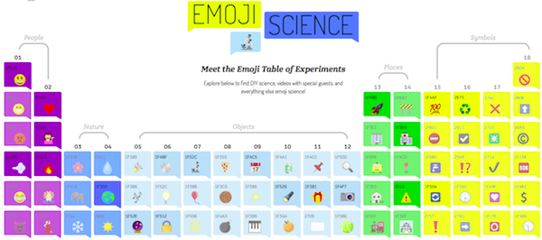
6th Grd. LO / Dol
LO: We will create a poster to demonstrate our knowledge over the different groups of elements on the periodic table to demonstrate our knowledge over specific elements on the periodic table.
TEK: 6.5C differentiate between elements and compounds on the basic level
6.5D identify the formation of a new substance by using the evidence of a possible chemical change such as production of gas, change in temperature, production of a parcipitate, or color change.
6.6A compare metals, nonmetals, and metalloids using physical properties such as luster, conductivity, or malleability

Slide 10
6th Grd. Lo / DOL
DOL: I will complete an exit slip to explain 3 new things I learned about the group of elements that my poster project is about.

Slide 11
7th Grd. Catastrophic Event Foldable
Login to www.coachpease.com
Click on Schoology
Click on link : http://dallasisd.schoology.com
Click on Courses
Click on Science
Click on Purple/Pink Folder for Catastrophic Events
Use information Provided to complete

Slide 12
7th Grd. Card Sort
Once Foldable is complete
Collect Catastrophic Events Vocab Match Up Card Sort
Reading directions inside the bag to play
May do groups of 1 to 4 players top.

