Slide 1
October 19, 2016
Sharpen Pencil
Collect PDN, textbook
Sit in assigned seat
Complete your PDN

Slide 2
7th / 6th Grade PDN
Collect 1 fryer model with vocabulary word already on it to complete.
You will not have the same word as your neighbor
Please take your time, these will be hung up for others to see
Definition
From
book
Definition
in own
words
Vocab
Word
Picture
Example of
What it is not

Slide 3
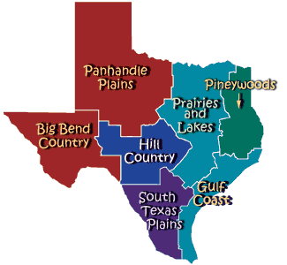
7th Grade TEK
7.8A: predict and describe how types of catastrophic events impact ecosystems such as floods, hurricanes, or tonadoes
7.8B: analyze the effects of weathering, erosion, and deposition on the environment in ecoregions of Texas
7.8C: model the effects of human activity on groundwater and surface water in a watershed.

Slide 4
7th Grade LO
LO: We will create an informative presentation that interprets how wreathing, erosion, deposition, natural disasters and human impact on water effect Texas ecoregions.
7.8A: predict and describe how types of catastrophic events impact ecosystems such as floods, hurricanes, or tonadoes
7.8B: analyze the effects of weathering, erosion, and deposition on the environment in ecoregions of Texas
7.8C: model the effects of human activity on groundwater and surface water in a watershed.

Slide 5
7th Grade DOL
I will complete an exit slip that will explain 5 new things I learned about TX ecoregions.

Slide 6
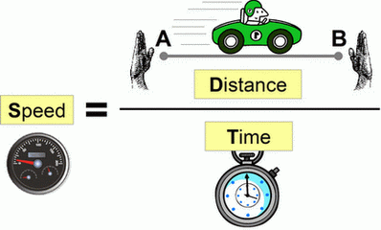
6th Grade TEK
6.8C Calculate Average Speed using distance and time measurements

Slide 7
6th Grade LO
LO: We will determine how to solve for average speed of an object in motion through completion of practice math problems.
TEK: 6.8C: Calculate average speed using distance and time measurements.

Slide 8
6th Grade DOL
DOL: I will complete 5 written assessment questions over average speed via the all in clickers.

Slide 9
6th Grade Essential Question
If the speedometer in my car was broken, how could I figure out how fast the car was moving at an average speed in my trip to the mall?

Slide 10
7th Grade Project
Use the information gathered to create a poster over your assigned eco-region
Poster must include…
Name of Ecoregion
Location of ecoregion on TX map : picture of map
Landscape (how it looks, what it is made up of) : picture of landscape with description
Climate (temperature/rainfall)
Types of animals / plants commonly found : 2 pictures, 1 animal/1plant
How (weathering / erosion / deposition) effect the landscape : picture of one
Human Effects on the watershed in the region
Natural Disasters that are prone to occur
Damage Natural Disasters cause to the area: picture of natural disaster destruction

Slide 11
6th Grade Video Clip
https://youtu.be/JZD3WlqtRyo

Slide 12
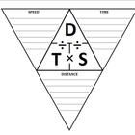
6th Grade Speed Triangle

