Slide 1
October 17, 2017
Collect PDN / DOL from basket
Collect Clicker from Drawer
Sharpen Pencil
Take assigned seat
Complete PDN / DOL on Own

Slide 2
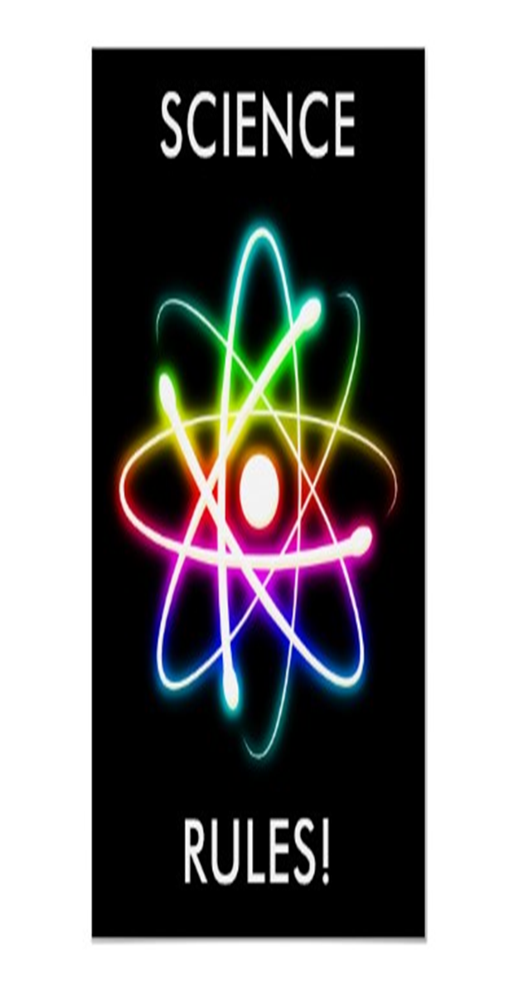
7th Grade
LO: We will identify the structures and functions of the endocrine system.
6th Grade
LO: We will compare / contrast the different types of energy.

Slide 3
7th Grade
DOL: I will identify the structures of the endocrine system in an exit slip.
6th Grade
DOL: I will complete written assessment questions over types of energy.

Slide 4
7th Grade
1. PDN
2. Vocab Quiz
3. Endocrine System Foldable
4. DOL
6th Grade
1. DOL Quiz
2. Types of Energy Foldable.
3. DOl

Slide 5
7th Grade
7.12 (B) identify the main functions of the systems of the human organism, including the circulatory, respiratory, skeletal, muscular, digestive, excretory, reproductive, integumentary, nervous, and endocrine systems
6th Grade
6.7 (A) research and debate the advantages and disadvantages of using coal, oil, natural gas, nuclear power, biomass, wind, hydropower, geothermal, and solar resources

