Slide 1
October 14, 2016
Sharpen Pencil
Collect textbook, pdn, clicker
Sit in assigned seat
Open textbook and READ to complete the pdn / Do card sort

Slide 2
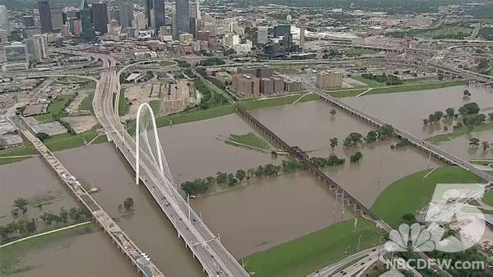
Essential Question
If someone handed you a glass of water and told you that it was taken directly from the trinity river would you drink it? Why or Why not? Explain.

Slide 3
7th Grade TEk
7.8C Earth and Space. The student knows that natural events and human activity can impact earth systems. The student is expected to model the effects of human activity on groundwater and surface water in a watershed.

Slide 4
7th LO
LO: We will compare and contrast watersheds, ground water and surface water through completion of a foldable.
7.8C Earth and Space. The student knows that natural events and human activity can impact earth systems. The student is expected to model the effects of human activity on groundwater and surface water in a watershed.

Slide 5
7th DOL
DOL: I will complete 5 written assessment questions over ground water and surface water via the all in clickers.

Slide 6
6th Grade TEK
6.8Force, motion, and energy. The student knows force and motion are related to potential and kinetic energy.
6.8A The student is expected to compare and contrast potential and kinetic energy.

Slide 7
6th TEK
LO: We will compare and contrast potential energy to kinetic energy through completion of an inter-active lab.
TEK6.8A Compare and contrast potential and kinetic energy

Slide 8
6th DOL
DOL: I will complete 5 written assessment questions over potential and kinetic energy via the all in clickers.

Slide 9
7th Grade Foldable (inside of foldable)
Definition in own words
Definition in own words
Definition in own words
Definition in own words
Definition in own words
Definition in own words
Watershed
Ground Water
Surface Water
Aquifer
Water Table
Water Pollution

Slide 10
What can you do to keep your water safe?
https://www.youtube.com/watch?v=PkSwGA_L-0k
https://www.youtube.com/watch?v=93BqLewm3bA

Slide 11
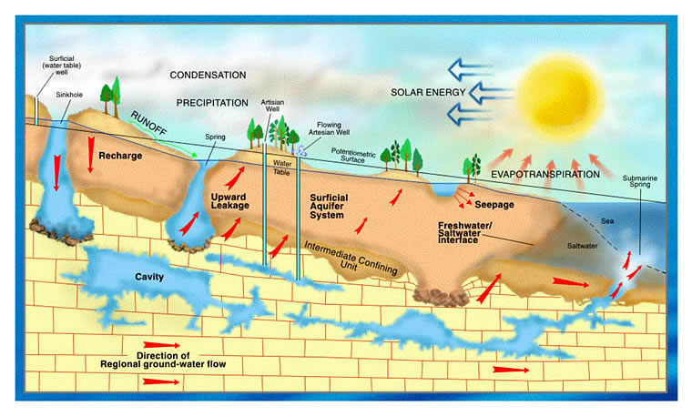
Explain in own words:
What an aquifer is..
Why is it important to us…
Why it is important to take care of it..
What can you do to take care of it…

Slide 12
7th Grade Video Clip
https://www.youtube.com/watch?v=0w7nW7TSKVY
https://www.youtube.com/watch?v=LJ63xGJY4pM
https://www.youtube.com/watch?v=F1YdaY0DKPo Trinity River Watershed
Virtual Tour of Water Treatment Plant https://www3.epa.gov/safewater/kids/wtp/flash/interactive.html

Slide 13
How does potential and kinetic energy work together?
https://www.youtube.com/watch?v=vl4g7T5gw1M
https://www.youtube.com/watch?v=LlM1pIefpBM
https://www.youtube.com/watch?v=IqV5L66EP2E

Slide 14
6th Grade Glencoe Virtual Lab Kinetic Energy
http://www.glencoe.com/sites/common_assets/science/virtual_labs/PS05/PS05.html
Potential Energy (J) | Kinetic Energy (J)

Slide 15
Energy and Energy resources Name: ________________________________ Period: ___
What are the relationships between kinetic energy and potential energy?
Question 1 :When do you think the clock pendulums and the swings where at there highest and lowest kinetic and potential energy? Why?
Question 2 :What happens to the total energy of the pendulums as it swings? What determines the maximum total energy of the pendulum?
Question 3 :How are potential energy and kinetic energy related?
Question 4 :How does energy change from potential energy to kinetic energy?

