Slide 1
October 10, 2016
Sharpen Pencil
Collect Please Do Now, textbook, clicker
Take the numbered seat that matches the number on your clicker (teacher may change as needed)
Open your textbook, READ the information to complete the PDN

Slide 2
7th Grade PDN
PDN: Physical Weathering
# | Question / Statement | Answer
1 | What is the process of breaking down of rock in smaller materials called?
2 | _________________ can happen through temperature changes, pressure changes, plant and animal actions, water, wind, and gravity agents.
3 | A rise in _____________ will cause a rock to expand but a decrease in ___________ will cause a rock to contract.
4 | What is the process of the outermost layers of rock when they separate from the underlying layers?
5 | The process that causes rocks to break down into smaller rocks or are made smaller due to wearing away of the outer layers is called _____________________.
A
C
Answer | Key Word Bank
A | Weathering
B | Abrasion
C | Physical weathering
D | Temperature
E | Exfoliation
D
E
B

Slide 3
6th Grade PDN
PDN: Energy in a Flashlight
Answer | Key Word Bank
A | Stored Chemical Energy
B | Light Energy
C | Heat Energy
D | Electrical Energy
E | Stored Potential Energy
5.
Stored Potential Energy
3.
1.
2.
4.

Slide 4
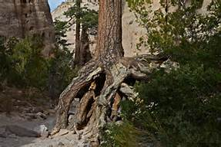
7th Grade Essential Question
Look at the picture provided. What do you think caused all the soil around these trees/plants roots to disappear? Explain.

Slide 5
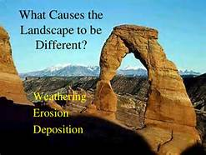
7th Grade TEKS
7.8B: analyze the effects of weathering, erosion, and deposition on the environment in ecoregions of Texas

Slide 6
7th Grade LO
LO: We will compare and contrast weathering, erosion, and deposition in the environment by completing an inter-active, virtual lab foldable.

Slide 7
7th Grade DOL
DOL: I will complete 5 written assessment questions over weathering, erosion and deposition via the all in clickers.

Slide 8
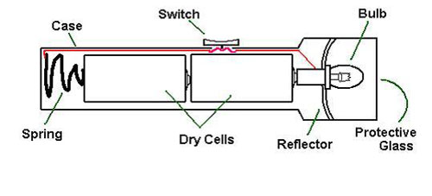
6th Grade Essential Question
What does a flashlight need to work? Does it only use one type of energy? Explain.

Slide 9
6th Grade TEK
6.9C: Demonstrate energy transformation such as energy in a flashlight battery changes from chemical energy to electrical energy to light energy.

Slide 10
6th Grade LO
LO: We will investigate the different forms of energy and how they are transferred through various items, such as a flashlight, cell phone automobile and/or gas lawn mover through differentiated instruction/playlist stations.

Slide 11
6th Grade DOL
DOL: I will complete a written assessment over energy transformation via the all in clickers.

Slide 12
7th Grade Weathering Foldable
1. Teacher will hand out foldable
2. Students will follow directions on the back to complete the foldable
Directions:
.Fold along the long dashed line in towards the center of foldable (fold so directions section is on back, chart on inside and words on the front)
.Login to www.coachpease.com
.Click on 2nd 6 weeks
.Click on Weathering Glencoe Virtual Lab Link
http://www.glencoe.com/sites/common_assets/science/virtual_labs/E06/E06.html
5. Read/follow directions on left side of screen to complete lab
6. Use information gathered from lab to complete foldable. (answer questions on back of the square that has the question on the front of it)
7. Once Teacher has graded foldable, cut along the small dotted lines to form 4 flaps to aid in studying vocabulary
Name: ______________________________________________
Class Period: ____________

Slide 13
Answer Question on Back of Square.
Weathering Virtual Lab Foldable
Weathering
#1: Which scenes that you observed show examples of mechanical weathering? Why?
Directions:
.Fold along the long dashed line in towards the center of foldable (fold so directions section is on back, chart on inside and words on the front)
.Login to www.coachpease.com
.Click on 2nd 6 weeks
.Click on Weathering Glencoe Virtual Lab Link
http://www.glencoe.com/sites/common_assets/science/virtual_labs/E06/E06.html
5. Read/follow directions on left side of screen to complete lab
6. Use information gathered from lab to complete foldable. (answer questions on back of the square that has the question on the front of it)
7. Once Teacher has graded foldable, cut along the small dotted lines to form 4 flaps to aid in studying vocabulary
Name: ______________________________________________
Class Period: ____________
#2: Which scenes that you observed show examples of chemical weathering? Why?
Mechanical
Weathering
#3: What do you think would be the weathering effects of moving a rock sculpture from a dry climate to a wet climate?
Chemical
Weathering
#4: What effect do small burrowing animals and earthworms have on the rocks and soil in the ground?
Erosion
#5: In terms of weathering, explain what will happen to a set of metal tools left outdoors in the rain for a long time?
#6: Is it possible for any of the Earth materials scenes to be affected by both mechanical and chemical weathering? If so, describe the scene and situations.

Slide 14
#1
Complete table below with data collected from lab.
Weathering Definition
Scene # | Before Weathering | Weathering Effect | After Weathering
Scene #
#2
Mechanical Weathering Definition
#3
Chemical Weathering Definition
#4
Erosion Definition
#5
#6

Slide 15
Playlist Stations Due at end of Class this End of Class Tuesday!
Station 1 = hands on card sort with teacher assistance to show flow of energy Transfer information learned to create a poster to diagram the flow of energy in a flashlight.
Station 2 = Virtual lab over flow of energy in an object. (may be done by self or with a partner) Students will also complete written aspect of the lab to turn in for a grade.
Station 3 = Students will create an item blue print/diagram that shows / explains the transformation of energy it goes through to operate. Must include Chemical to electrical to light energy.

