Slide 1
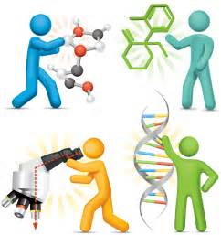
October 9, 2017
Collect PDN and Clicker
Sharpen Pencil
Sit in Assigned Seat
Open Textbook and Complete PDN

Slide 2
7th Grade
LO: We will identify the structure and functions of the circulatory system.
6th Grade
We will compare / contrast renewable to nonrenewable energy resources.

Slide 3
7th Grade
DOL: I will complete 5/5 questions over the circulatory system.
6th Grade
DOL: I will complete an exit slip that gives 1 example of a renewable and 1 nonrenewable energy resource.

Slide 4
6th Grade
PDN
Video over Natural Resources
Natural Resources Handout with Board Game
DOL
7th Grade
1. PDN
2. Video over Circulatory System
3. Circulatory System Foldable
4. DOL

Slide 5
7th Grade
7.12 (B) identify the main functions of the systems of the human organism, including the circulatory, respiratory, skeletal, muscular, digestive, excretory, reproductive, integumentary, nervous, and endocrine systems
6th Grade
6.7 (A) research and debate the advantages and disadvantages of using coal, oil, natural gas, nuclear power, biomass, wind, hydropower, geothermal, and solar resources

Slide 6
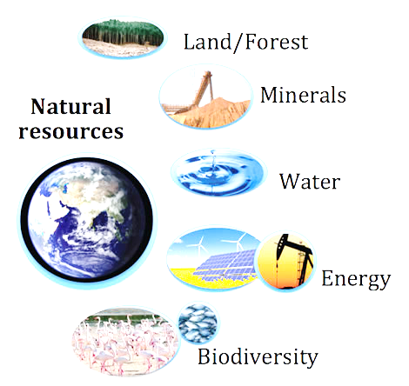
6th Grade
How would you get around town if there was not longer any gas in the world? What else could you use? Explain.
FYI: Gas is a form of _____________________ that produces __________ for vehicles to move around on.
Pair share with neighbor what you think (30 seconds)
Re-group and discuss as group

Slide 7
What are Natural Resources? (5:16 mins)
https://www.bing.com/videos/search?q=renewable+and+non-renewable+resources+kids&&view=detail&mid=41A2E9FD9AF40A172E7341A2E9FD9AF40A172E73&FORM=VRDGAR
Crash Courses Natural Resources Video (3:14mins)
https://www.bing.com/videos/search?q=natural+energy+resources+for+kids&&view=detail&mid=8D3D3E904991DF5D474F8D3D3E904991DF5D474F&FORM=VRDGAR
Renewable / Nonrenewable Game Show Video (9mins)
https://www.bing.com/videos/search?q=Resources+Renewable+and+Non+Renewable+Resources+Game+Show&&view=detail&mid=6EE3AB80BE7430930DAF6EE3AB80BE7430930DAF&FORM=VRDGAR
Fossils Fuels Vs’ Renewable Resources (5:05pm)
https://www.bing.com/videos/search?q=natural+energy+resources+for+kids&&view=detail&mid=D732266EEE76F2CF62F5D732266EEE76F2CF62F5&FORM=VRDGAR

Slide 8
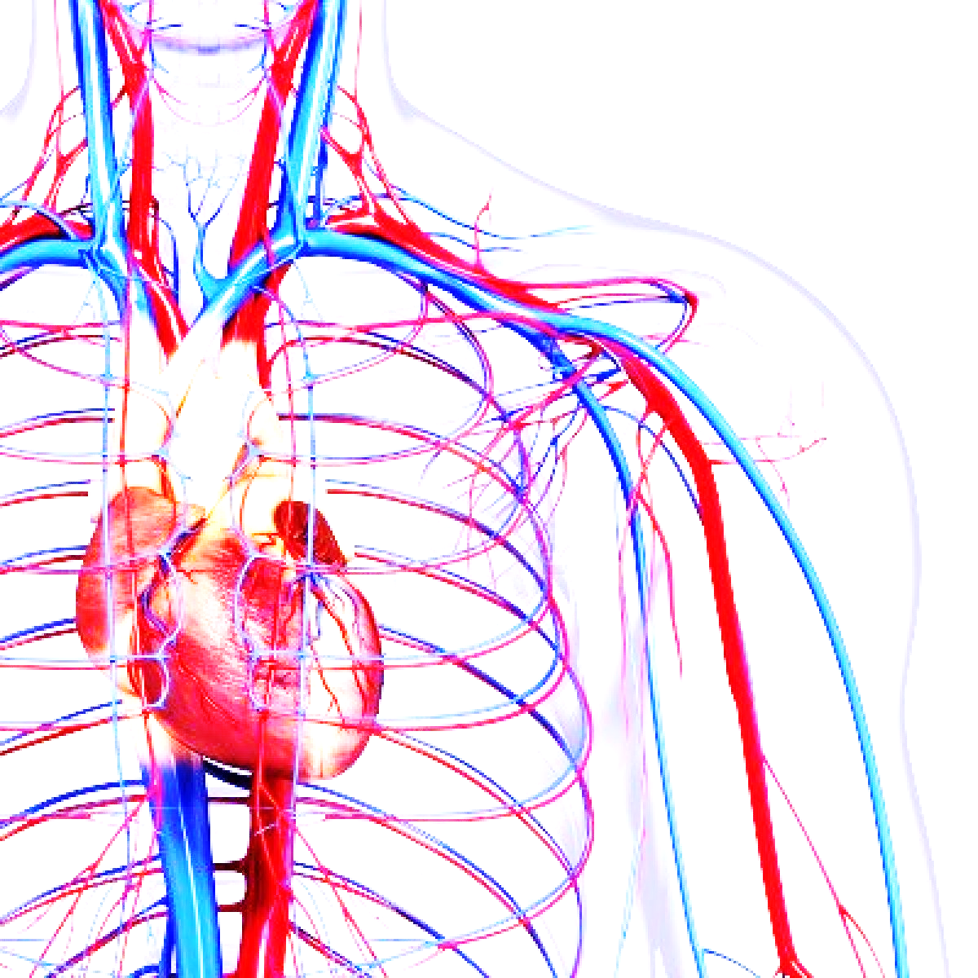
7th Grade
What is happening when someone has a heart attack? What body system is in trouble during this? What can you do to protect your body system against a heart attack?
TED TALK Video Below
https://www.bing.com/videos/search?q=heart+attack+for+kids&&view=detail&mid=AF0B857C84E22C91DA22AF0B857C84E22C91DA22&FORM=VRDGAR
Pair share with table partner
Regroup and discuss as a class
Coach will pass out Foldable / Follow directions on back of foldable to complete to learn more about the circulatory system.

