Slide 1
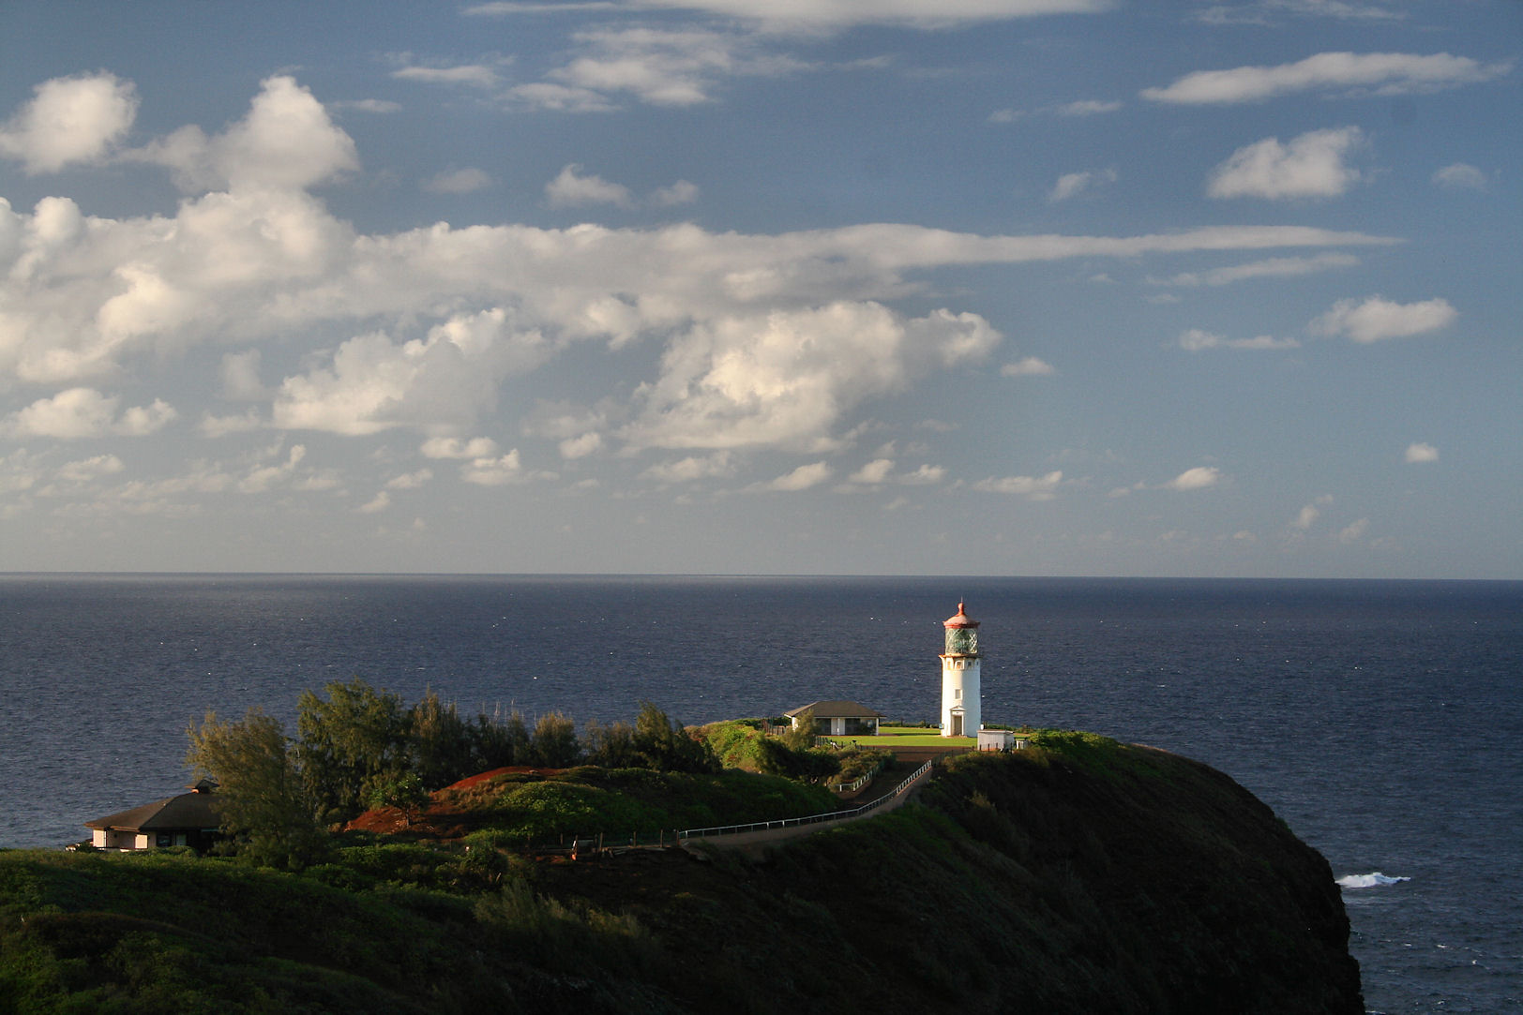
October 7, 2016
Sharpen Pencil
Collect Textbook, clicker, PDN
Please sit in assigned seat quietly
Open your textbook and use the information provided to complete your PDN
Notes:
Half-circle picture with accent arcs
(Basic)
To reproduce the shape effects on this slide, do the following:
On the Home tab, in the Slides group, click Layout, and then click Blank.
On the Home tab, in the Drawing group, click Shapes, and then under Basic Shapes, click Arc (third row, 12th option from the left). On the slide, drag to draw an arc.
Select the arc. Under Drawing Tools, on the Format tab, in the Size group, do the following:
In the Shape Height box, enter 7.5”.
In the Shape Width box, enter 7.5”.
Drag the right yellow diamond adjustment handle to the bottom of the slide to create a half-circle.
Under Drawing Tools, on the Format tab, in the bottom right corner of the Shape Styles group, click the Format Shape dialog box launcher. In the Format Shape dialog box, click Fill in the left pane. In the Fill pane, select Picture or texture fill, and then under Insert from, click File.
In the Insert Picture dialog box, select a picture, and then click Insert.
Also in the Format Shape dialog box, in the Fill pane, under Insert from, select Tile picture as texture.
Also in the Format Shape dialog box, click Line Color in the left pane, and then select No line in the Line Color pane.
Also in the Format Shape dialog box, click Shadow in the left pane, and then do the following in the Shadow pane:
Click the button next to Presets, and then under Inner click Inside Diagonal Top Right (first row, third option from the left).
In the Transparency box, enter 70%.
In the Blur box, enter 20 pt.
In the Distance box, enter 20 pt.
Drag the half-circle to the left until the two middle yellow adjustment diamonds are lined up with the left edge of the slide. On the Home tab, in the Drawing group, click Arrange, point to Align, and then do the following:
Click Align to Slide.
Click Align Middle.
Select the arc. On the Home tab, in the Clipboard group, click the arrow under Copy, and then click Duplicate.
Select the second arc. Under Drawing Tools, on the Format tab, in the Size group, do the following:
In the Shape Height box, enter 6.79”.
In the Shape Width box, enter 10.03”.
On the Home tab, in the bottom right corner of the Drawing group, click the Format Shape dialog box launcher. In the Format Picture dialog box, click Fill in the left pane, and then in the Fill pane, select No fill.
Also in the Format Shape dialog box, click Line Color in the left pane. In the Line Color pane, select Solid line and then do the following:
Click the button next to Color, and then under Theme Colors click White, Background 1 (first row, first option from the left).
In the Transparency box, enter 50%.
Also in the Format Shape dialog box, click Line Style in the left pane. In the Line Style pane, in the Width box, enter 1.5 pt.
Drag the second arc left on the slide until the two middle yellow adjustment diamonds are lined up with the left edge of the slide. On the Home tab, in the Drawing group, click Arrange, point to Align, and then do the following:
Click Align to Slide.
Click Align Middle.
Select the second arc. On the Home tab, in the Clipboard group, click the arrow under Copy, and then click Duplicate.
Select the third arc. Under Drawing Tools, on the Format tab, in the Size group, do the following:
In the Shape Height box, enter 6.86”.
In the Shape Width box, enter 9.98”.
On the Home tab, in the bottom right corner of the Drawing group, click the Format Shape dialog box launcher. In the Format Shape dialog box, click Line Color in the left pane, select Gradient line in the Line Color pane, and then do the following:
In the Type list, select Linear.
Click the button next to Direction, and then click Linear Down (first row, second option from the left).
Under Gradient stops, click Add gradient stop or Remove gradient stop until two stops appear in the slider.
Also under Gradient stops, customize the gradient stops that you added as follows:
Select the first stop in the slider, and then do the following:
In the Position box, enter 0%.
Click the button next to Color, and then under Theme Colors click Blue, Accent 1, Lighter 40% (fourth row, fifth option from the left).
In the Transparency box, enter 77%.
Select the second stop in the slider, and then do the following:
In the Position box, enter 100%.
Click the button next to Color, click More Colors, and then in the Colors dialog box, on the Custom tab, enter values for Red: 208, Green: 215, Blue: 222.
In the Format Shape dialog box, in the Line Style pane, in the Transparency box, enter 90%.
Also in the Format Shape dialog box, click Line Style in the left pane. In the Line Style pane, in the Width box, enter 4.25 pt.
On the Home tab, in the Drawing group, click Arrange, point to Align, and then do the following:
Click Align to Slide.
Click Align Left.
Drag the third arc left on the slide until the two middle yellow adjustment diamonds are lined up with the left edge of the slide. Drag the third arc vertically as needed to position it slightly above the second arc on the slide.
To reproduce the background on this slide, do the following:
Right-click the slide background area, and then click Format Background. In the Format Background dialog box, click Fill in the left pane, select Gradient fill in the Fill pane, and then do the following:
In the Type list, select Linear.
Click the button next to Direction, and then click Linear Up (second row, second option from the left).
In the Angle box, enter 270⁰.
Under Gradient stops, click Add gradient stop or Remove gradient stop until four stops appear in the slider
Also under Gradient stops, customize the gradient stops that you added as follows:
Select the first stop in the slider, and then do the following:
In the Position box, enter 0%.
Click the button next to Color, click More Colors, and then in the Colors dialog box, on the Custom tab, enter values for Red: 167, Green: 185, Blue: 197.
Select the second stop in the slider, and then do the following:
In the Position box, enter 30%.
Click the button next to Color, and then under Theme Colors click White, Background 1 (first row, first option from the left).
Select the third stop in the slider, and then do the following:
In the Position box, enter 70%.
Click the button next to Color, and then under Theme Colors click White, Background 1 (first row, first option from the left).
Select the fourth stop in the slider, and then do the following:
In the Position box, enter 100%.
Click the button next to Color, click More Colors, and then in the Colors dialog box, on the Custom tab, enter values for Red: 167, Green: 185, Blue: 197.

Slide 2
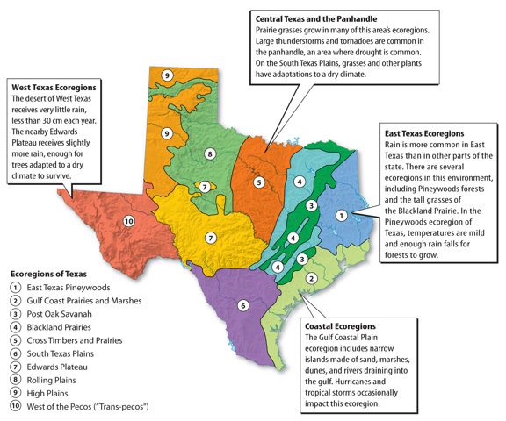
Natural Disasters happen in Ecoregions of TX
Directions: Complete the information below for each ecoregion
1. Type of biome (ecosystem)
2. Natural Disasters that can happen there
3. Description of what the disaster might do to the ecoregions landscape and inhabitants.
You may use Pgs. 594—607 in your textbook to assist you.
2.
1.
3.
4.

Slide 3
PDN: Energy Transformation
# | Question / Statement | Answer
1 | What states that energy cannot be created nor destroyed?
2 | What is a group of objects that transfer energy only to one another called?
3 | When energy changes from one form into another we call this an _____________________________.
4 | Your body uses stored potential energy to breakdown the food you eat and transfers it into __________ ______________ that allows you to move and play.
5 | As a roller coaster moves along its track it transfers mechanical _________ into heat and sound ________________.
Answer | Key Word Bank
A | Energy Transformation
B | Law of Conservation of Energy
C | Closed System
D | Kinetic Energy
E | Energy
B
C
A
D
E

Slide 4
DOL Quiz: Catastrophic Events
Which of the following is a possible effect of a catastrophic event?
  A: animals killed C: habitats damaged
  B: erosion D: all of the above
2. Which of the following can cause high waves along coastlines and result in the beach erosion?
A: tornado C: pollution
B: flash flood D: hurricane
3. Which of the following human activities can increase the severity of a catastrophic event?
A: recycling C: burying power lines
B: land development D: weather forecasting
# | Statement | True or False
4 | A hurricane is a rapidly spinning column of air that reaches down from a thunderstorm and touches Earth’s surface.
5 | A natural hazard is a physical event resulting from Earth’s processes that has the potential to harm the environment and people.
False
True

Slide 5

7th Grade TEK
7.8A: predict and describe how different types of catastrophic events impact ecosystems such as floods, hurricanes, or tornadoes.

Slide 6
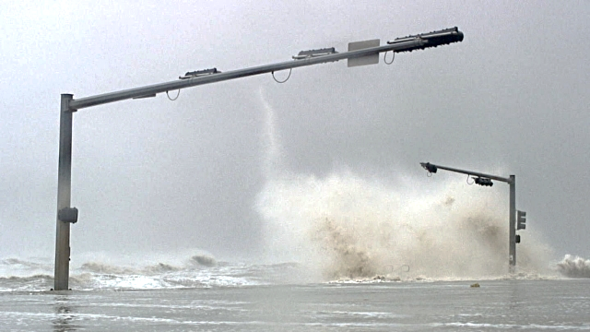
7th Grade LO
LO: We will investigate catastrophic events and the damage they cause through differentiated play list stations activities.
7.8A: predict and describe how different types of catastrophic events impact ecosystems such as floods, hurricanes, or tornadoes.

Slide 7
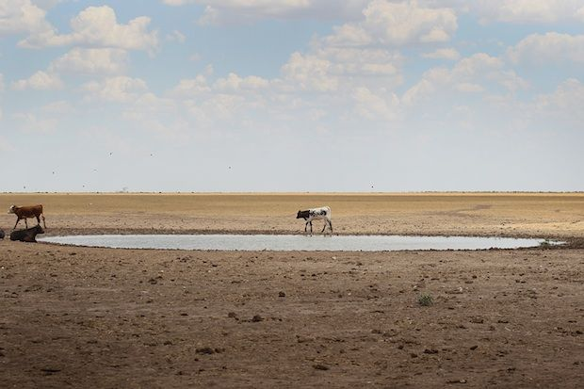
7th Grade DOL
DOL: I will complete 5 written assessment questions over catastrophic events via the all in clickers.

Slide 8

6th Grade TEK
6.8A: Compare/contrast potential and kinetic energy
6.9C: Demonstrate energy transformations such as energy in a flashlight battery changes from chemical energy to electrical energy to light energy

Slide 9

6th Grade LO
LO: We will compare / contrast energy and the different forms that it can be found in by creating and then playing flashcard race vocabulary game.
6.8A: Compare/contrast potential and kinetic energy
6.9C: Demonstrate energy transformations such as energy in a flashlight battery changes from chemical energy to electrical energy to light energy

Slide 10

6th Grade DOL
DOL: I will compare/contrast the different forms of energy by completing 5 written assessment questions via the all in clickers.

Slide 11
DOL Quiz: Catastrophic Events
Which of the following is a possible effect of a catastrophic event?
  A: animals killed C: habitats damaged
  B: erosion D: all of the above
2. Which of the following can cause high waves along coastlines and result in the beach erosion?
A: tornado C: pollution
B: flash flood D: hurricane
3. Which of the following human activities can increase the severity of a catastrophic event?
A: recycling C: burying power lines
B: land development D: weather forecasting
# | Statement | True or False
4 | A hurricane is a rapidly spinning column of air that reaches down from a thunderstorm and touches Earth’s surface.
5 | A natural hazard is a physical event resulting from Earth’s processes that has the potential to harm the environment and people.

Slide 12
7th Grade Playlist Stations
Look at your DOL Quiz Score
See where it falls in the list below
  69% or lower = Station 1
  70% to 89% = Station 2
  90% or Higher = Station 3.
  At the top of your quiz write down the station number you will be working on

Slide 13
7th Grade Playlist
Each Stations Description is listed on the blue pocket chart that hangs in front of the windows, above the black tables.
Station 0 = Pg. 607
(complete, rip out, turn in to basket/milk crate)
Station 1 = Card Sort with Teacher, Natural Disaster Booklet
Station 2 = Natural Disaster Poster
Station 3 = Natural Disaster Service Announcement

Slide 14
6th Grade Flashcard Race
Teacher will pass out chrome books
Login to www.coachpease.com
Click on Schoology
Click on link to dallasisd.schoology.com
Login: ID # only
Password: Disd@2016
Click on Courses
Click on Science
Click on the folder for Energy
Use any of the links provided to help finish making your flashcards
Once Flashcards are complete find another student who is also done and set up/play flashcard race

Slide 15
Flashlight Energy Transfer
Card Sort
Collect card sort from teacher
Read ALL THE DIRECTIONS FIRST
Follow the directions to complete the card sort
  Remember that you may use your flashcards as a reference on the different types of energy as you complete the card sort.
  Once your card sort is complete, transfer your answers to handout for a grade.

