Slide 1
October 3, 2016 / 7th Grade
Sharpen Pencil
Collect textbook, pdn, clicker
Take assigned seat silently
Open your textbook and use it to complete your pdn

Slide 2
October 3, 2016 / 6th Grade Pre-Ap
1. Sharpen Pencil
2. Take seat with partner for the Metal / Nonmetal / Metalloid Poster Project
3. Continue to work on / finish project

Slide 3
PDN: Catastrophic Events / Hurricanes & Tornadoes
Directions: Use pg. 566-567 from the textbook Interactive Science (handout copy) and use the information to answer the questions below.
Answer | Key Word Bank
A | Hurricane
B | Tornado
C | Beach Erosion
D | 400 km/h
E | Tropical Cyclone
# | Question / Statement | Answer
1 | What is a rapidly spinning column of air that reaches down from a thunderstorm and comes in contact with Earth’s surface called?
2 | A tropical storm that forms over the ocean with sustained winds of 119 km/h or more is called a ________________.
3 | Another name for the answer to #2 is a _______________.
4 | A tornado’s wind speed can reach up to _______________.
5 | Hurricanes can greatly and often reshape coastlines through the process of ______________________________.

Slide 4
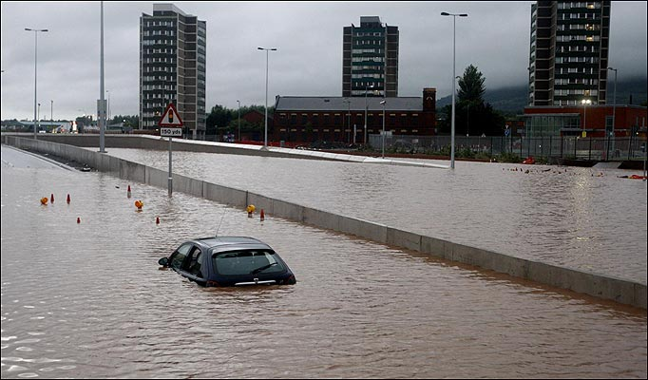
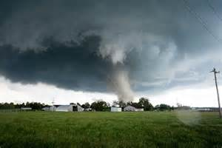
7th Grade Essential Question
Have you ever experienced a natural disaster, such as a hurricane, tornado or severe flood? What was the experience like?

Slide 5
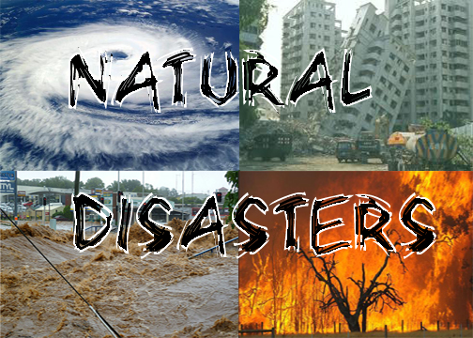
7th Grade TEK
TEK: 7.8A Predict and describe how different types of catastrophic events impact ecosystems such as floods, hurricanes, or tornadoes.

Slide 6
7th Grade Lo / DOL
Lo: We will compare/contrast different types of catastrophic events in our world by completing a foldable.
TEK: 7.8A Predict and describe
how different types of catastrophic events impact ecosystems such as floods, hurricanes, or tornadoes.

Slide 7
7th Grade Lo / DOL
DOL: I will complete 5 written assessment questions over catastrophic events via the all in clickers.

Slide 8
7th Grade
In small groups students will answer the essential question in a pair share setting.
They will list things that they noticed that were alike between the storms and that were different by completing a T chart
Groups will pick one alike and one thing that was different to add to class T chart. They will write their information on a post-it note.

Slide 9
Each group will present ideas and add information to the class T chart
Students will create a T chart in their journal and record information discussed.
Teacher will facilitate discussion to lead around the different types of events

Slide 10
7th Grade Natural Disasters
Teacher will pass out foldable to be completed and turn in by the end of class on Tuesday for a grade.
Students will login to www.coachpease.com
Students will click on Links
Students will Scroll to Natural Disasters / Catastrophic Events
Students may use any of the links listed to complete foldable

