Slide 1
1. Collect DOL from Green Basket
2. Sharpen Pencil
3. Sit in assigned seat
4. Complete DOL on Own
Oct. 2, 2018

Slide 2
TEK 6.5C
(C) identify the formation of a new substance by using the evidence of a possible chemical change such as production of a gas, change in temperature, production of a precipitate, or color change

Slide 3
LO
Students will investigate types of evidence to determine if a chemical change has taken place by completing a hands-on lab activity.

Slide 4
DOL
Students will complete 10/10 questions over types of evidence to prove if a chemical / physical reaction has taken place with 80% accuracy or higher.

Slide 5
Balloon Experiment
Teacher will explain / model lab expectations
Students will complete a basic lab report over the balloon experiment using the scientific method

Slide 6
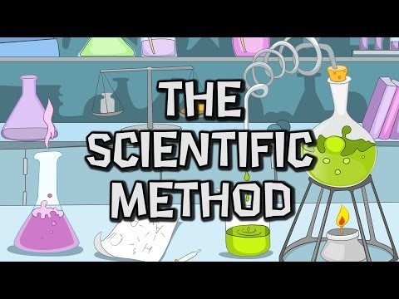
What are the steps you use when using the scientific method?
https://www.youtube.com/watch?v=ptADSmJCVwQ

Slide 7
How can we blow up a balloon using a chemical reaction?
State the Question

Slide 8
Collect Data
What is a chemical change?
What can we use to blow up a balloon?
What type of evidence / indicator of a chemical reaction could create this type of evidence to take place?

Slide 9
Form a Hypothesis
If __________________________________________________________ then my balloon will blow up due to a chemical reaction.

Slide 10
Experiment
Materials : See lab directions
Procedure: How to complete the lab (see lab directions)

Slide 11
Record Data
Write in detail what happens as you complete each step of the labs procedure
Record the final results that help to answer the question

Slide 12
Conclusion
Based on data recorded from doing the lab determine if your hypothesis is correct or not.
Explain in detail why.

Slide 13
Name: _________________________________________ Teacher: _______________ Period: _____ Date: ___/____/______D
DOL: Scientific Method / Chemical Reaction
1. Which of the following is an example of chemical change?
Filling up a balloon with hot air.
Taking a glass of water and freezing it by placing it in the freezer.
A plant collecting sunlight and turning it into food.
Your dog ripping up your homework.
2. One clue of a chemical change is the formation of a precipitate. A precipitate is formed when
Two liquids react and a gas is produced
A solid dissolves in a liquid
One liquid dissolves in another
Two liquids react and a solid is formed
3. Chemical changes are
A. reversible
B. irreversible
C. interchangeable
D. non interchangeable
4. Which indicator below does NOT prove a chemical reaction
has occurred?
A: gas produced
B: smaller size
C: precipitate forms
D: odor produced
5. When we mixed the baking soda and vinegar together we saw bubbles produced and the mixture had a change in temperature. What type of change does this evidence prove happened during the lab?
A: Physical Change
B: Heat Change
C: Chemical Reaction
D: Color Change

Slide 14
Name: _________________________________________ Teacher: _______________ Period: _____ Date: ___/____/______D
DOL: Scientific Method / Chemical Reaction
1. Which of the following is an example of chemical change?
Filling up a balloon with hot air.
Taking a glass of water and freezing it by placing it in the freezer.
A plant collecting sunlight and turning it into food.
Your dog ripping up your homework.
2. One clue of a chemical change is the formation of a precipitate. A precipitate is formed when
Two liquids react and a gas is produced
A solid dissolves in a liquid
One liquid dissolves in another
Two liquids react and a solid is formed
3. Chemical changes are
A. reversible
B. irreversible
C. interchangeable
D. non interchangeable
4. Which indicator below does NOT prove a chemical reaction
has occurred?
A: gas produced
B: smaller size
C: precipitate forms
D: odor produced
5. When we mixed the baking soda and vinegar together we saw bubbles produced and the mixture had a change in temperature. What type of change does this evidence prove happened during the lab?
A: Physical Change
B: Heat Change
C: Chemical Reaction
D: Color Change

