Slide 1
October 17, 2016
Sharpen Pencil
Collect PDN, Textbook, Clicker
Sit in assigned seat
Open textbook and complete PDN
Notes:
Time in Motion (Intermediate)
To reproduce the top banner effect on this slide, do the following:
On the Home tab, in the Slides group, click Layout, and then click Blank.
On the Insert tab, in the Illustrations group, click Shapes, and then under Rectangles click Rectangle (first option from the left).
On the slide, drag to draw a rectangle.
Under Drawing Tools, on the Format tab, in the Size group, enter 1.9” into the Height box and enter 10” into the Width box.
Select the rectangle. Under Drawing Tools, on the Format tab, in the Arrange group, click the arrow below Align and select Align Top (fourth option from top).
Still under Drawing Tools, on the Format tab, in the Shape Styles group, click Shape Fill and select Black, Text 1 (first row, second option from left).
Then, under Drawing Tools, on the Format tab, in the Shape Styles group, click Shape Outline and select No Outline.
With the rectangle still selected, on the Home tab, in the bottom right corner of the Drawing group, click the arrow to launch the Format Shape dialog box.
In the Format Shape dialog box, click Shadow in the left pane, under Shadow in the right pane, click Presets and select Offset Bottom (under Outer, first row, second option from left).
Close the Format Shape dialog box.
Select the rectangle. Type “Time in Motion”.
Select the text. On the Home tab, in the Font group, select a theme that uses Arial Black from the Font list. Then select 54 pt from the Font Size list and click the Bold icon.
With the text still selected, On the Home tab, in the Paragraph group, click Align Text and select Middle. Click the Center text icon.
With the text selected, under Drawing Tools, on the Format tab, in the WordArt Styles group, click Text Effects, click Reflection and select Tight Reflection Touching (under Reflection Variations, first row, first option from left).
With the text select, under Drawing Tools, on the Format tab, in the WordArt Styles group, click Text Effects, click Shadow and select Inside Top (under Inner, first row, second option from left).
To reproduce the video effect on this slide, do the following:
On the Insert tab, in the Media group, click Video, and then click Video from file.
In the left pane of the Insert Video dialog box, click the drive or library that contains the video. In the right pane of the dialog box, click the video that you want and then click Insert.
Select the video, under Video Tools, on the Format tab, in the Size group, set Width to 10”.
With the video selected, on the Home tab, in the Drawing group, click Arrange, point to Align, and then do the following:
Click Align Center.
Click Align Bottom.
With the video still selected, on the Home tab, in the Drawing group, click Arrange, select Send to Back.
Under Video Tools, in the Format tab, in the Adjust group, click the arrow under Color, then under Recolor select Black and White 50% (first row, sixth option from left).
Select the video. On the Animations tab, under the Animation group, select Play.
Also on the Animations tab, in the Timing group, click the arrow to the right of Start and select With Previous.

Slide 2
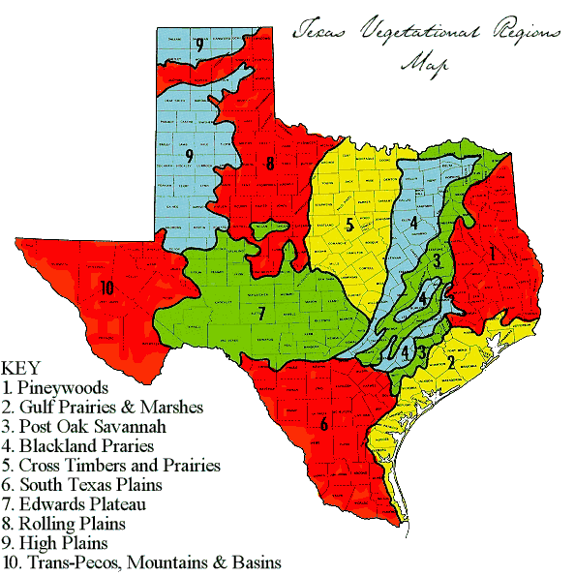
7th Grade PDN
Directions: Match the correct Ecoregion Name with the correct location on the map of TX. You may use your textbook to assist you.
Ecoregion Title | # to match area on map
Piney woods
Gulf Prairies and Marshes
Post Oak Savannah
Black land Prairies
Cross Timbers and Prairies
South Texas Plains
Edwards Plateau
Rolling Plains
High Plains
Trans-Pecos, Mountains and Basins

Slide 3
6th Grade PDN
Name: ____________________________
Class Period: _______________
Directions: Complete the Fryer Model below, you may use your textbook pg. 224-225
Book Definition
Picture
Book Definition
Picture
A change in position over time
A measure of how far something moves in a given amount of time
Speed
Motion
Definition in
Own words
Example of what
It is not
Definition in
Own words
Example of what
It is not

Slide 4
7th Grade TEK
7.8A: predict and describe how different types of catastrophic events impact ecosystems such as floods, hurricanes, or tornadoes
7.8B: analyze the effects of weathering, erosion, and deposition on the environment in ecoregions of Texas
7.8C: model the effects of human activity on groundwater and surface water in a watershed

Slide 5
7th Grade Essential Questions
Have you noticed how certain type of disasters always seem to happen in certain area of Texas? Why do you think this is? Explain

Slide 6
7th Grade LO
We will create an informative presentation that interprets how weathering, erosion, deposition, natural disasters and human impact on water effects Texas Ecoregions.
7.8A: predict and describe how different types of catastrophic events impact ecosystems such as floods, hurricanes, or tornadoes
7.8B: analyze the effects of weathering, erosion, and deposition on the environment in ecoregions of Texas
7.8C: model the effects of human activity on groundwater and surface water in a watershed

Slide 7
7th Grade DOL
DOL: I will complete 5 written assessment questions over characteristics of Texas ecoregions via the all in clickers.

Slide 8
6th Grade TEK
6.8B: identify and describe the changes in position, direction, and speed of an object when acted upon by unbalanced force
6.8C: calculate average speed using distance and time measurements

Slide 9
6th Grade Essential Question
Have you ever seen a wind up toy as it moves across a table? Explain how you know it is in motion?

Slide 10
6th Grade LO
LO: We will determine what motion, distance, speed and time have in common and how they work together to determine how fast or slow an object is moving by completing a foldable.
6.8B: identify and describe the changes in position, direction, and speed of an object when acted upon by unbalanced force
6.8C: calculate average speed using distance and time measurements

Slide 11
6th Grade DOL
DOL: I will complete 5 written assessment questions over motion, speed, distance, and time via the all in clickers.

Slide 12
7th Grade Ecoregion of Texas Gallery Walk Project
Teacher will explain directions/expectations for project
Teacher will assign partners for project
Teacher will assign ecoregion to each group of 2 students
Students will collect 1 chrome book per group to start research
Login to www.coachpease.com
Click on links
Scroll to section over Texas Ecoregions
Click on link to ecoregion assigned and begin researching

Slide 13
6th Grade Essential Question Activity
Students will work in small groups (tables)
Students will discuss possible answers to essential question and record in journal
Students will wind up a toy and record in journal what happens
Students will review what they thought the answer to the essential question and add/delete based on observation
Each group will pick top answer to question
Class will re-group and discuss

Slide 14
6th Grade Video clip on Motion / Speed
Students will use information gathered from Dr. Skateboard’s Videos to complete Motion / Speed / Distance / Time Vocabulary Foldable
Dr. Skateboard 1 Motion
https://www.youtube.com/watch?v=6RTeoKgh9V4
Dr. Skateboard 2 Motion, Speed, Velocity Velocityhttps://www.youtube.com/watch?v=dKDDrnx-Fgw
Dr. Skateboard 3 Motion, Acceleration
https://www.youtube.com/watch?v=uWkTV3ejTc4
Dr. Skateboard 4 Motion, Momentum
https://www.youtube.com/watch?v=tmRQ7Ba4Auc
Dr. Skateboard 5 Motion, energy
https://www.youtube.com/watch?v=tmRQ7Ba4Auc
DR. Skateboard 6 Motion Overview
https://www.youtube.com/watch?v=lRD9C1mfIG8

Slide 15
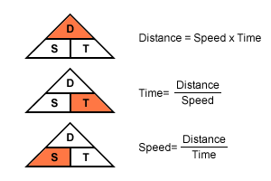
6th Grade Speed Triangle
Students will complete the speed triangle with teacher assistance (power point is available at schoology.com under the energy/speed/motion folder)
Students will use the triangle to complete speed= distance / time practice problems on own

