Slide 1
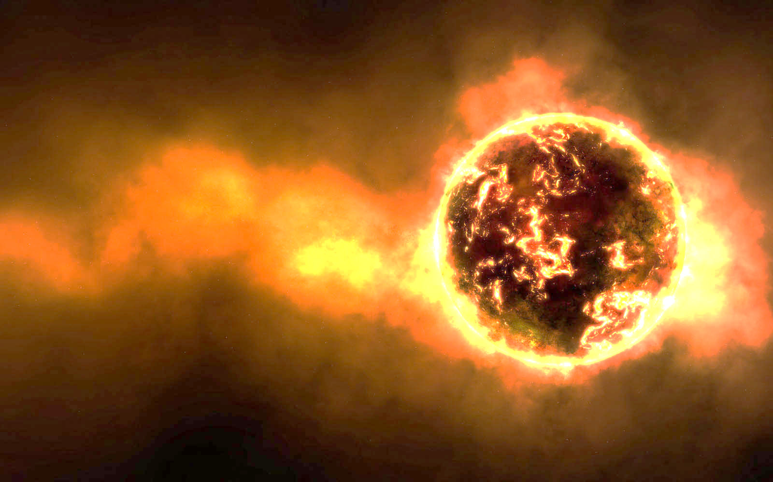
November 9, 2016
Sharpen Pencil
Collect PDN / DOL QUIZ, CLICKER, NO TEXTBOOK OR JOURNAL
Sit in assigned seat
Work on the PDN / DOL QUIZ by yourself, no talking because this is a quiz.

Slide 2
7th Grade TEK
TEK: 7.9B identify the accommodations, considering the characteristics of our solar system, that enabled manned space exploration.

Slide 3
7th Grade LO
We will identify how humans have accommodated to life in space by completing an inter-active virtual note outline / foldable.
TEK: 7.9B identify the accommodations, considering the characteristics of our solar system, that enabled manned space exploration.

Slide 4
7th Grade. LO Stem
I will teach about manned space exploration today.
Specifically, my students will learn how astronuts survive in space.
To show me they have learned it, my students will complete an lab report outline.

Slide 5
7th Grade DOL
I will complete written assessment questions over human accommodating to line in space via the online fusion quiz.

Slide 6
7th Grade Lab Directions
Collect 1 chrome book per table (must have own ear buds/headphones)
Teacher will pass out lab report for you to complete as you do the lab.

Slide 7
7th Grade Lab cont…
Login to computer, Login to www.clever.com
Click on Think Central
Click on My Library
Click on Science
Click on Student Resources 7
Click on Unit 9, scroll down to Lesson 2
Click on the 2nd Megaphone, under digital lab
Follow along / complete lab to complete handout (handout is a grade)

Slide 8
6th Grade TEK
TEK: 6.11A describe the physical properties, locations, and movements of the sun, planets, Galilean moons, meteors, asteroids, and comets.
6.11B understand that gravity is the force that governs the motion of our solar system.

Slide 9
6th Grade LO
We will create a “scrapbook” (google slides) over our “trip” to the solar system to identify the physical peoperties, locations, and movements of the sun, planets, Galilean moons, meteors, asteroids, comets, and planets in outer space.
TEK: 6.11A describe the physical properties, locations, and movements of the sun, planets, Galilean moons, meteors, asteroids, and comets.
6.11B understand that gravity is the force that governs the motion of our solar system.

Slide 10
6th Grade LO Stems
I will teach about objects locations and movements in space.
Specifically, my students will learn about the properties, locations and movements of objects in space.
To show me they have learned it, my students will complete a google slide “scrapbook”.

Slide 11
6th Grade DOL
I will complete an exit slip to explain 5 interesting facts I learned about our solar system.

Slide 12
6th Grade “Scrapbook”
Teacher will explain expectations and procedures for creating scrapbook.
Teacher will handout note outline to assist students with creating scrapbook over trip to the solar system
Student directions are written on first page of outline (teacher will read aloud with students and answer questions)

