Slide 1
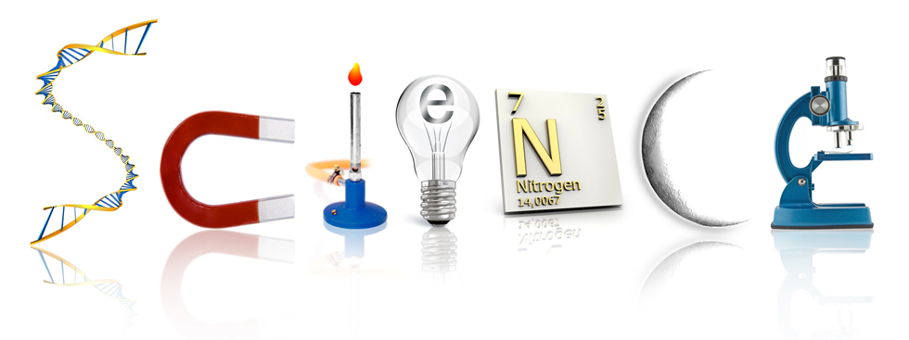
November 6, 2017
Collect PDN and Clicker
Sharpen Pencil
Sit in assigned seat quietly
Collect textbook and follow directions on PDN

Slide 2
LO
6th Grade
We will compare/contrast balanced and unbalanced forces through completion of a foldable.
7th Grade
We will identify different types of internal and external stimuli through completion of a foldable.

Slide 3
DOL
6th Grade
I will complete 5/5 written assessment questions over balanced/unbalanced forces.
7th Grade
I will complete 5/5 written assessment questions over internal / external stimuli.

Slide 4
TEK
6th Grade
6.8(B) identify and describe the changes in position, direction, and speed of an object when acted upon by unbalanced forces;
7th Grade
7.13(13) Organisms and environments. The student knows that a living organism must be able to maintain balance in stable internal conditions in response to external and internal stimuli. The student is expected to:
(A) investigate how organisms respond to external stimuli found in the environment such as phototropism and fight or flight; and
(B) describe and relate responses in organisms that may result from internal stimuli such as wilting in plants and fever or vomiting in animals that allow them to maintain balance

Slide 5
AGENDA
6th Grade
PDN
Brainstorm
Foldable
DOL
7th Grade
PDN
Demo
Foldable
DOl

Slide 6
6th Grade
Brainstorm in Small Groups What A Force Is…..
Force

Slide 7
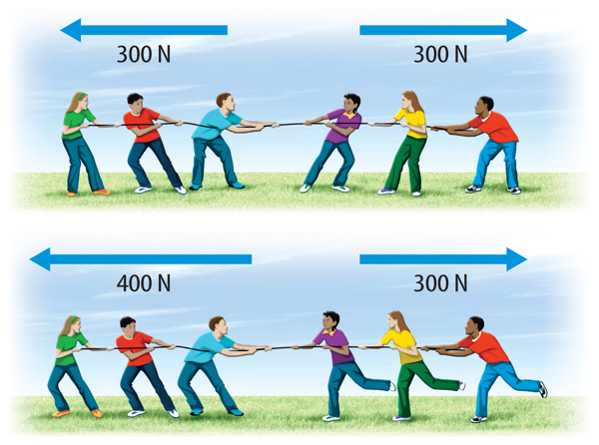
6th Grade
Teacher will pass out and explain/model directions for Foldable
Students will follow along with video clip to complete foldable.
https://www.youtube.com/watch?v=NlN9e8tDwXg
https://www.youtube.com/watch?v=QMpYOW8fpl8
Students will also use textbook and PDN to complete foldable.

Slide 8
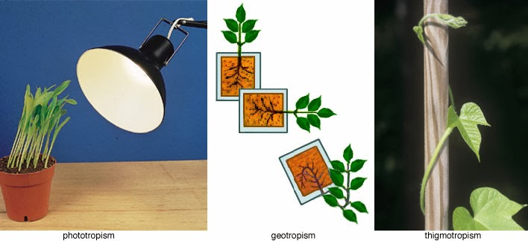
7th Grade
1. Open journal to next empty page
2. Write Plant responces at top of page
3. Draw the plant Coach shows you in journal and explain its location in relation to the window
4. Brainstorm what you think will happen if we turn the pot in different directions from the window… draw and explain in journal
5. Pair share ideas in journal
6. Re-group as a class and discuss

Slide 9
7th Grade
Students will brainstorm what they think will happen if a plant is turned in different directions in relation to the suns location.
Students discuss in small groups what they think will happen.
Class re-groups and discuss
Teacher facilitates discussion around plant responding to sunlight
Class will re-vist plant once complete foldable to re-evaluate what is happening and if it caused by an internal or external stimuli.

Slide 10
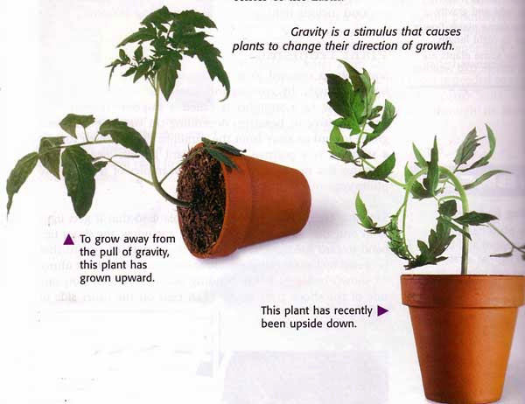
7th Grade
Teacher will pass out model/explain how to complete foldable
Students may use textbook to complete the foldable

