Slide 1
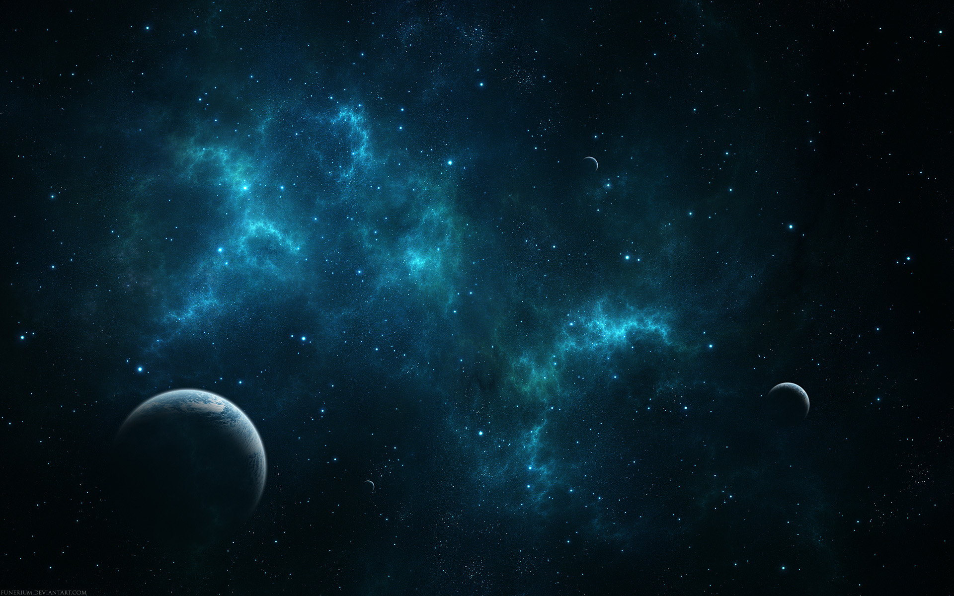
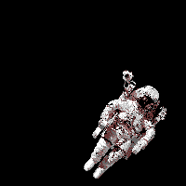
November 11, 2016 / 7th Grade
Sharpen Pencil
Collect PDN (read front to answer back)
Sit in assigned seat
Work on the PDN

Slide 2
November 11, 2016 / 6th Grade
Sharpen Pencil
Collect Chrome Book, “Out of This World” research packet
Sit in assigned seat
Login to www.clever.com
Click on google classroom
Click on google slides for “Out of this World” space scrap book
Continue working on scrap book

Slide 3
7th Grade TEK
TEK: 7.9B identify the accommodations, considering the characteristics of our solar system, that enabled manned space exploration.

Slide 4
7th Grade LO
We will apply our knowledge over how humans have accommodated to life in space by completing a multiple choice assessment.
TEK: 7.9B identify the accommodations, considering the characteristics of our solar system, that enabled manned space exploration.

Slide 5
7th Grade. LO Stem
I will teach about manned space exploration today.
Specifically, my students will learn how astronuts survive in space.
To show me they have learned it, my students will complete a multiple choice assessment.

Slide 6
7th Grade DOL
I will complete written assessment questions over human accommodating to line in space via the Unit 9 Fusion Test A.

Slide 7
6th Grade TEK
TEK: 6.11A describe the physical properties, locations, and movements of the sun, planets, Galilean moons, meteors, asteroids, and comets.
6.11B understand that gravity is the force that governs the motion of our solar system.

Slide 8
6th Grade LO
We will continue to create our “scrapbook” (google slides) over our “trip” to the solar system to identify the physical poperties, locations, and movements of the sun, planets, Galilean moons, meteors, asteroids, comets, and planets in outer space.
TEK: 6.11A describe the physical properties, locations, and movements of the sun, planets, Galilean moons, meteors, asteroids, and comets.
6.11B understand that gravity is the force that governs the motion of our solar system.

Slide 9
6th Grade LO Stems
I will teach about objects locations and movements in space.
Specifically, my students will learn about the properties, locations and movements of objects in space.
To show me they have learned it, my students will complete a google slide “scrapbook”.

Slide 10
6th Grade DOL
I will complete an exit slip to explain 5 interesting facts I learned about our solar system.

