Slide 1
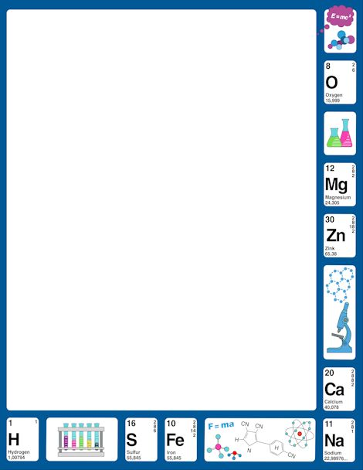
November 8, 2017
7th Grade: Card Sort
6th Grade: PDN in Blue
Basket
2.Sharpen Pencil
3. Sit in Assigned Seat
4. Complete Card Sort/ PDN

Slide 2
LO
7th Grade
We will identify the different types of ways plants respond to external stimuli.
6th Grade
We will compare/contrast potential and kinetic energy.

Slide 3
DOL
7th Grade
I will explain 5 facts I learned about external stimuli in an exit slip.
6th Grade
I will compare/contrast potential versus kinetic energy in an exit slip.

Slide 4
TEK
7th Grade
7.13A/7.7C
7.7(C) demonstrate and illustrate forces that affect motion in everyday life such as emergence of seedlings, turgor pressure, and geotropism
7.13(A) investigate how organisms respond to external stimuli found in the environment such as phototropism and fight or flight
6th Grade
6.8A
(A) compare and contrast potential and kinetic energy

Slide 5
Agenda
7th Grade
Card Sort
Record Plant Data
Tropism Card Sort/Foldable
DOL
6th Grade
PDN
Pendulum Demo
Skate Park Virtual
DOL

