Slide 1
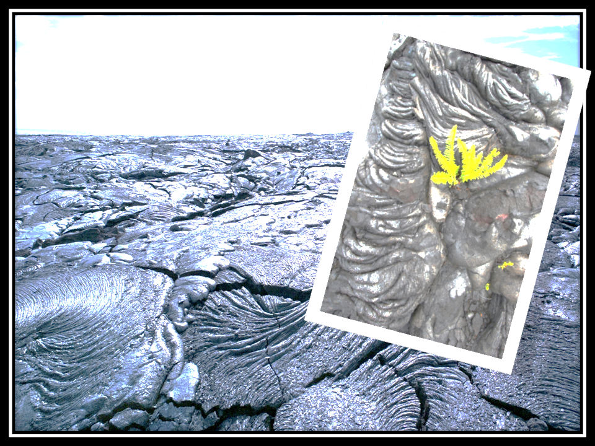
November 30, 2016
Sharpen Pencil
Collect STAAR TUTORITAL 7.10B SUCCESSION (7th Grade)
Collect PDN from Basket (6th Grade)
3. Read information to answer questions on own

Slide 2
7th Grade TEK
7.10C Observe, record, and describe the role of ecological succession such as in a microhabitat of a garden with weeds.

Slide 3
7th Grade LO
We will investigate what ecological succession is and the steps an area goes through when experiencing it through a web quest.
7.10C Observe, record, and describe the role of ecological succession such as in a microhabitat of a garden with weeds.

Slide 4
7th Grade DOL
I will complete 5 STAAR type written assessment questions over ecological succession.

Slide 5
7th Grade Essential Question
When they get ready to build a new building they completely take out all the land cover in the area, leaving nothing but dirt to look at. Why is it then if you came back to that exact spot a year later, you would see plant life again? What is this process called?

Slide 6
6th Grade TEK
6.10C identify the major tectonic plates, including Eurasian, African, Indo-Australian, Pacific, North American, and South American; and
6.10D describe how plate tectonics causes major geological events such as ocean basins, earthquakes, volcanic eruptions, and mountain building

Slide 7
6th Grade LO
We will determine what tectonic plates are and how their movement has shaped landforms on Earth through completion of a web quest.
6.10C identify the major tectonic plates, including Eurasian, African, Indo-Australian, Pacific, North American, and South American; and
6.10D describe how plate tectonics causes major geological events such as ocean basins, earthquakes, volcanic eruptions, and mountain building

Slide 8
6th Grade DOL
I will complete 5 STAAR TYPE written assessment questions over plate tectonics.

Slide 9
6th Grade Essential Question
Have you ever put a jig saw puzzle together? Explain how you did it. Now look at the shapes of the worlds continents. Do you notice anything special about them? (think about the puzzle)

